Slide 1
Applications of FFT

Slide 2
Problem 1
Given an array of n distinct numbers and a target t, find number of permutations of these n numbers that sum up to t.
1
2
3
3
3
1
2
2
1
1
1
1
Ans =4
3

Slide 3
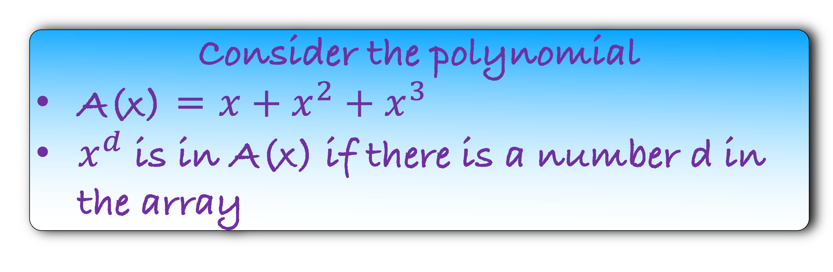
We will a smaller subproblem in which we want to find number of permutations containing two terms that sum up to 3
1
2
3
3
Consider the polynomial
A(x) = $x+x^{2}+x^{3}$
$x^{d}$ is in A(x) if there is a number d in the array
1
2
2
1
What will happen if we multiply A(x) by A(x)?

Slide 4


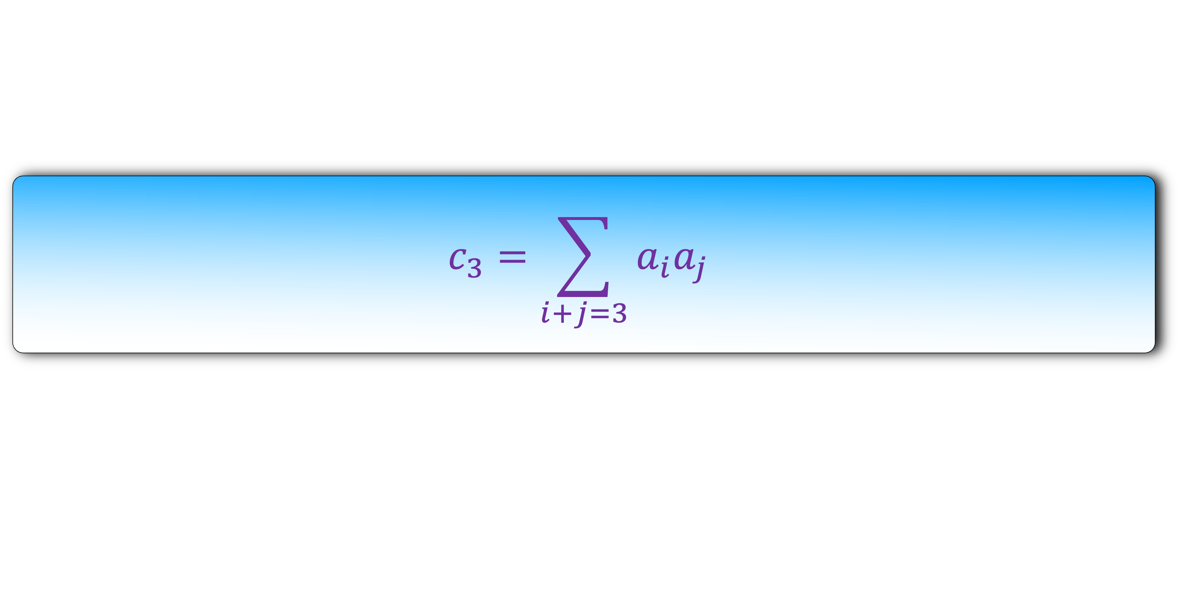
C(x)= $\left(x+x^{2}+x^{3}\right)(x+x^{2}+x^{3})$
What is the co-efficient of $c_{3}$?
$$c_{3}=\sum_{i+j=3}{a_{i}a_{j}}$$

Slide 5
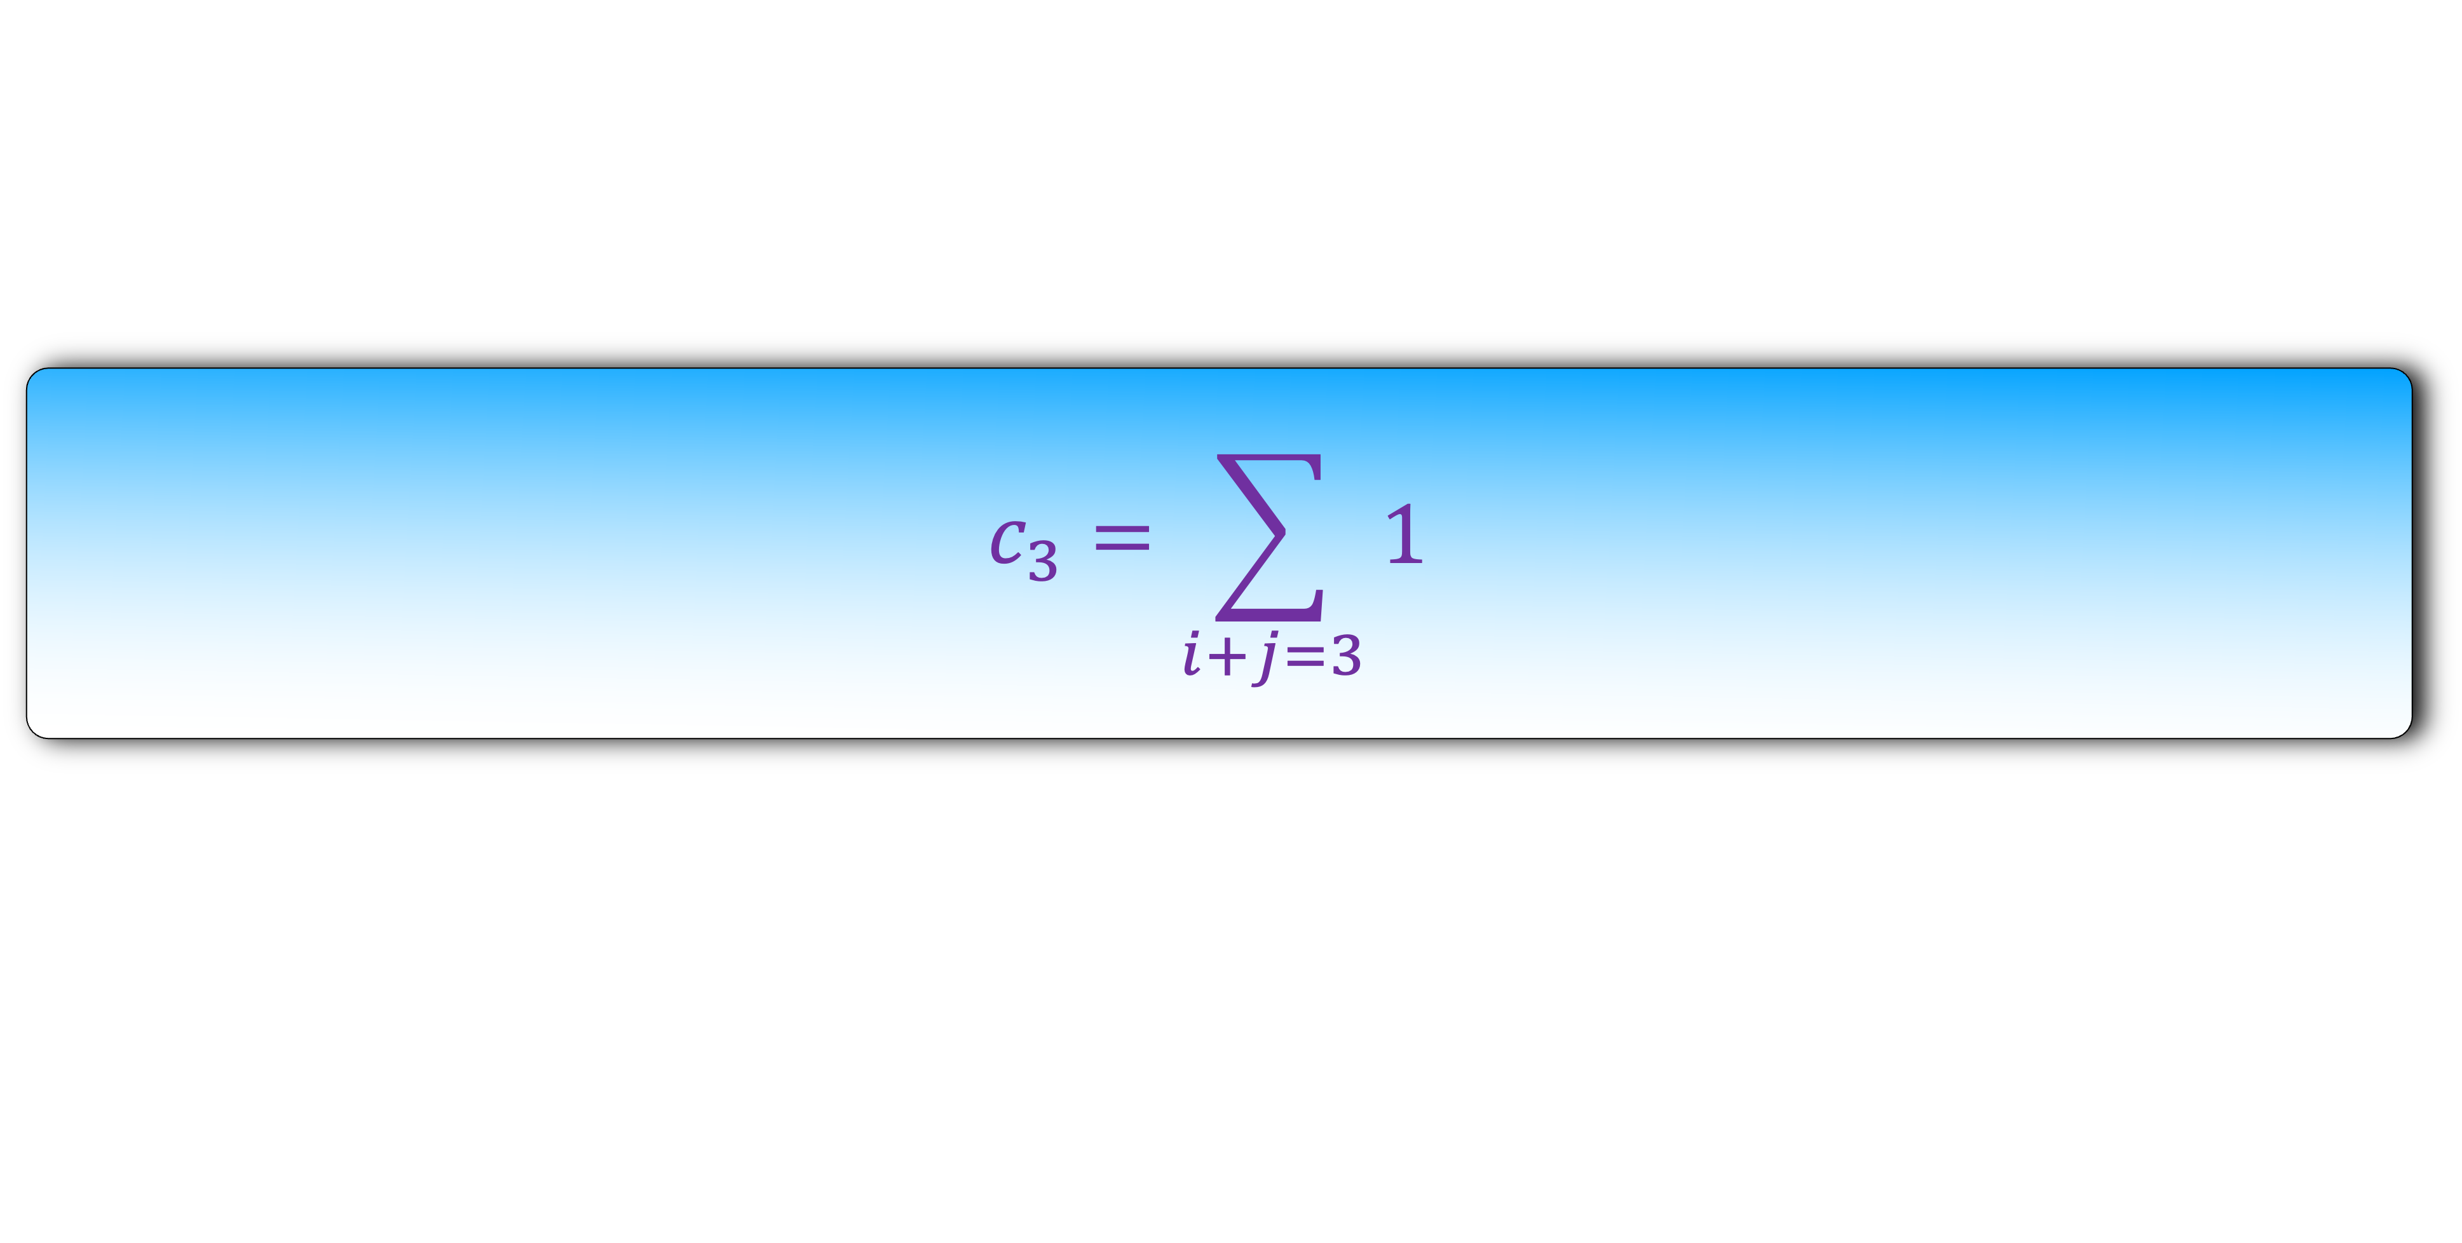
C(x)= $\left(x+x^{2}+x^{3}\right)(x+x^{2}+x^{3})$
What is the co-efficient of $c_{3}$?
$$c_{3}=\sum_{i+j=3}{1}$$
But this is the number of possible permutations containing two terms that sum up to 3

Slide 6

C(x)= $\left(x+x^{2}+x^{3}\right)(x+x^{2}+x^{3})$
We can use FFT algorithm to find C(x)
Report $c_{3}$ as the answer

Slide 7

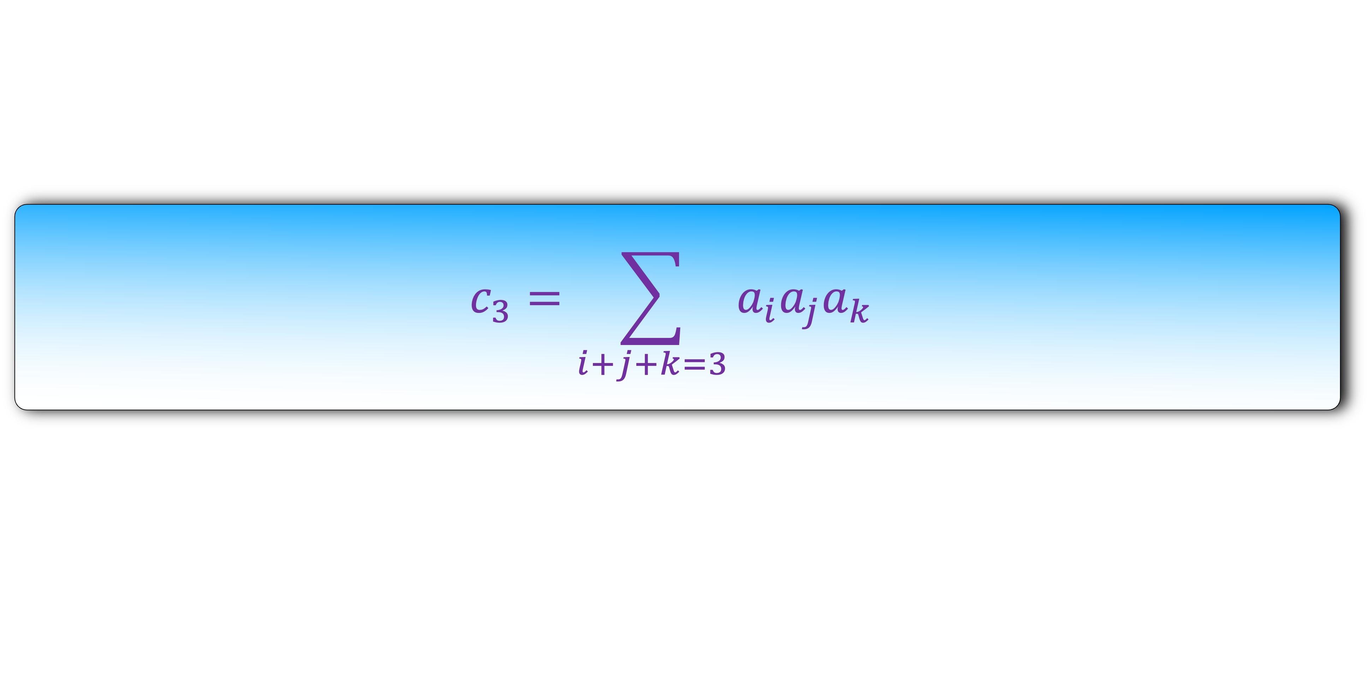
C(x)= $\left(x+x^{2}+x^{3}\right)(x+x^{2}+x^{3})$ $(x+x^{2}+x^{3})$
What is the co-efficient of $c_{3}$?
$$c_{3}=\sum_{i+j+k=3}{a_{i}a_{j}a_{k}}$$

Slide 8

C(x)= $\left(x+x^{2}+x^{3}\right)(x+x^{2}+x^{3})$ $(x+x^{2}+x^{3})$
What is the co-efficient of $c_{3}$?
$$c_{3}=\sum_{i+j+k=3}{1}$$
But this is the number of possible permutations containing three terms that sum up to 3

Slide 9
Home Work
Write a complete optimized algorithm for this problem
Calculate the running time of the problem.

Slide 10
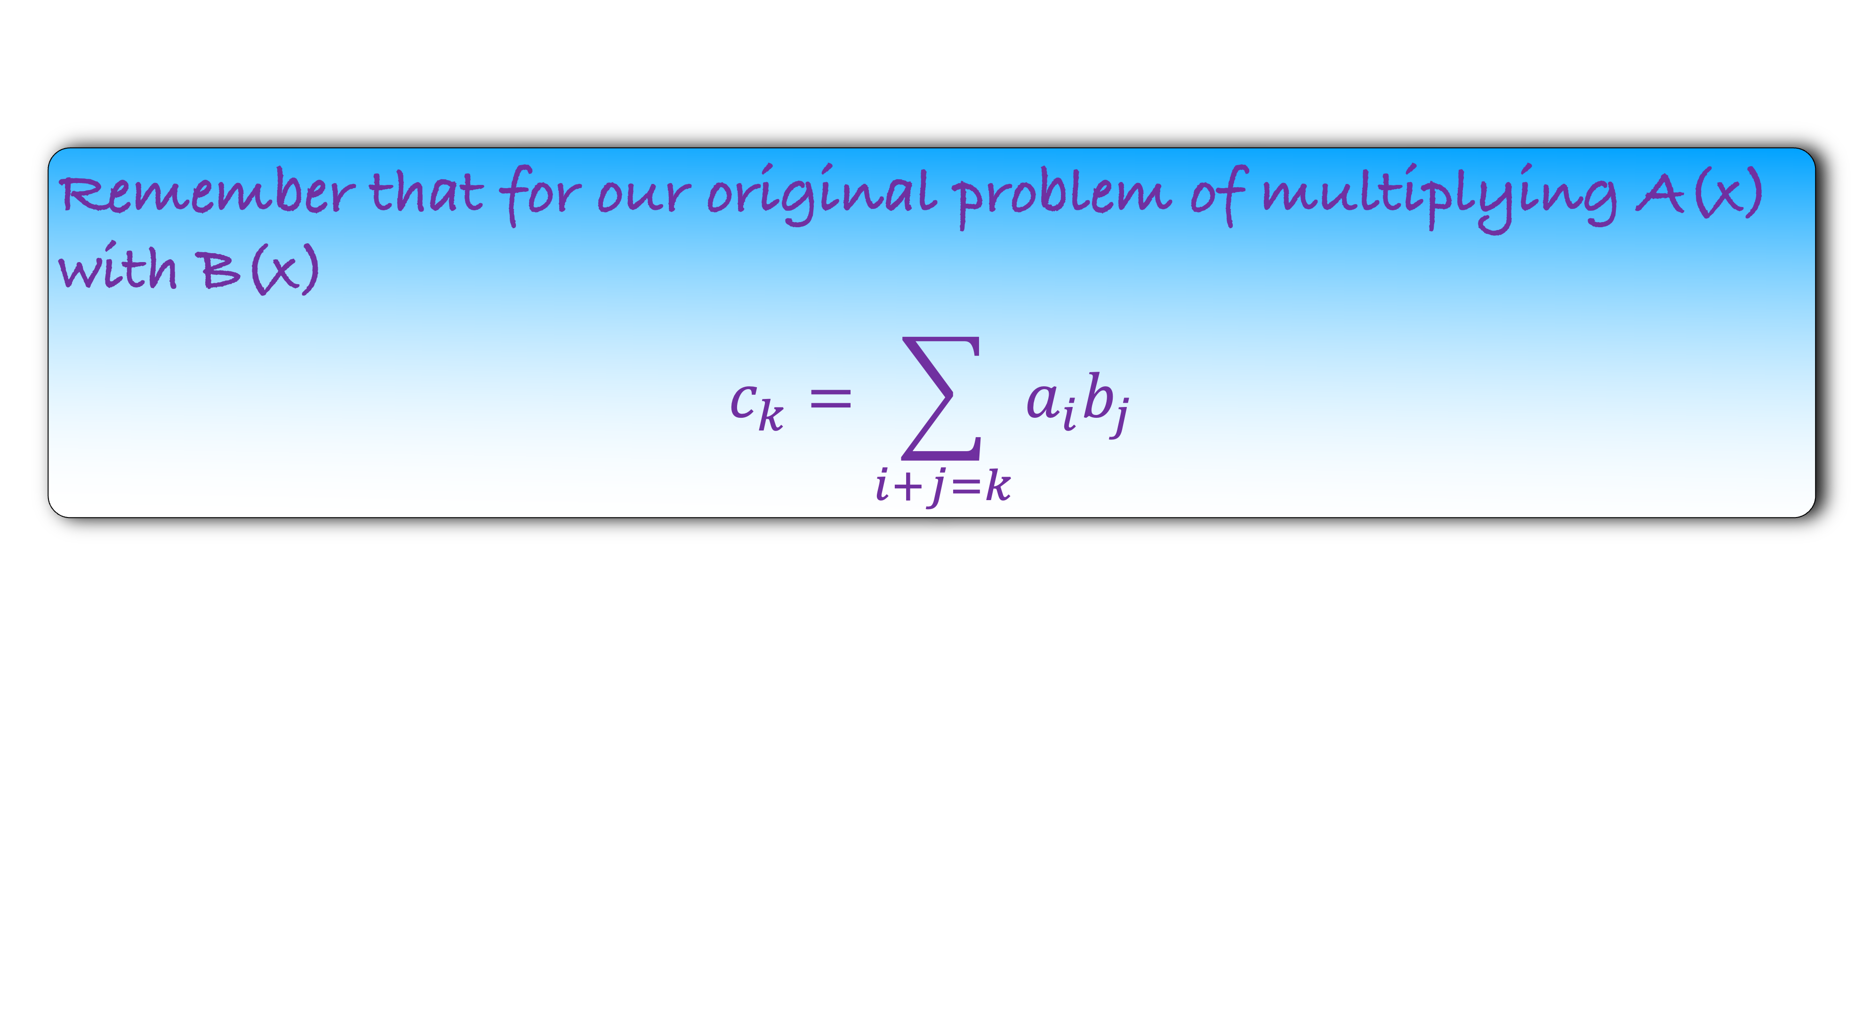
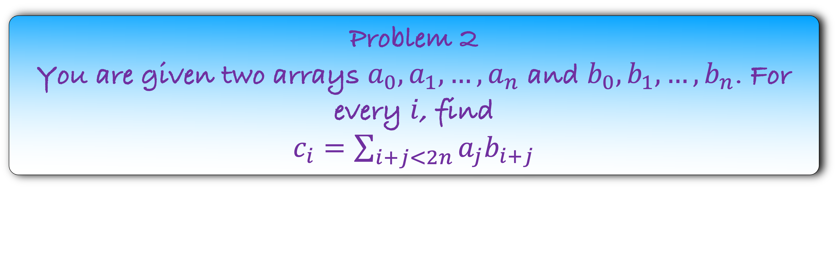
Problem 2
You are given two arrays $a_{0},a_{1},…,a_{n}$ and $b_{0},b_{1},…,b_{n}$. For every $i$, find
$c_{i}=\sum_{i+j<2n}{a_{j}b_{i+j}}$
Remember that for our original problem of multiplying A(x) with B(x)
$$c_{k}=\sum_{i+j=k}{a_{i}b_{j}}$$
These two problems look similar!!!

Slide 11
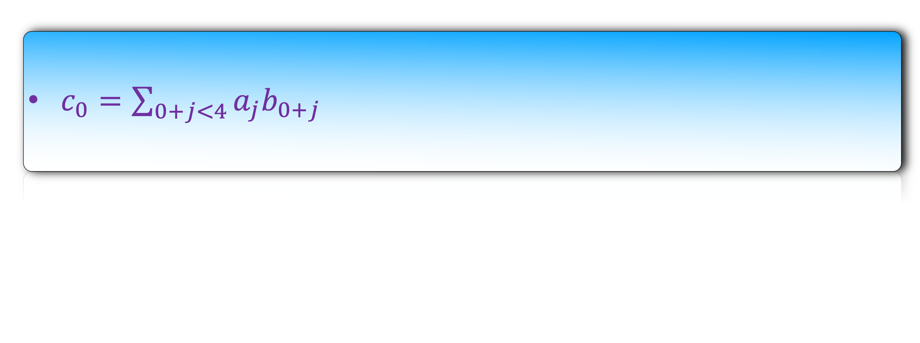
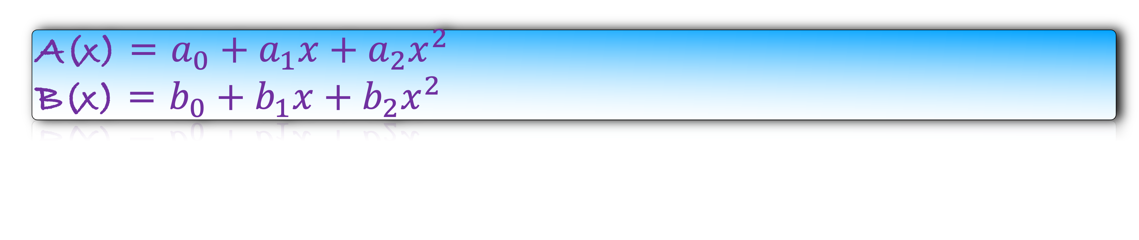
Problem 2
You are given two arrays $a_{0},a_{1},…,a_{n}$ and $b_{0},b_{1},…,b_{n}$. For every $i$, find
$c_{i}=\sum_{i+j<2n}{a_{j}b_{i+j}}$
A(x) = $a_{0}+a_{1}x+a_{2}x^{2}$
B(x) = $b_{0}+b_{1}x+b_{2}x^{2}$
$c_{0}=\sum_{0+j<4}{a_{j}b_{0+j}}$

Slide 12
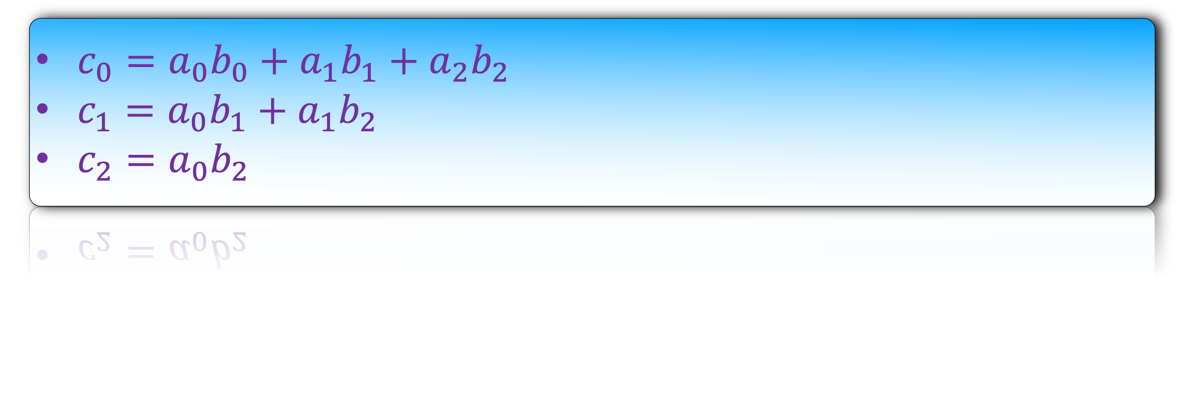
Problem 2
You are given two arrays $a_{0},a_{1},…,a_{n}$ and $b_{0},b_{1},…,b_{n}$. For every $i$, find
$c_{i}=\sum_{i+j<2n}{a_{j}b_{i+j}}$
A(x) = $a_{0}+a_{1}x+a_{2}x^{2}$
B(x) = $b_{0}+b_{1}x+b_{2}x^{2}$
$c_{0}=a_{0}b_{0}+a_{1}b_{1}+a_{2}b_{2}$
$c_{1}=a_{0}b_{1}+a_{1}b_{2}$
$c_{2}=a_{0}b_{2}$

Slide 13
Problem 2
You are given two arrays $a_{0},a_{1},…,a_{n}$ and $b_{0},b_{1},…,b_{n}$. For every $i$, find
$c_{i}=\sum_{i+j<2n}{a_{j}b_{i+j}}$
A(x) = $a_{0}+a_{1}x+a_{2}x^{2}$
B(x) = $b_{0}+b_{1}x+b_{2}x^{2}$
Reverse the second polynomial

Slide 14
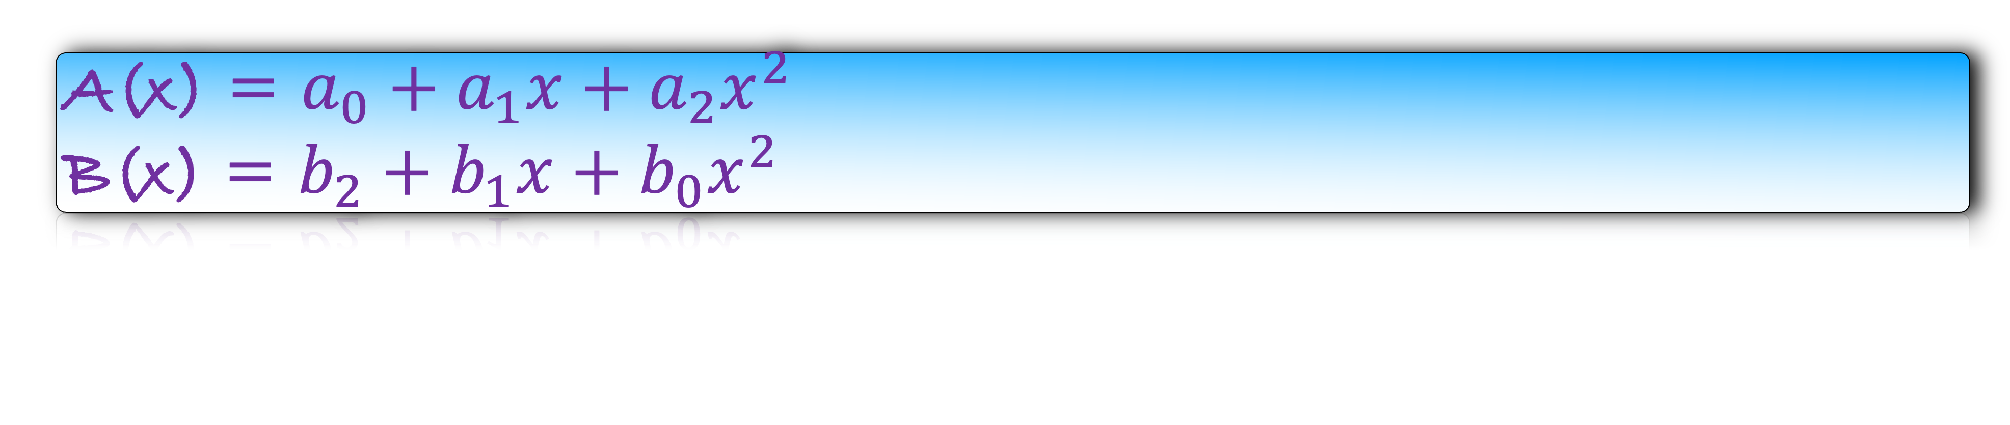
Problem 2
You are given two arrays $a_{0},a_{1},…,a_{n}$ and $b_{0},b_{1},…,b_{n}$. For every $i$, find
$c_{i}=\sum_{i+j<2n}{a_{j}b_{i+j}}$
A(x) = $a_{0}+a_{1}x+a_{2}x^{2}$
B(x) = $b_{2}+b_{1}x+b_{0}x^{2}$
Apply FFT

Slide 15
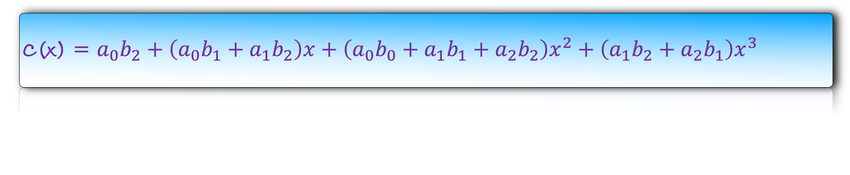
Problem 2
You are given two arrays $a_{0},a_{1},…,a_{n}$ and $b_{0},b_{1},…,b_{n}$. For every $i$, find
$c_{i}=\sum_{i+j<2n}{a_{j}b_{i+j}}$
A(x) = $a_{0}+a_{1}x+a_{2}x^{2}$
B(x) = $b_{2}+b_{1}x+b_{0}x^{2}$
C(x) = $a_{0}b_{2}+\left(a_{0}b_{1}+a_{1}b_{2}\right)x+\left(a_{0}b_{0}+a_{1}b_{1}+a_{2}b_{2}\right)x^{2}+\left(a_{1}b_{2}+a_{2}b_{1}\right)x^{3}$

Slide 16
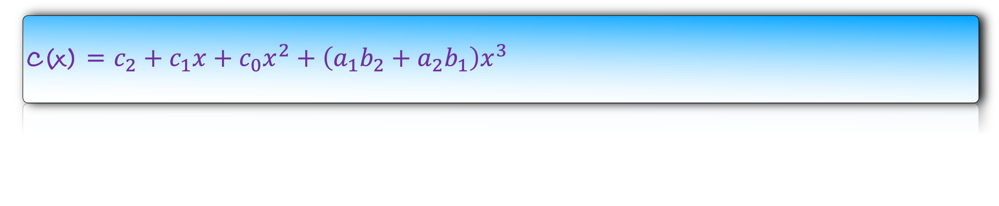
Problem 2
You are given two arrays $a_{0},a_{1},…,a_{n}$ and $b_{0},b_{1},…,b_{n}$. For every $i$, find
$c_{i}=\sum_{i+j<2n}{a_{j}b_{i+j}}$
A(x) = $a_{0}+a_{1}x+a_{2}x^{2}$
B(x) = $b_{2}+b_{1}x+b_{0}x^{2}$
C(x) = $c_{2}+c_{1}x+c_{0}x^{2}+\left(a_{1}b_{2}+a_{2}b_{1}\right)x^{3}$

Slide 17
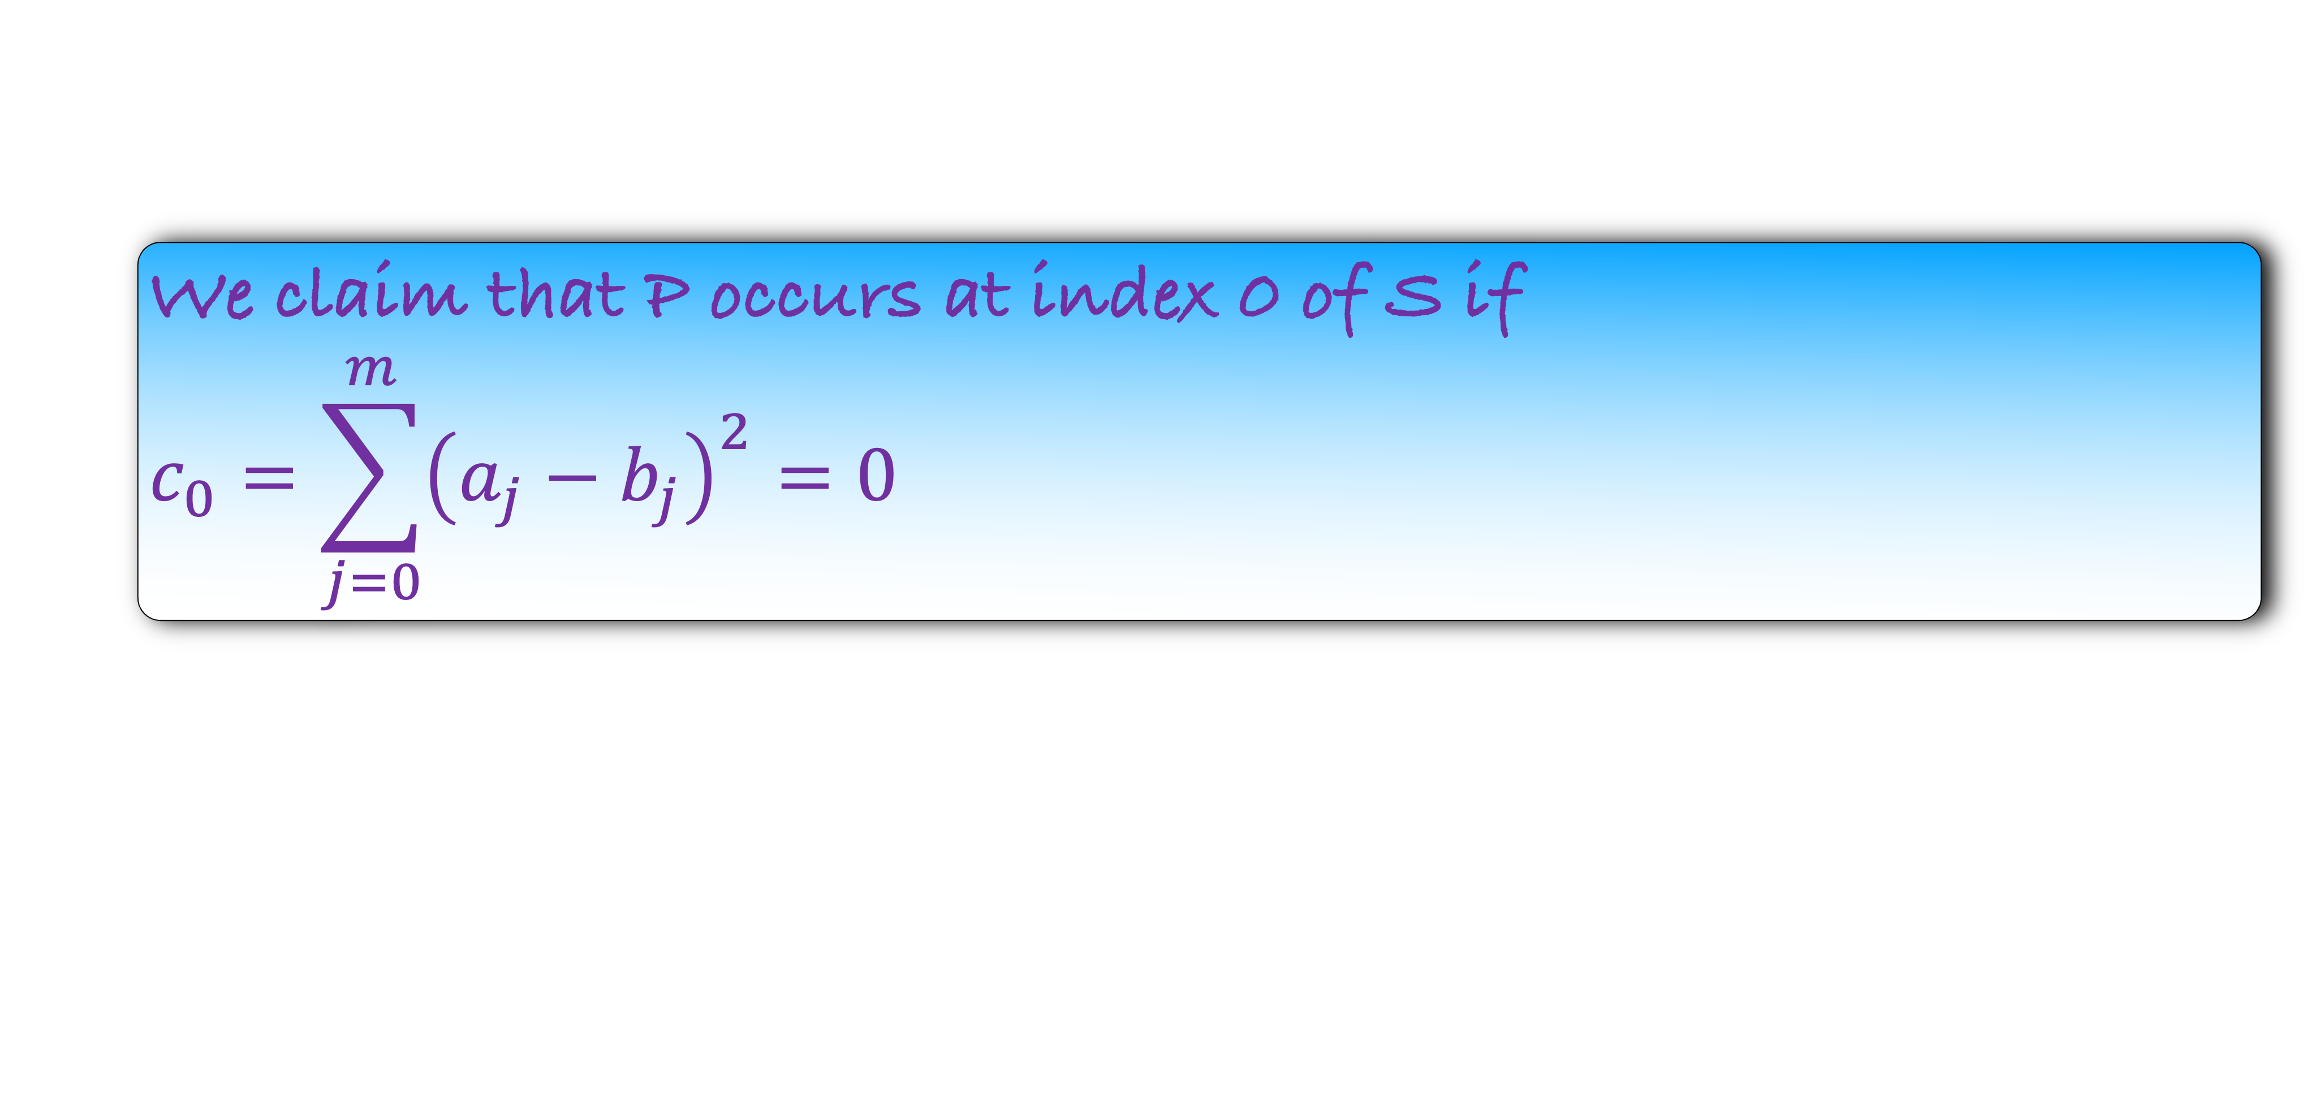
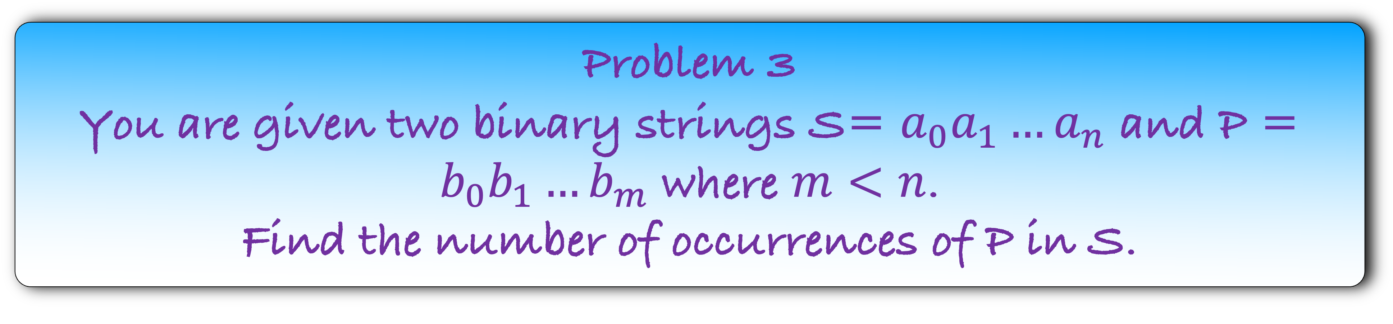
Problem 3
You are given two binary strings S= $a_{0}a_{1}…a_{n}$ and P = $b_{0}b_{1}…b_{m}$ where $m<n$.
Find the number of occurrences of P in S.
We claim that P occurs at index 0 of S if
$$c_{0}=\sum_{j=0}^{m}{{\left(a_{j}−b_{j}\right)}^{2}=0}$$
What can we say about the i-th index of S?

Slide 18
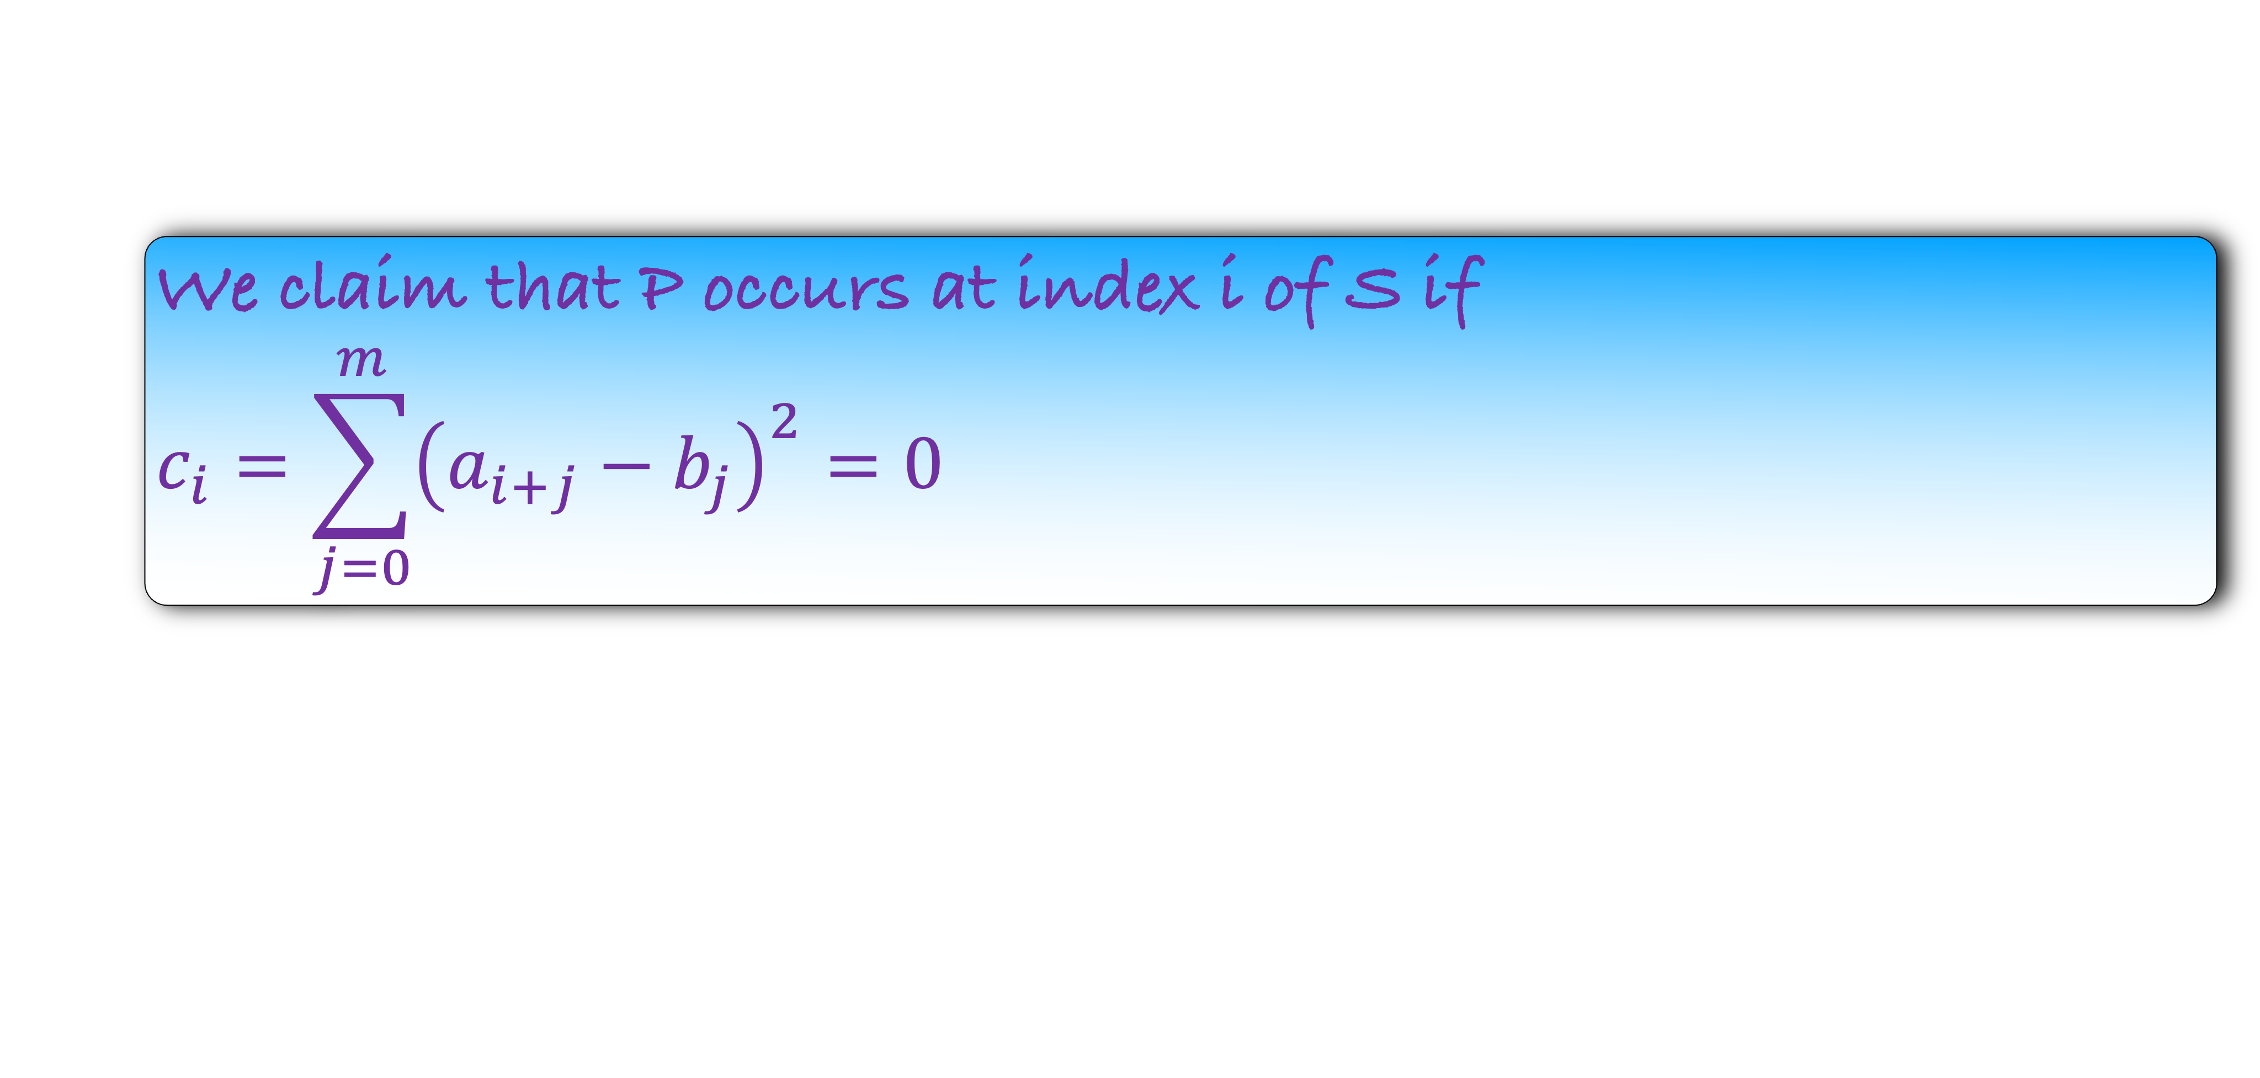
Problem 3
You are given two binary strings S= $a_{0}a_{1}…a_{n}$ and P = $b_{0}b_{1}…b_{m}$ where $m<n$.
Find the number of occurrences of P in S.
We claim that P occurs at index i of S if
$$c_{i}=\sum_{j=0}^{m}{{\left(a_{i+j}−b_{j}\right)}^{2}=0}$$

Slide 19

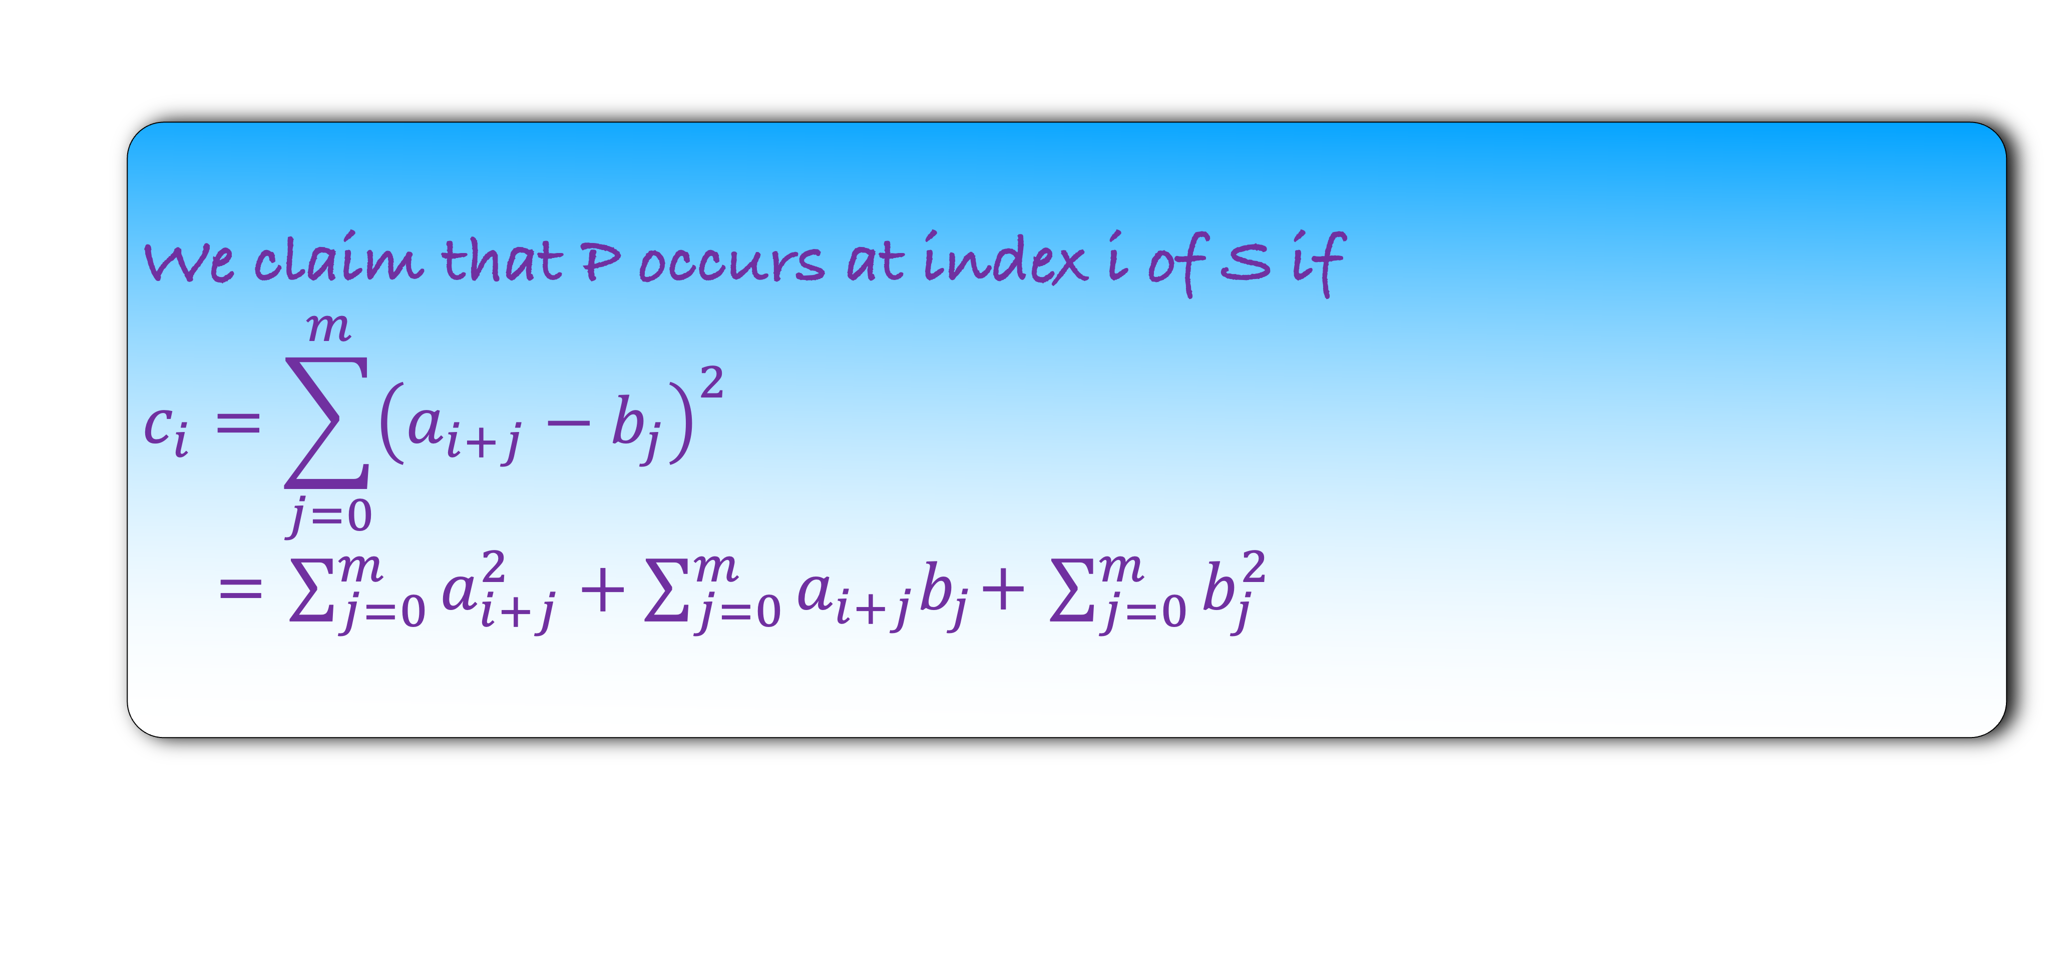
We claim that P occurs at index i of S if
$$c_{i}=\sum_{j=0}^{m}{{\left(a_{i+j}−b_{j}\right)}^{2}}$$
= $\sum_{j=0}^{m}{a_{i+j}^{2}}+\sum_{j=0}^{m}{a_{i+j}b_{j}}$+ $\sum_{j=0}^{m}{b_{j}^{2}}$
This term looks similar to what we saw in the previous problem
(HW) Use FFT to find this term in each $c_{i}$
(HW) Find an efficient algorithm to find the other terms

