Slide 1
Fast Fourier Transform

Slide 2
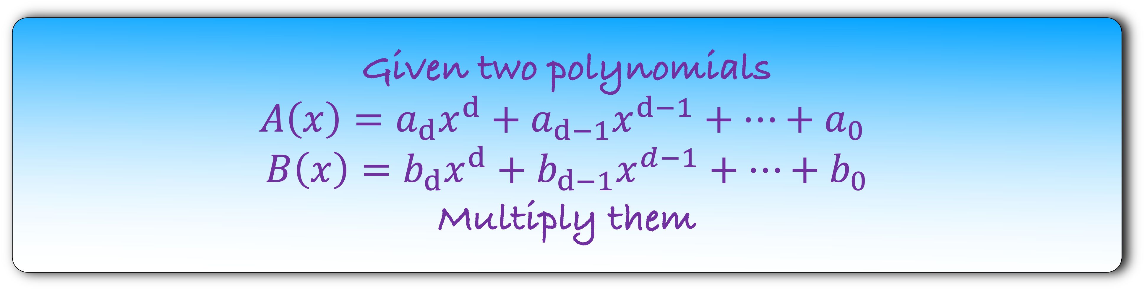
Given two polynomials
$$A\left(x\right)={a_{d}x}^{d}+a_{d−1}x^{d−1}+…+a_{0}$$
$$B\left(x\right)={b_{d}x}^{d}+b_{d−1}x^{d−1}+…+b_{0}$$
Multiply them

Slide 3
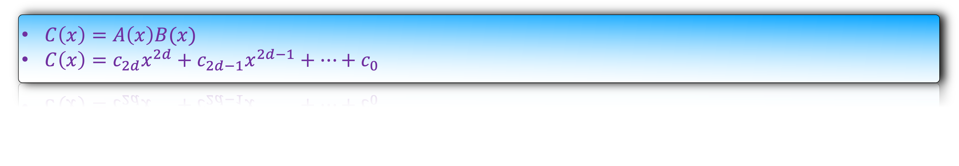


Given two polynomials
$$A\left(x\right)={a_{d}x}^{d}+a_{d−1}x^{d−1}+…+a_{0}$$
$$B\left(x\right)={b_{d}x}^{d}+b_{d−1}x^{d−1}+…+b_{0}$$
Multiply them
$C\left(x\right)=A\left(x\right)B(x)$
$C\left(x\right)=c_{2d}x^{2d}+c_{2d−1}x^{2d−1}+…+c_{0}$
What is the co-efficient of $x^{k}$?
$$c_{k}=a_{0}b_{k}+a_{1}b_{k−1}+…+a_{k}b_{0}$$

Slide 4


Given two polynomials
$$A\left(x\right)={a_{d}x}^{d}+a_{d−1}x^{d−1}+…+a_{0}$$
$$B\left(x\right)={b_{d}x}^{d}+b_{d−1}x^{d−1}+…+b_{0}$$
Multiply them
$C\left(x\right)=A\left(x\right)B(x)$
$C\left(x\right)=c_{2d}x^{2d}+x_{2d−1}x^{2d−1}+…+c_{0}$
What is the co-efficient of $x^{k}$?
$$c_{k}=\sum_{i+j=k}{a_{i}b_{j}}$$

Slide 5

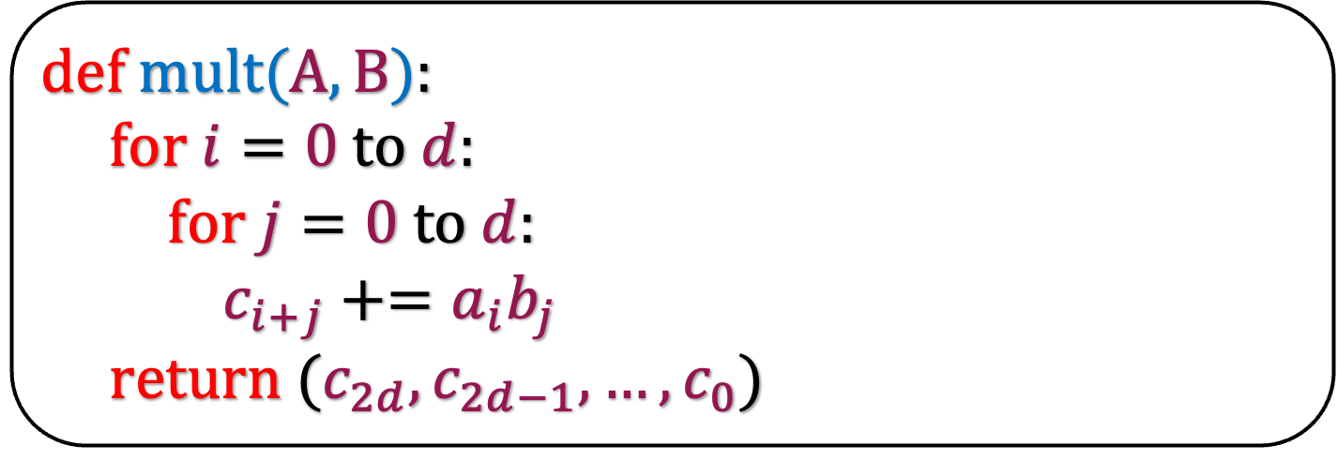

$$c_{k}=\sum_{i+j=k}{a_{i}b_{j}}$$
def m$ult(A,B$):
for $i=0$ to $d$:
for $j=0$ to $d$:
$c_{i+j}+=a_{i}b_{j}$
return ($c_{2d},c_{2d−1},…,c_{0}$)
What is the running time of this algorithm?
O($d^{2}$)
Can we do better?

Slide 6

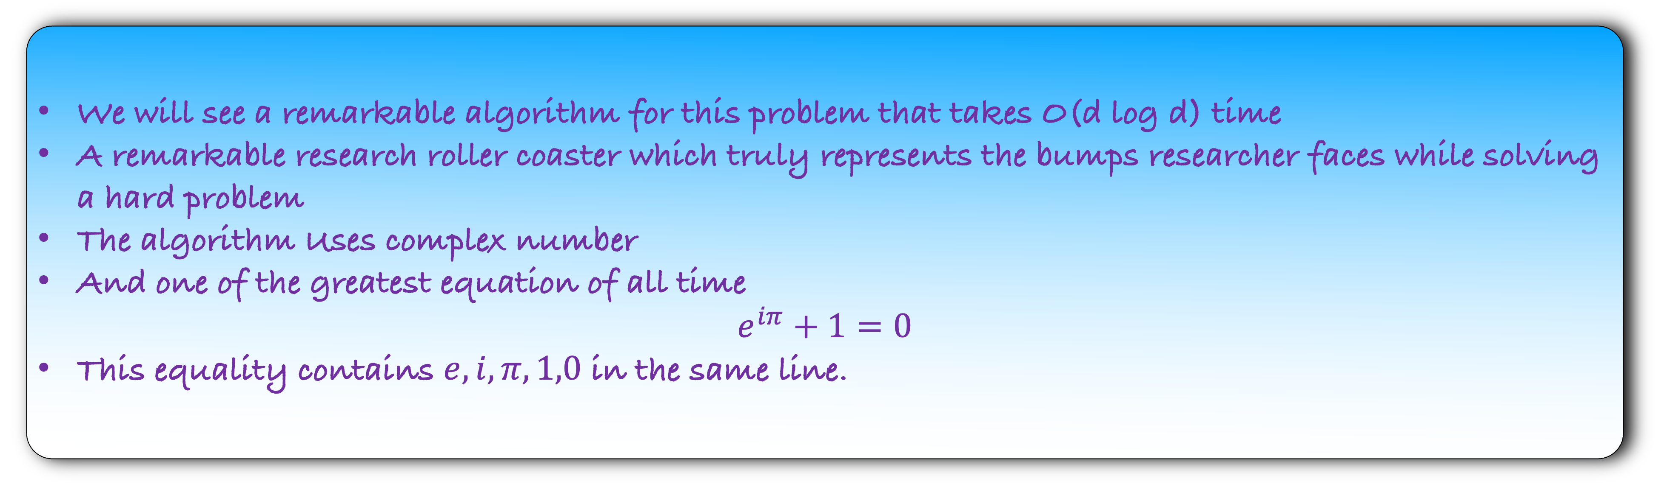
We will see a remarkable algorithm for this problem that takes O(d log d) time
A remarkable research roller coaster which truly represents the bumps researcher faces while solving a hard problem
The algorithm Uses complex number
And one of the greatest equation of all time
$$e^{iπ}+1=0$$
This equality contains $e,i,π,1,0$ in the same line.
$$e^{iπ}+1=0$$

Slide 7


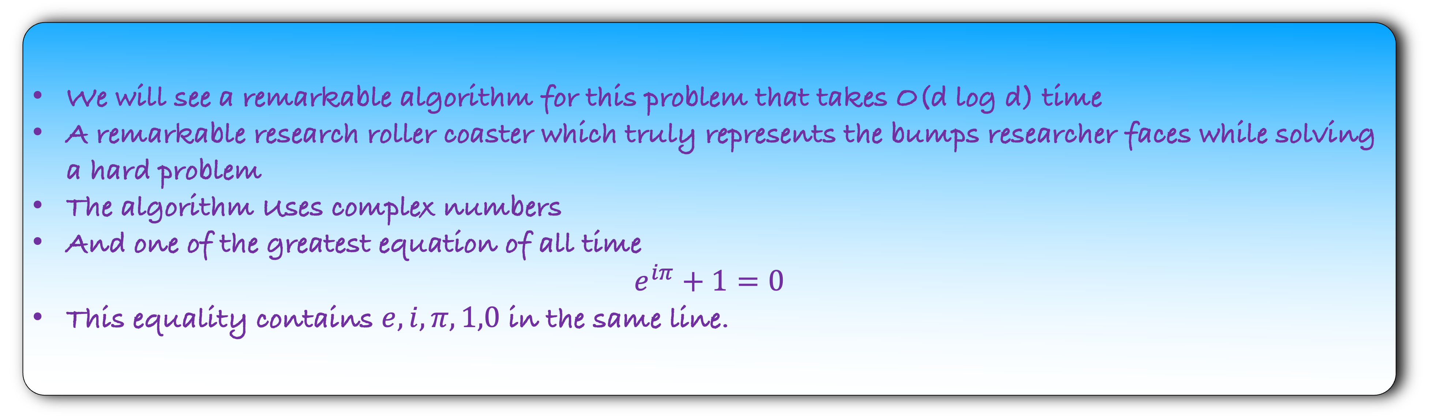
We will see a remarkable algorithm for this problem that takes O(d log d) time
A remarkable research roller coaster which truly represents the bumps researcher faces while solving a hard problem
The algorithm Uses complex numbers
And one of the greatest equation of all time
$$e^{iπ}+1=0$$
This equality contains $e,i,π,1,0$ in the same line.
$$e^{iθ}=\cos{θ+i\sin{θ}}$$
$$e^{iπ}+1=0$$
Very few algorithm can boast of such a connection
Also, the algorithm has practical use in digital signal processing, data-compression, telecommunication etc.
Let us now see the algorithm.

Slide 8
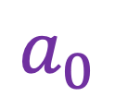
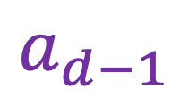

Co-efficient Representation of a polynomial
$$A\left(x\right)=a_{d}x^{d}+a_{d−1}x^{d−1}+…+a_{0}$$
$$a_{d}$$
$$a_{d−1}$$
$$a_{0}$$

Slide 9
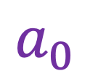
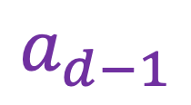

Co-efficient Representation of a polynomial
$$A\left(x\right)=a_{d}x^{d}+a_{d−1}x^{d−1}+…+a_{0}$$
$A\left(x\right)=($ $,$ $,…,$ )
$$a_{d}$$
$$a_{d−1}$$
$$a_{0}$$
There is another way to represent a polynomial

Slide 10
The first idea:
Value Representation

Slide 11

$$A\left(x\right)=x$$

Slide 12
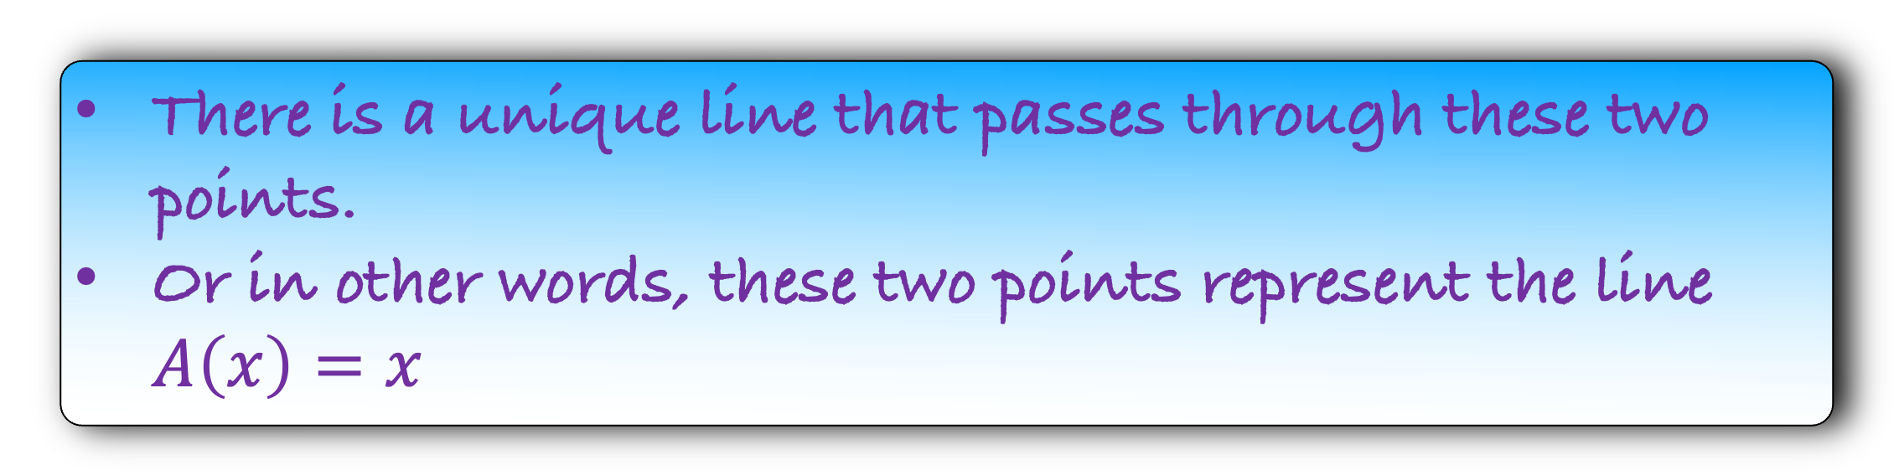
$$A\left(x\right)=x$$
There is a unique line that passes through these two points.
Or in other words, these two points represent the line $A\left(x\right)=x$

Slide 13

$$A\left(x\right)=x$$
There is a unique line that passes through these two points.
Or in other words, these two points represent the line $A\left(x\right)=x$
$A\left(x\right)$ ={ , }
(0,0)
(1,1)
This is the value representation of the polynomial.

Slide 14

$$A\left(x\right)=x$$
$$A\left(x\right)=x^{2}+2$$
Fact: There is a unique curve of degree d passing through d+1 distinct points.
Or in other words, d+1 distinct points represent a polynomial of degree d.

Slide 15

$$A\left(x\right)=x$$
$$B\left(x\right)=x+2$$
C(x) = A(x)B(x) is a polynomial of degree 2.
So, we need three points to represent it.
So, we will evaluate A(x) and B(x) at three points.

Slide 16
$$A\left(x\right)=x$$
$$B\left(x\right)=x+2$$
C(x) = A(x)B(x) is a polynomial of degree 2.
So, we need three points to represent it.
So, we will evaluate A(x) and B(x) at three points.

Slide 17
$$A\left(x\right)=x$$
$$B\left(x\right)=x+2$$
C(x) = A(x)B(x) is a polynomial of degree 2.
So, we need three points to represent it.
So, we will evaluate A(x) and B(x) at three points.
(
)
(
)
0
,
0
,
(
)
(
)
1
,
1
,
(
)
(
)
-1
,
-1
,

Slide 18
$$A\left(x\right)=x$$
$$B\left(x\right)=x+2$$
C(x) = A(x)B(x) is a polynomial of degree 2.
So, we need three points to represent it.
So, we will evaluate A(x) and B(x) at three points.
(
)
(
)
0
,
0
0
,
2
(
)
(
)
1
,
1
1
,
3
(
)
(
)
-1
,
-1
,
1
-1

Slide 19
$$A\left(x\right)=x$$
$$B\left(x\right)=x+2$$
(
)
(
)
(
)
,
,
2
,
0
0
2
0
0
0
(
)
(
)
(
)
,
,
3
,
1
3
1
1
1
1
(
)
(
)
(
)
,
-1
,
1
,
-1
-1
1
-1
-1

Slide 20
$$A\left(x\right)=x$$
$$B\left(x\right)=x+2$$
(
)
(
)
(
)
0
,
0
0
,
2
0
,
0
2
(
)
(
)
(
)
1
,
1
1
,
3
1
1
,
3
(
)
(
)
(
)
-1
,
-1
,
1
-1
,
-1
-1
1

Slide 21
$$A\left(x\right)=x$$
$$B\left(x\right)=x+2$$
(
)
(
)
(
)
,
,
,
0
0
0
0
2
0
0
(
)
(
)
(
)
1
,
1
1
,
3
1
,
3
3
(
)
(
)
(
)
-1
,
-1
,
1
-1
,
-1
-1
-1

Slide 22
$$A\left(x\right)=x$$
$$B\left(x\right)=x+2$$
(
)
(
)
(
)
0
,
0
0
,
2
0
,
0
(
)
(
)
(
)
1
,
1
1
,
3
1
,
3
(
)
(
)
(
)
-1
,
-1
,
1
-1
,
-1
-1

Slide 23


$$A\left(x\right)=x$$
$$B\left(x\right)=x+2$$
$$C\left(x\right)=x^{2}+2x$$
(
)
(
)
(
)
0
,
0
0
,
2
0
,
0
(
)
(
)
(
)
1
,
1
1
,
3
1
,
3
(
)
(
)
(
)
-1
,
-1
,
1
-1
,
-1
-1

Slide 24


$$A\left(x\right)=(a_{d},a_{d−1},…,a_{0})$$
C0-efficient Representation
$$B\left(x\right)=(b_{d},b_{d−1},…,b_{0})$$

Slide 25
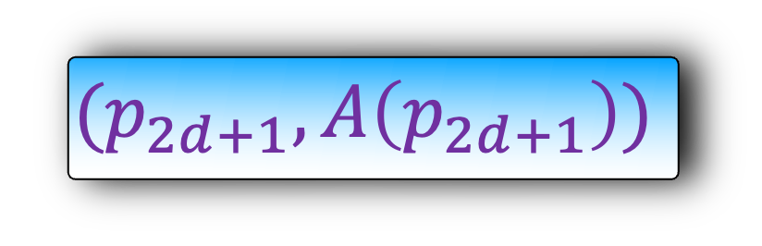
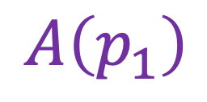
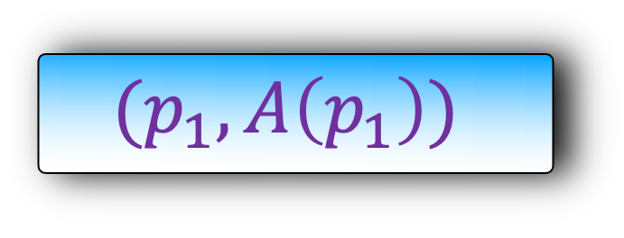
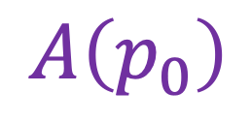
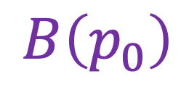
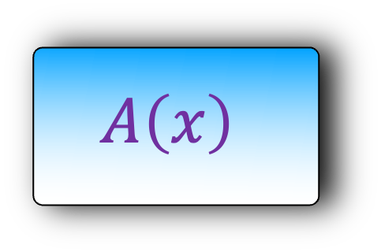
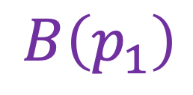

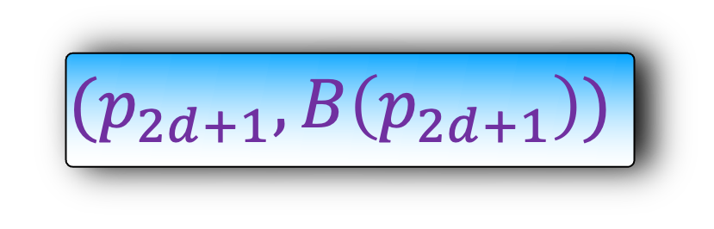

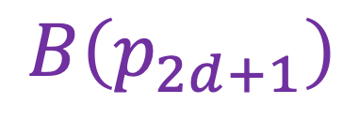
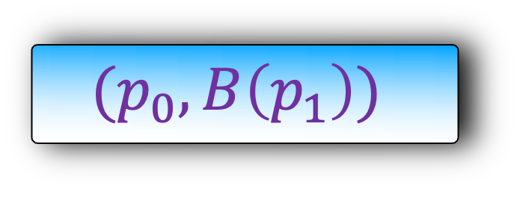
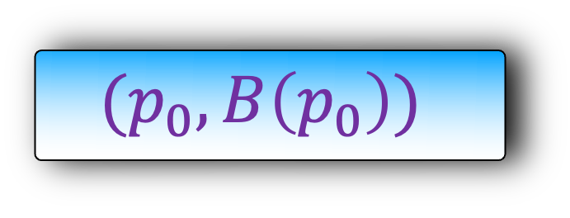
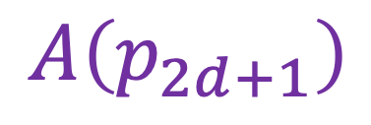
$$A\left(x\right)=(a_{d},a_{d−1},…,a_{0})$$
$$B\left(x\right)=(b_{d},b_{d−1},…,b_{0})$$
$$A\left(x\right)$$
$$B\left(x\right)$$
$$(p_{0},A\left(p_{0}\right))$$
$$(p_{0},B\left(p_{0}\right))$$
$$A\left(p_{0}\right)$$
$$B\left(p_{0}\right)$$
$$(p_{1},A\left(p_{1}\right))$$
$$(p_{0},B\left(p_{1}\right))$$
$$A\left(p_{1}\right)$$
$$B\left(p_{1}\right)$$
Value Representation
….
….
$$(p_{2d+1},A\left(p_{2d+1}\right))$$
$$(p_{2d+1},B\left(p_{2d+1}\right))$$
$$A\left(p_{2d+1}\right)$$
$$B\left(p_{2d+1}\right)$$

Slide 26
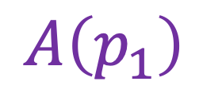
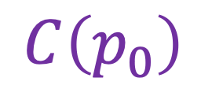


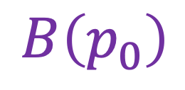

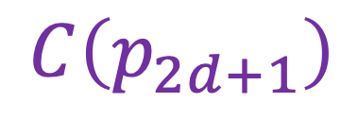
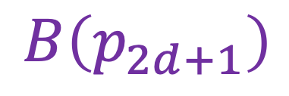
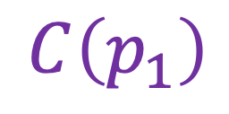
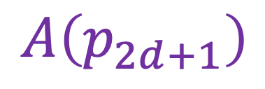

$$A\left(x\right)=(a_{d},a_{d−1},…,a_{0})$$
$$B\left(x\right)=(b_{d},b_{d−1},…,b_{0})$$
$$A\left(x\right)$$
$$B\left(x\right)$$
O(d) time
$$(p_{0},A\left(p_{0}\right))$$
$$(p_{0},B\left(p_{0}\right))$$
$$C\left(p_{0}\right)$$
$$=$$
$$A\left(p_{0}\right)$$
$$B\left(p_{0}\right)$$
$$(p_{1},A\left(p_{1}\right))$$
$$(p_{0},B\left(p_{1}\right))$$
$$C\left(p_{1}\right)$$
$$=$$
$$A\left(p_{1}\right)$$
$$B\left(p_{1}\right)$$
….
….
….
$$(p_{2d+1},A\left(p_{2d+1}\right))$$
$$(p_{2d+1},B\left(p_{2d+1}\right))$$
$$C\left(p_{2d+1}\right)$$
$$=$$
$$A\left(p_{2d+1}\right)$$
$$B\left(p_{2d+1}\right)$$

Slide 27

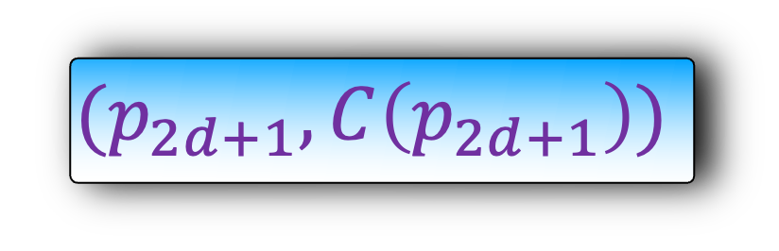
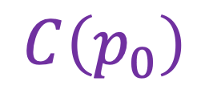





$$A\left(x\right)=(a_{d},a_{d−1},…,a_{0})$$
$$C\left(x\right)=(c_{2d+1},c_{2d},…,c_{0})$$
$$B\left(x\right)=(b_{d},b_{d−1},…,b_{0})$$
We will see later that we can convert from co-efficient to value representation and vice-verse in O(d log d) time.
$$A\left(x\right)$$
$$B\left(x\right)$$
$$C\left(x\right)$$
$$(p_{0},A\left(p_{0}\right))$$
$$(p_{0},B\left(p_{0}\right))$$
$$C\left(p_{0}\right)$$
$$(p_{0},C\left(p_{0}\right))$$
$$(p_{1},A\left(p_{1}\right))$$
$$(p_{0},B\left(p_{1}\right))$$
$$(p_{0},C\left(p_{1}\right))$$
O(d) time
$$C\left(p_{1}\right)$$
….
….
….
$$(p_{2d+1},B\left(p_{2d+1}\right))$$
$$(p_{2d+1},C\left(p_{2d+1}\right))$$
$$(p_{2d+1},A\left(p_{2d+1}\right))$$
$$C\left(p_{2d+1}\right)$$

