Slide 1
The first hurdle:
Co-efficient Representation
to
Value Representation

Slide 2
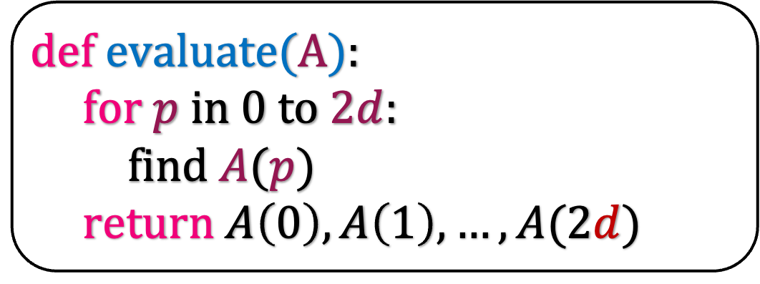

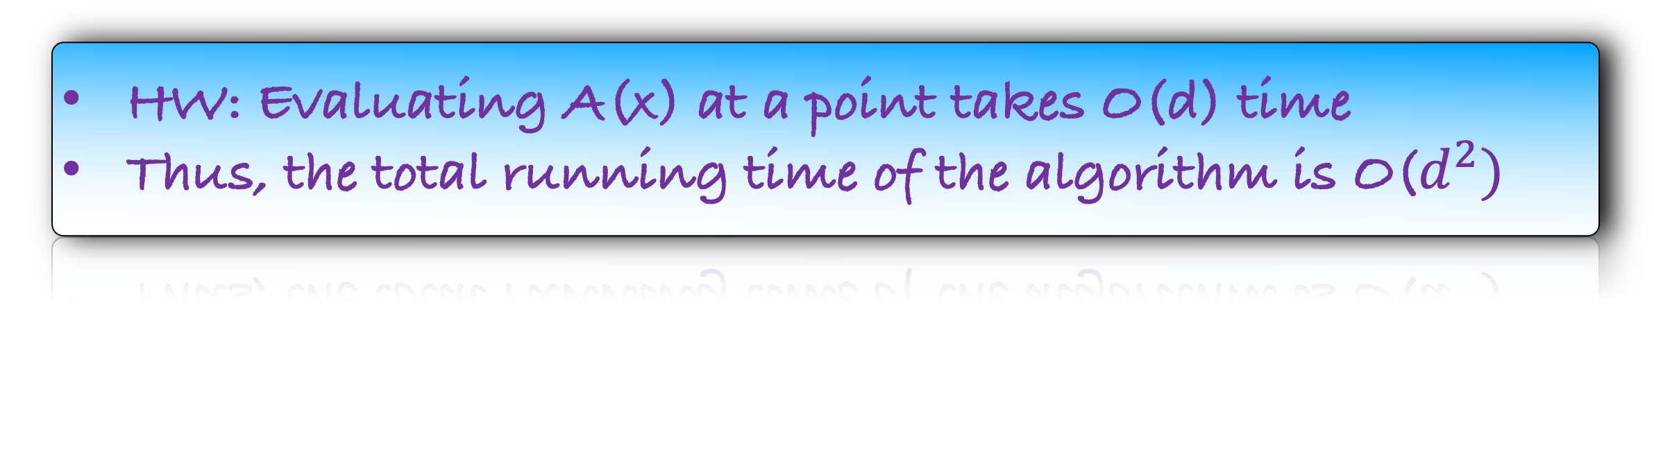
Evaluate A(x) at $2d+1$ different points
def e$valuate(A$):
for $p$ in $0$ to $2d$:
find $A(p)$
return $A\left(0\right),A\left(1\right),…,A(2d)$
HW: Evaluating A(x) at a point takes O(d) time
Thus, the total running time of the algorithm is O($d^{2})$
How to reduce the running time of this algorithm?

Slide 3




$$A\left(x\right)=x^{3}+2x^{2}−3x+1$$
$$A\left(x\right)=x^{3}+2x^{2}−3x+1$$
Is there a simple way to evaluate A(x) at two points?
We can choose those two points. What are those points?
$$p_{0}=1$$
$$p_{1}=−1$$

Slide 4

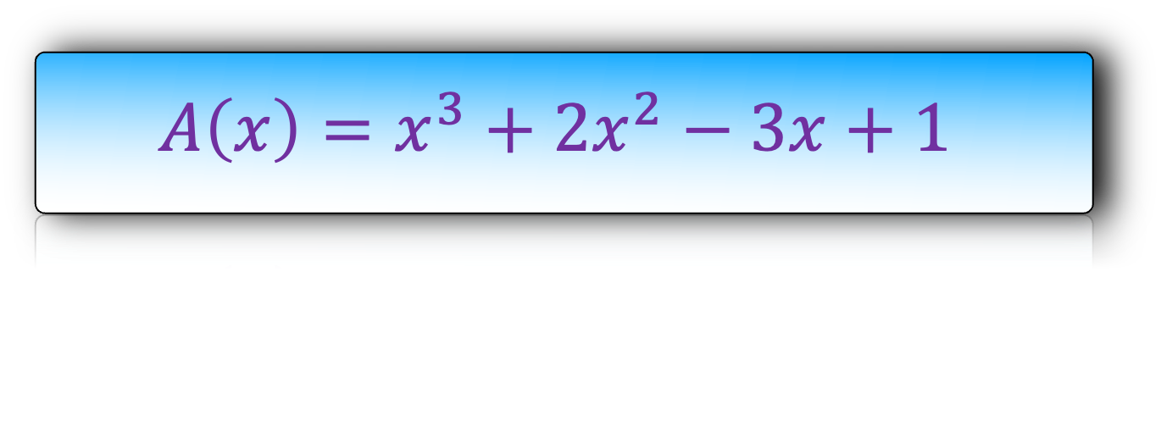
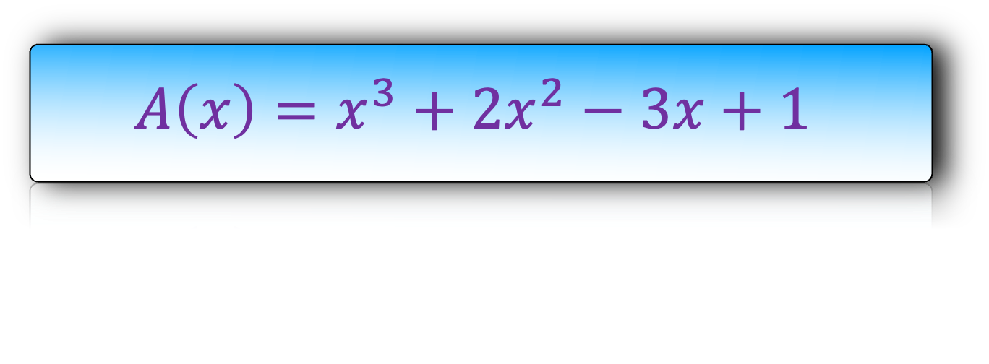

$$A\left(x\right)=x^{3}+2x^{2}−3x+1$$
$$A\left(x\right)=x^{3}+2x^{2}−3x+1$$
$$p_{0}=1$$
$$p_{1}=−1$$

Slide 5
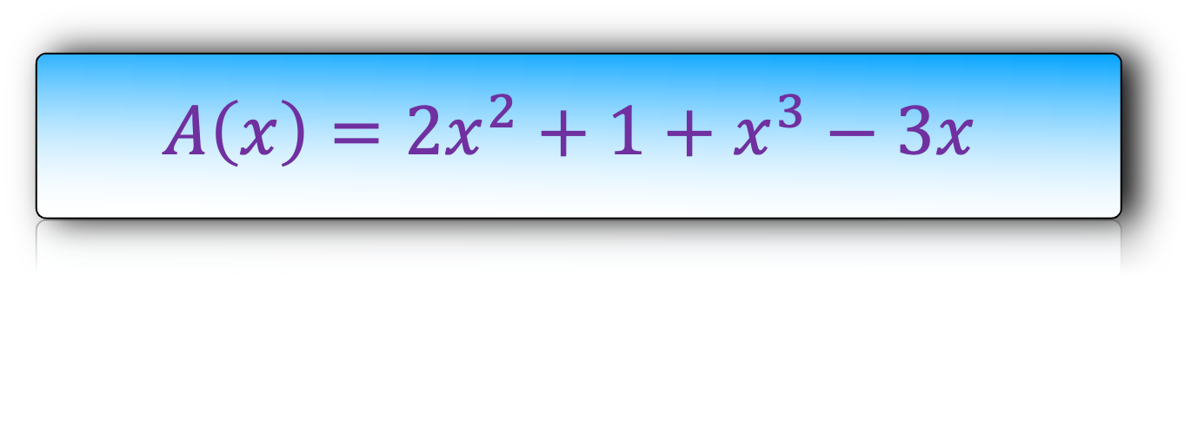

$$A\left(x\right)=2x^{2}+1+x^{3}−3x$$
$$A\left(x\right)=2x^{2}+1+x^{3}−3x$$
$$p_{0}=1$$
$$p_{1}=−1$$

Slide 6
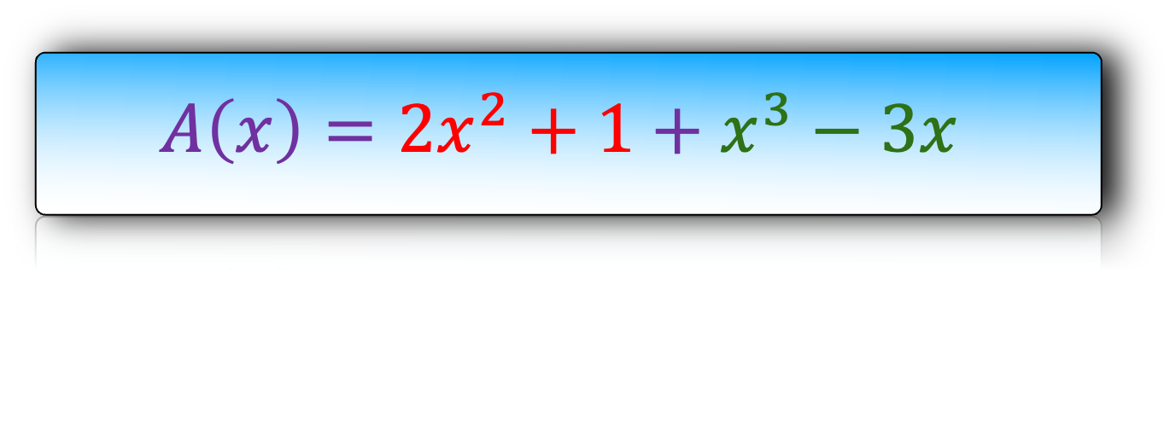

$$A\left(x\right)=2x^{2}+1+x^{3}−3x$$
$$A\left(x\right)=2x^{2}+1+x^{3}−3x$$
$$p_{0}=1$$
$$p_{1}=−1$$

Slide 7
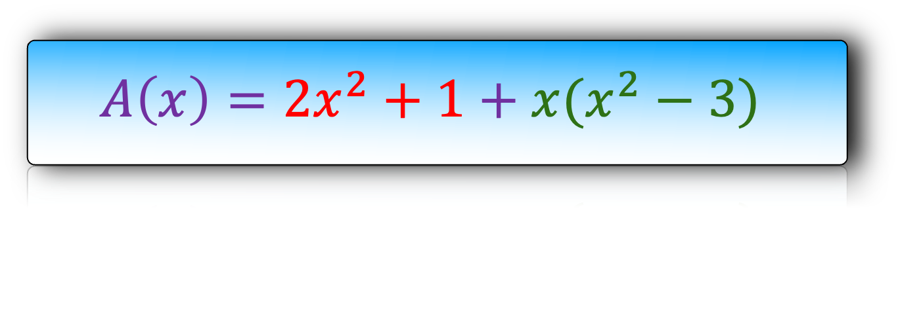
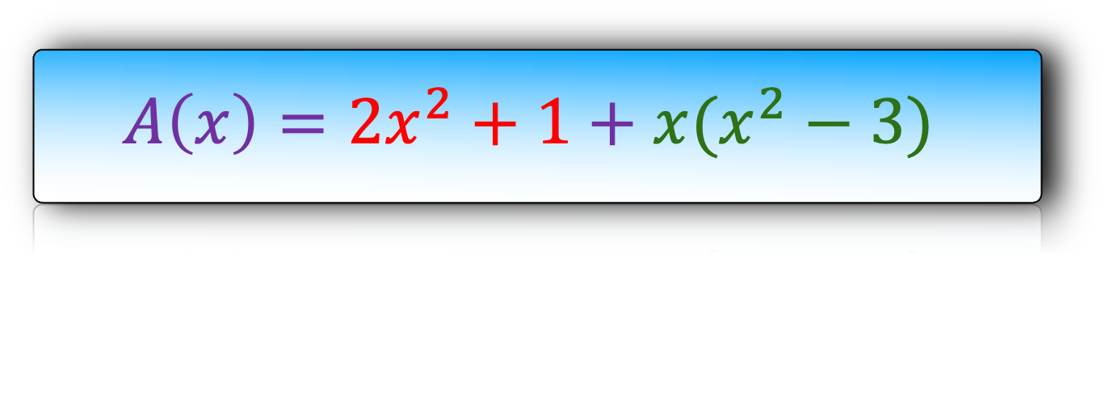
$$A\left(x\right)=2x^{2}+1+x(x^{2}−3)$$
$$A\left(x\right)=2x^{2}+1+x(x^{2}−3)$$
$$p_{0}=1$$
$$p_{1}=−1$$

Slide 8
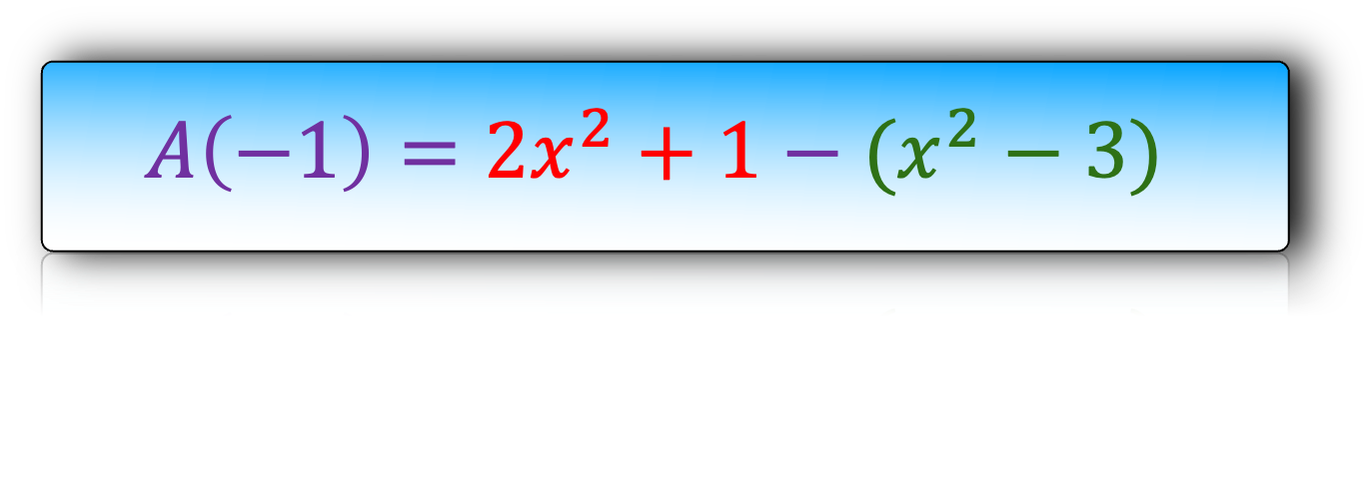
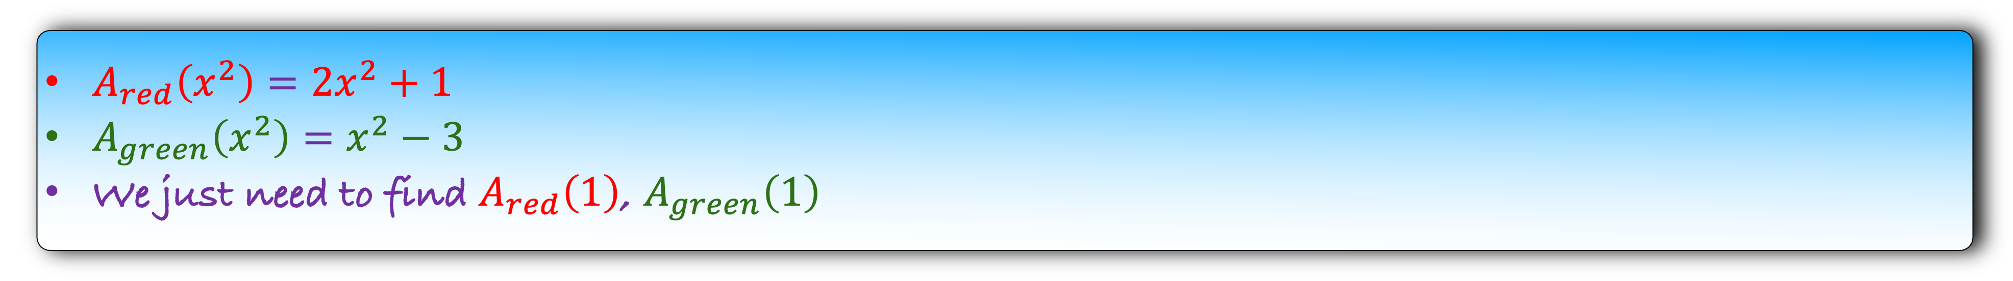

$$A\left(1\right)=2x^{2}+1+(x^{2}−3)$$
$$A\left(−1\right)=2x^{2}+1−(x^{2}−3)$$
$$p_{0}=1$$
$$p_{1}=−1$$
$A_{red}\left(x^{2}\right)=2x^{2}+1$
$A_{green}\left(x^{2}\right)=x^{2}−3$
We just need to find $A_{red}\left(1\right)$, $A_{green}\left(1\right)$

Slide 9
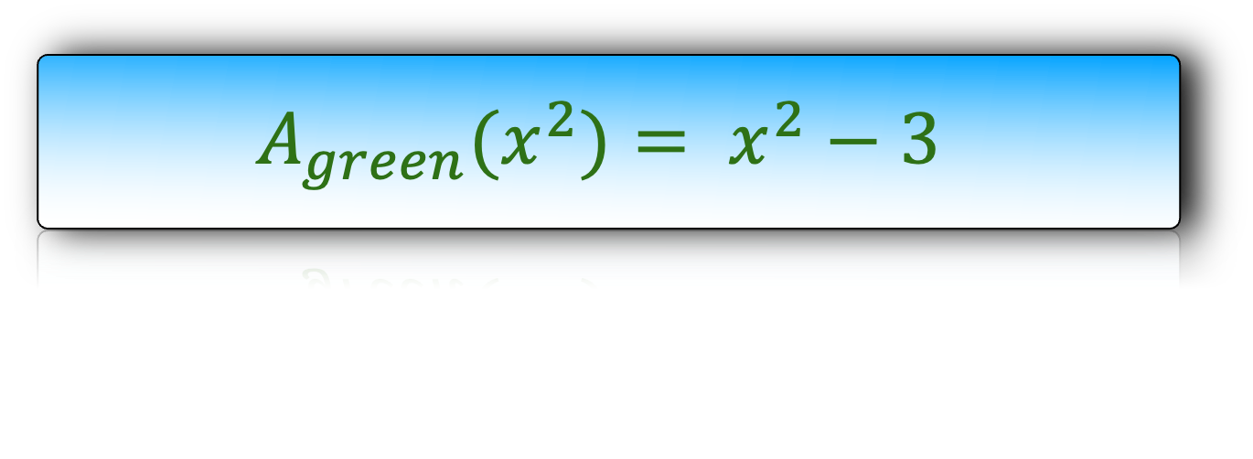
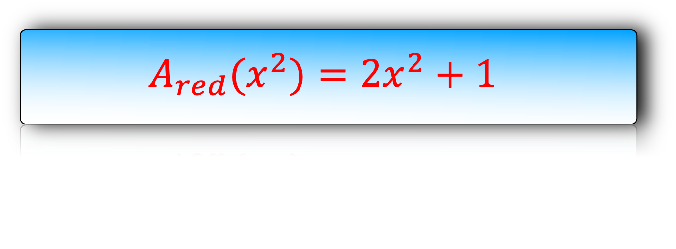

$$A\left(1\right)=2x^{2}+1+(x^{2}−3)$$
$$A\left(−1\right)=2x^{2}+1−(x^{2}−3)$$
$$p_{0}=1$$
$$p_{1}=−1$$
$$A_{red}(x^{2})=2x^{2}+1$$
$$p_{2}=1$$
$$A_{green}(x^{2})= x^{2}−3$$

Slide 10
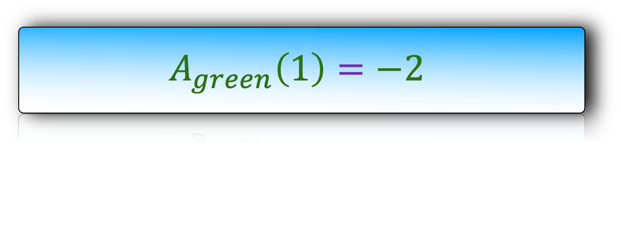
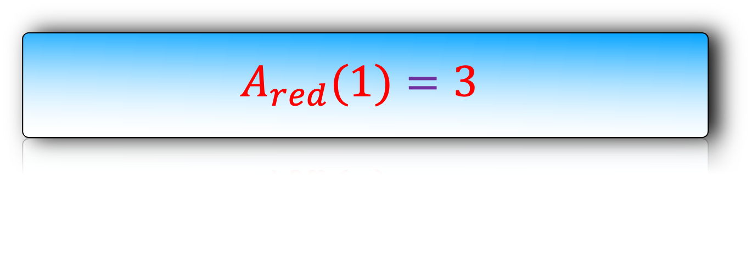
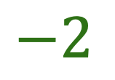
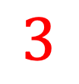
$$A\left(1\right)=2x^{2}+1+(x^{2}−3)$$
$$A\left(−1\right)=2x^{2}+1−(x^{2}−3)$$
$$p_{0}=1$$
$$p_{1}=−1$$
$$A_{red}(1)=3$$
$$3$$
$$3$$
$$p_{2}=1$$
$$A_{green}\left(1\right)=−2$$
$$−2$$
$$−2$$

Slide 11

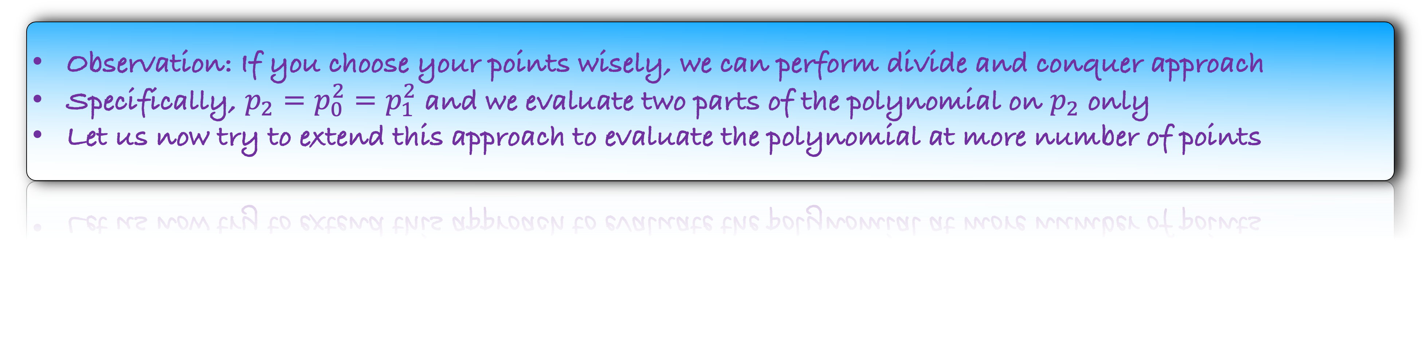
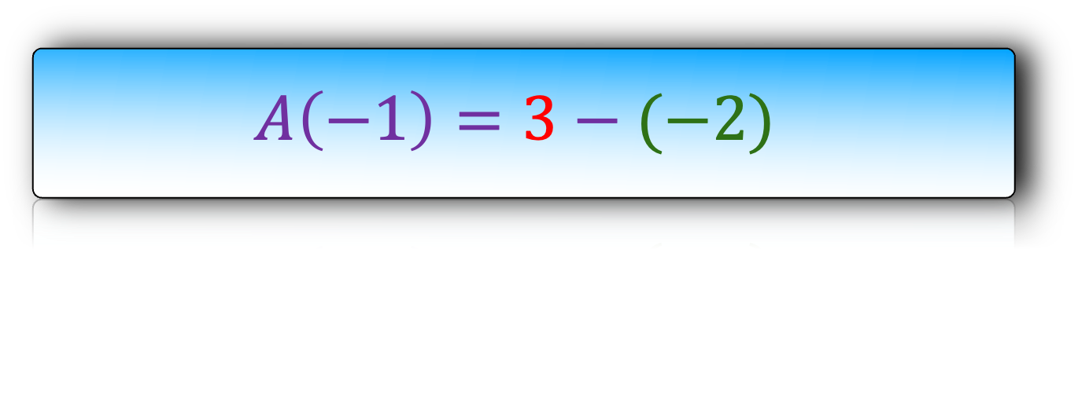
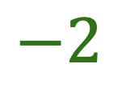
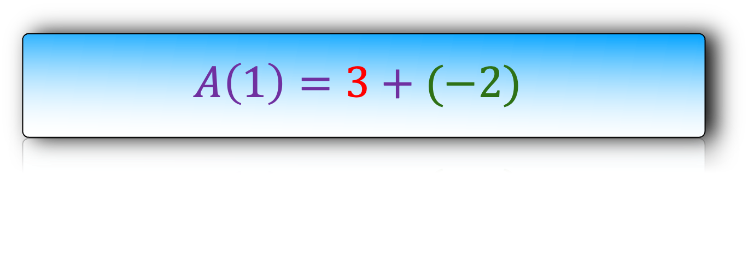
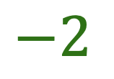
$$A\left(1\right)=3+(−2)$$
$$A\left(−1\right)=3−(−2)$$
$$3$$
$$−2$$
$$3$$
$$−2$$
$$p_{0}=1$$
$$p_{1}=−1$$
$$A_{red}(1)=3$$
$$p_{2}=1$$
$$A_{green}\left(1\right)=−2$$
Observation: If you choose your points wisely, we can perform divide and conquer approach
Specifically, $p_{2}=p_{0}^{2}=p_{1}^{2}$ and we evaluate two parts of the polynomial on $p_{2}$ only
Let us now try to extend this approach to evaluate the polynomial at more number of points

Slide 12





$$A\left(x\right)=x^{8}+8x^{7}−3x^{6}+3x^{5}+x^{4}−2x^{3}+2x^{2}−3x+1$$
$$p_{0}=1$$
$$p_{1}=−1$$
$$p_{2}=??$$
$$p_{3}=??$$

Slide 13

$$A\left(x\right)=x^{8}−3x^{6}+x^{4}+2x^{2}+1+8x^{7}+3x^{5}−2x^{3}−3x$$
$$p_{0}=1$$
$$p_{1}=−1$$
$$p_{2}=??$$
$$p_{3}=??$$

Slide 14

$$A\left(x\right)=x^{8}−3x^{6}+x^{4}+2x^{2}+1+x(8x^{6}+3x^{4}−2x^{2}−3)$$
$$p_{0}=1$$
$$p_{1}=−1$$
$$p_{2}=??$$
$$p_{3}=??$$

Slide 15



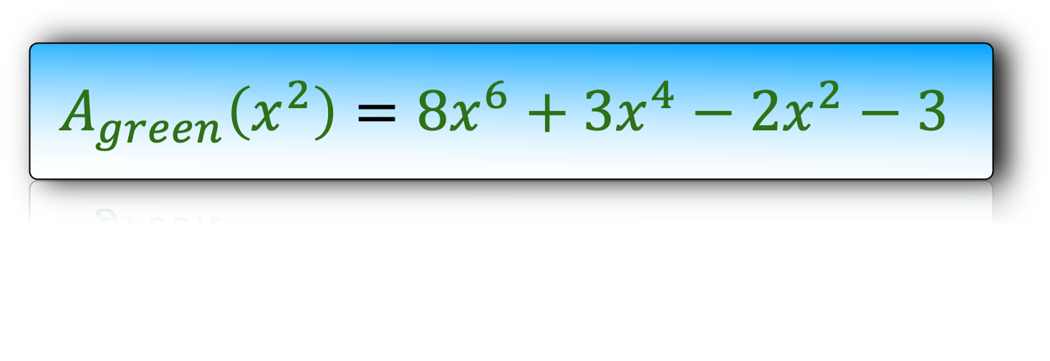
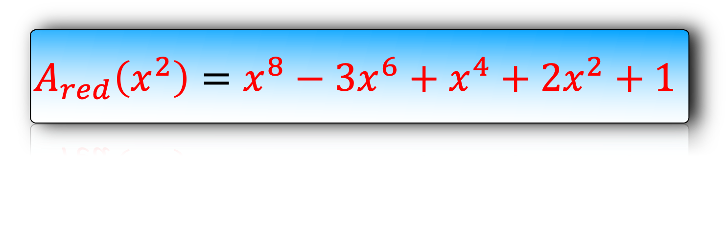
$$A\left(x\right)=x^{8}−3x^{6}+x^{4}+2x^{2}+1+x(8x^{6}+3x^{4}−2x^{2}−3)$$
$$p_{0}=1$$
$$p_{1}=−1$$
$$p_{2}=??$$
$$p_{3}=??$$
$$p_{4}=1$$
$$p_{5}=??$$
$$A_{red}\left(x^{2}\right)=x^{8}−3x^{6}+x^{4}+2x^{2}+1$$
$$A_{green}\left(x^{2}\right)=8x^{6}+3x^{4}−2x^{2}−3$$

Slide 16
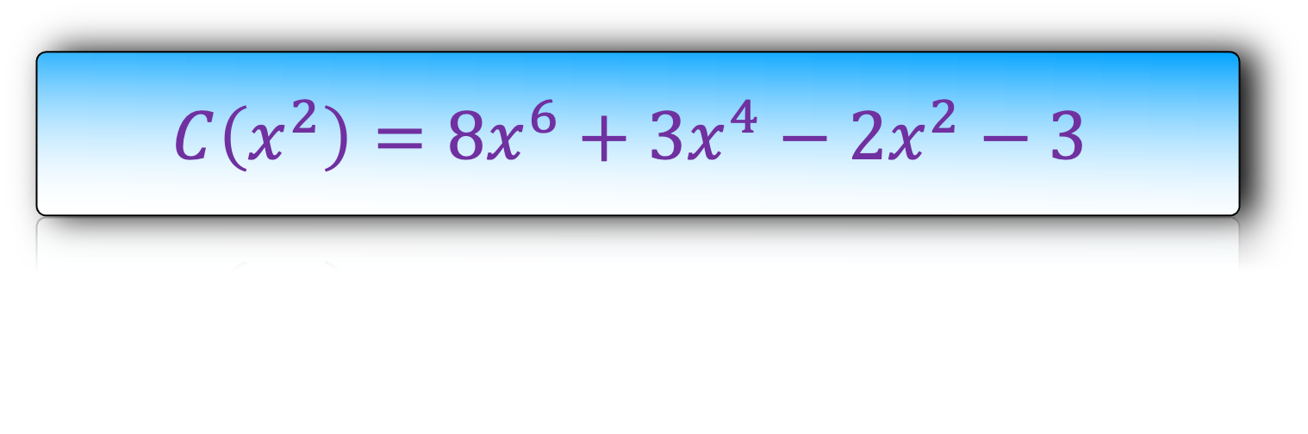
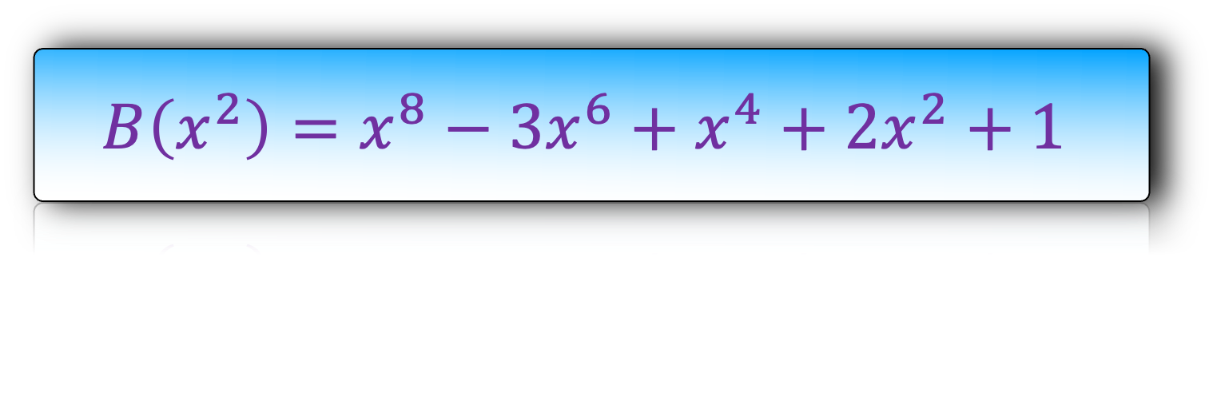
$$A\left(x\right)=x^{8}−3x^{6}+x^{4}+2x^{2}+1+x(8x^{6}+3x^{4}−2x^{2}−3)$$
$$p_{0}=1$$
$$p_{1}=−1$$
$$p_{2}=??$$
$$p_{3}=??$$
$$p_{4}=1$$
$$p_{5}=??$$
$$B\left(x^{2}\right)=x^{8}−3x^{6}+x^{4}+2x^{2}+1$$
$$C\left(x^{2}\right)=8x^{6}+3x^{4}−2x^{2}−3$$

Slide 17
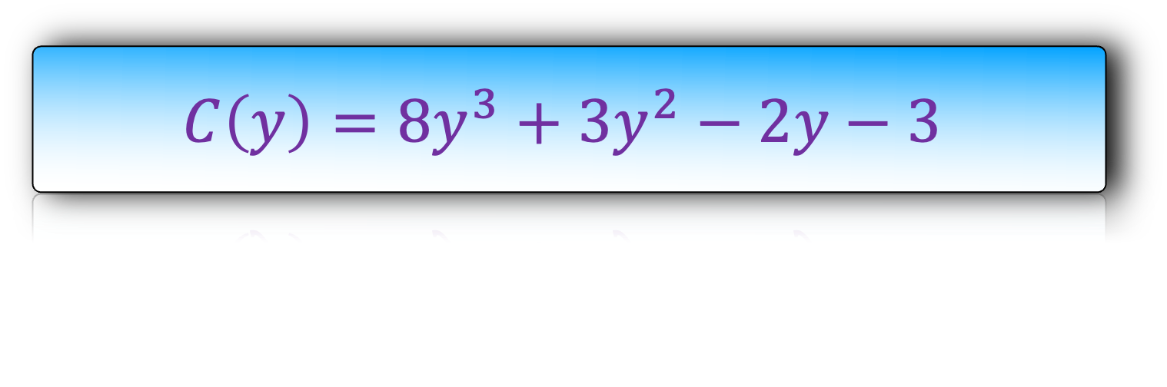

$$A\left(x\right)=x^{8}−3x^{6}+x^{4}+2x^{2}+1+x(8x^{6}+3x^{4}−2x^{2}−3)$$
$$p_{0}=1$$
$$p_{1}=−1$$
$$p_{2}=??$$
$$p_{3}=??$$
$$p_{4}=1$$
$$p_{5}=??$$
$$B\left(y\right)=y^{4}−3y^{3}+y^{2}+2y+1$$
$$C\left(y\right)=8y^{3}+3y^{2}−2y−3$$

Slide 18
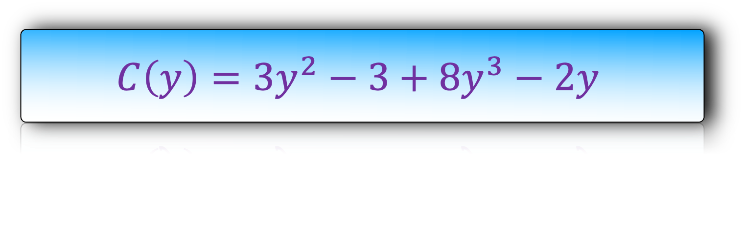

$$A\left(x\right)=x^{8}−3x^{6}+x^{4}+2x^{2}+1+x(8x^{6}+3x^{4}−2x^{2}−3)$$
$$p_{0}=1$$
$$p_{1}=−1$$
$$p_{2}=??$$
$$p_{3}=??$$
$$p_{4}=1$$
$$p_{5}=??$$
$$B\left(y\right)=y^{4}+y^{2}+1−3y^{3}+2y$$
$$C\left(y\right)=3y^{2}−3+8y^{3}−2y$$

Slide 19
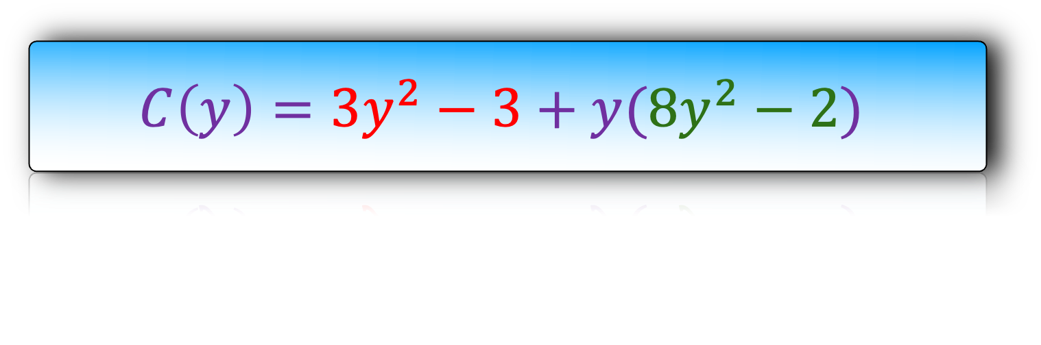
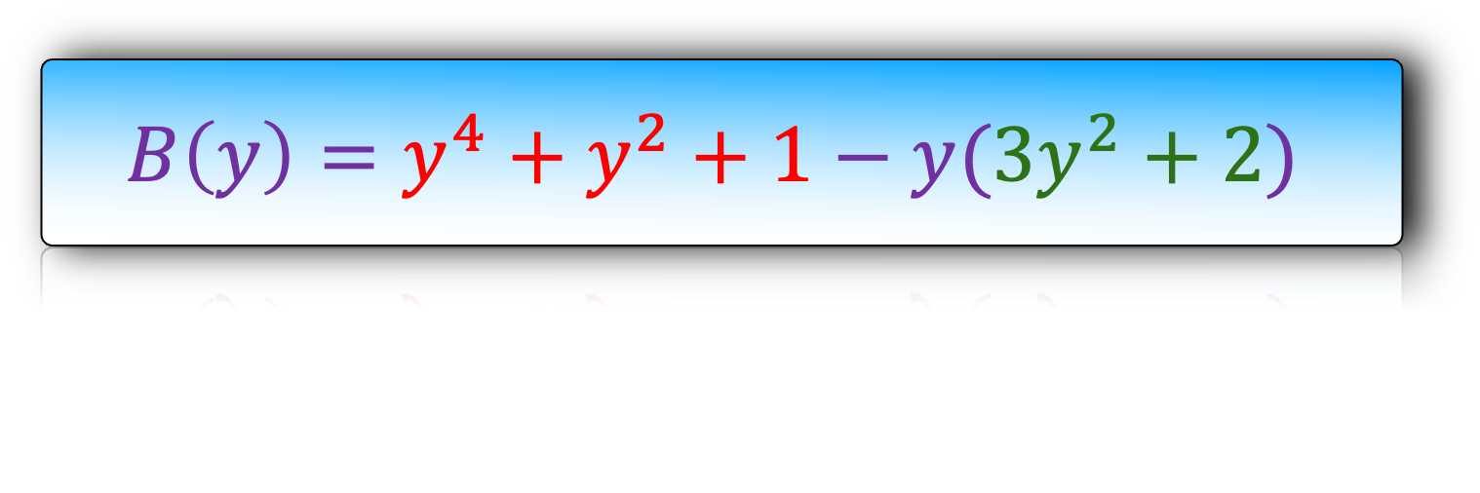
$$A\left(x\right)=x^{8}−3x^{6}+x^{4}+2x^{2}+1+x(8x^{6}+3x^{4}−2x^{2}−3)$$
$$p_{0}=1$$
$$p_{1}=−1$$
$$p_{2}=??$$
$$p_{3}=??$$
$$p_{4}=1$$
$$p_{5}=??$$
$$B\left(y\right)=y^{4}+y^{2}+1−y(3y^{2}+2)$$
$$C\left(y\right)=3y^{2}−3+y(8y^{2}−2)$$

Slide 20
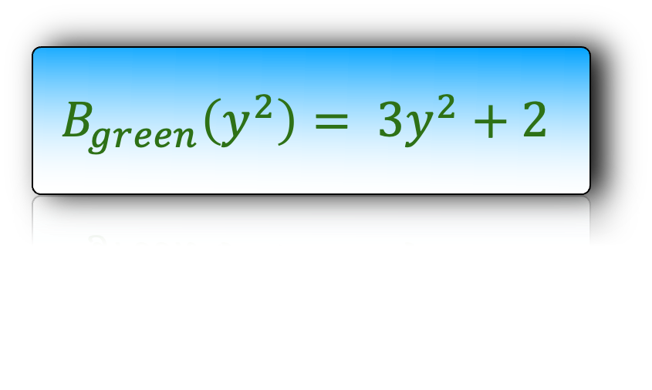
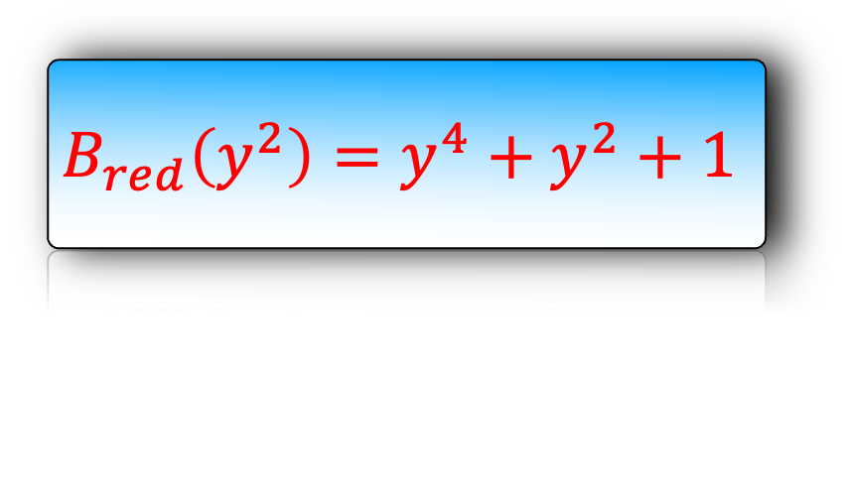

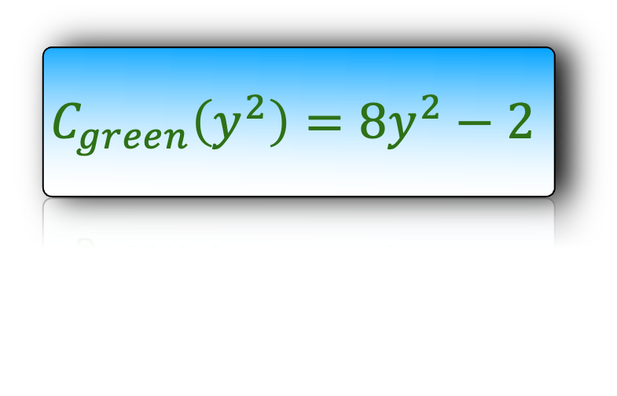
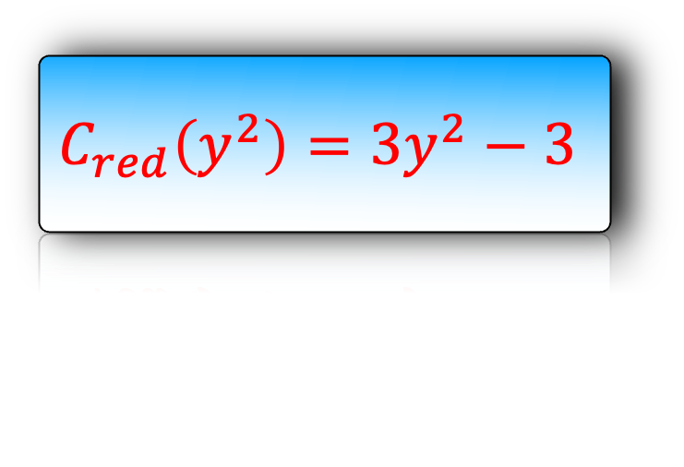
$$A\left(x\right)=x^{8}−3x^{6}+x^{4}+2x^{2}+1+x(8x^{6}+3x^{4}−2x^{2}−3)$$
$$p_{0}=1$$
$$p_{1}=−1$$
$$p_{2}=??$$
$$p_{3}=??$$
$$p_{4}=1$$
$$p_{5}=??$$
$$B\left(y\right)=y^{4}+y^{2}+1−y(3y^{2}+2)$$
$$C\left(y\right)=3y^{2}−3+y(8y^{2}−2)$$
$$B_{red}\left(y^{2}\right)=y^{4}+y^{2}+1$$
$$C_{red}\left(y^{2}\right)=3y^{2}−3$$
$$p_{6}=??$$
$$B_{green}\left(y^{2}\right)= 3y^{2}+2$$
$$C_{green}\left(y^{2}\right)=8y^{2}−2$$

Slide 21


$$A\left(x\right)=x^{8}−3x^{6}+x^{4}+2x^{2}+1+x(8x^{6}+3x^{4}−2x^{2}−3)$$
$$p_{0}=1$$
$$p_{1}=−1$$
$$p_{2}=??$$
$$p_{3}=??$$
$$p_{4}=1$$
$$p_{5}=??$$
$$B\left(y\right)=y^{4}+y^{2}+1−y(3y^{2}+2)$$
$$C\left(y\right)=3y^{2}−3+y(8y^{2}−2)$$
What is $p_{6}$?
$$B_{red}\left(y^{2}\right)=y^{4}+y^{2}+1$$
$$C_{red}\left(y^{2}\right)=3y^{2}−3$$
$$p_{6}=p_{4}^{2}=p_{5}^{2}$$
$$p_{6}=??$$
$$B_{green}\left(y^{2}\right)= 3y^{2}+2$$
$$C_{green}\left(y^{2}\right)=8y^{2}−2$$

Slide 22


$$A\left(x\right)=x^{8}−3x^{6}+x^{4}+2x^{2}+1+x(8x^{6}+3x^{4}−2x^{2}−3)$$
$$p_{0}=1$$
$$p_{1}=−1$$
$$p_{2}=??$$
$$p_{3}=??$$
$$p_{4}=1$$
$$p_{5}=−1$$
$$B\left(y\right)=y^{4}+y^{2}+1−y(3y^{2}+2)$$
$$C\left(y\right)=3y^{2}−3+y(8y^{2}−2)$$
$$B_{red}\left(y^{2}\right)=y^{4}+y^{2}+1$$
$$C_{red}\left(y^{2}\right)=3y^{2}−3$$
$$p_{6}=1$$
$$B_{green}\left(y^{2}\right)= 3y^{2}+2$$
$$C_{green}\left(y^{2}\right)=8y^{2}−2$$

Slide 23


$$A\left(x\right)=x^{8}−3x^{6}+x^{4}+2x^{2}+1+x(8x^{6}+3x^{4}−2x^{2}−3)$$
$$p_{0}=1$$
$$p_{1}=−1$$
$$p_{2}=??$$
$$p_{3}=??$$
$$p_{4}=1$$
$$p_{5}=−1$$
$$B\left(y\right)=y^{4}+y^{2}+1−y(3y^{2}+2)$$
$$C\left(y\right)=3y^{2}−3+y(8y^{2}−2)$$
What is $p_{2}$ and $p_{3}$?
$$p_{5}=p_{2}^{2}=p_{3}^{2}$$
$$B_{red}\left(y^{2}\right)=y^{4}+y^{2}+1$$
$$C_{red}\left(y^{2}\right)=3y^{2}−3$$
$$p_{6}=1$$
$$B_{green}\left(y^{2}\right)= 3y^{2}+2$$
$$C_{green}\left(y^{2}\right)=8y^{2}−2$$

Slide 24


$$A\left(x\right)=x^{8}−3x^{6}+x^{4}+2x^{2}+1+x(8x^{6}+3x^{4}−2x^{2}−3)$$
$$p_{0}=1$$
$$p_{1}=−1$$
$$p_{2}=i$$
$$p_{3}=−i$$
Introducing : Complex Numbers
$$p_{4}=1$$
$$p_{5}=−1$$
$$B\left(y\right)=y^{4}+y^{2}+1−y(3y^{2}+2)$$
$$C\left(y\right)=3y^{2}−3+y(8y^{2}−2)$$
$$B_{red}\left(y^{2}\right)=y^{4}+y^{2}+1$$
$$C_{red}\left(y^{2}\right)=3y^{2}−3$$
$$p_{6}=1$$
$$B_{green}\left(y^{2}\right)= 3y^{2}+2$$
$$C_{green}\left(y^{2}\right)=8y^{2}−2$$

Slide 25
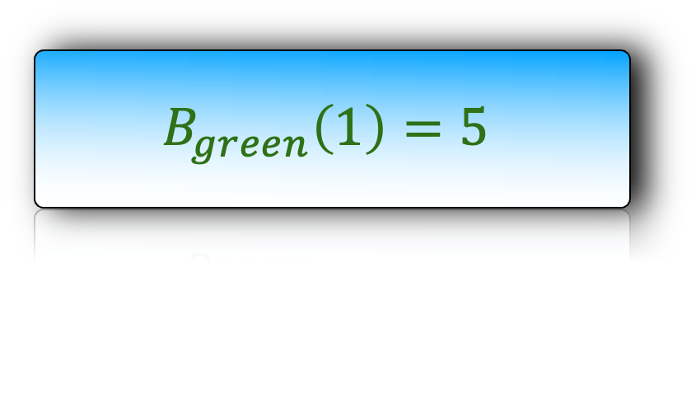
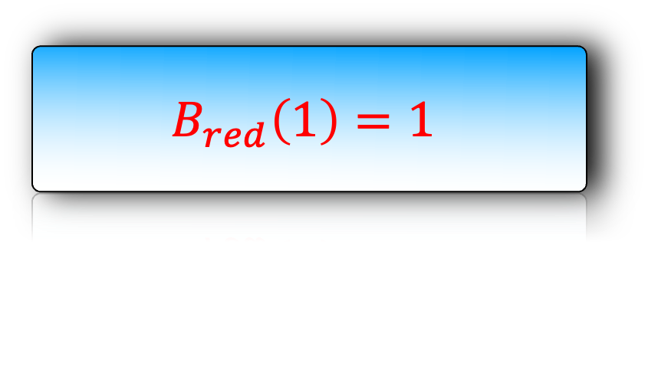
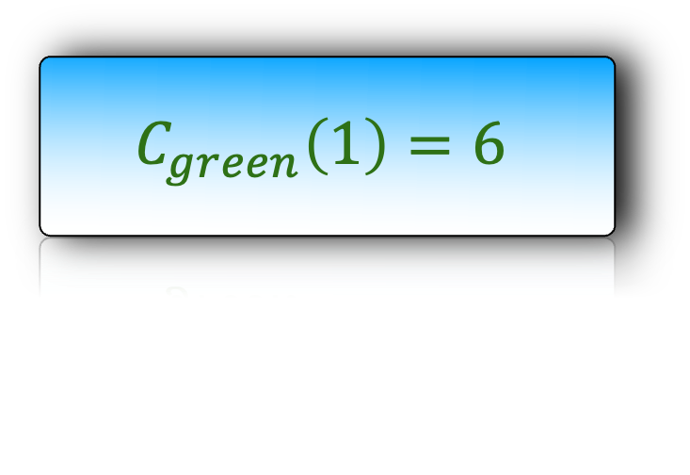
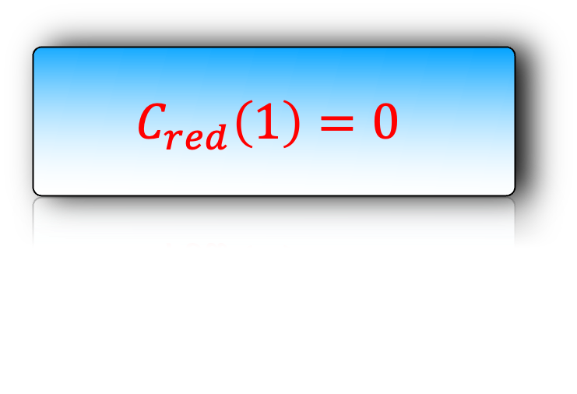
$$A\left(x\right)=x^{8}−3x^{6}+x^{4}+2x^{2}+1+x(8x^{6}+3x^{4}−2x^{2}−3)$$
$$p_{0}=1$$
$$p_{1}=−1$$
$$p_{2}=i$$
$$p_{3}=−i$$
$$p_{4}=1$$
$$p_{5}=−1$$
$$B\left(y\right)=y^{4}+y^{2}+1−y(3y^{2}+2)$$
$$C\left(y\right)=3y^{2}−3+y(8y^{2}−2)$$
$$B_{red}\left(1\right)=1$$
$$C_{red}\left(1\right)=0$$
$$p_{6}=1$$
$$B_{green}\left(1\right)=5$$
$$C_{green}\left(1\right)=6$$

Slide 26




$$A\left(x\right)=x^{8}−3x^{6}+x^{4}+2x^{2}+1+x(8x^{6}+3x^{4}−2x^{2}−3)$$
$$p_{0}=1$$
$$p_{1}=−1$$
$$p_{2}=i$$
$$p_{3}=−i$$
$$p_{4}=1$$
$$p_{5}=−1$$
$$B\left(y\right)=1−y(5)$$
$$B\left(y\right)=1−y(5)$$
$$C\left(y\right)=0+y(6)$$
$$C\left(y\right)=0+y(6)$$
$$B_{red}\left(1\right)=1$$
$$C_{red}\left(1\right)=0$$
$$p_{6}=1$$
$$B_{green}\left(1\right)=5$$
$$C_{green}\left(1\right)=6$$

Slide 27
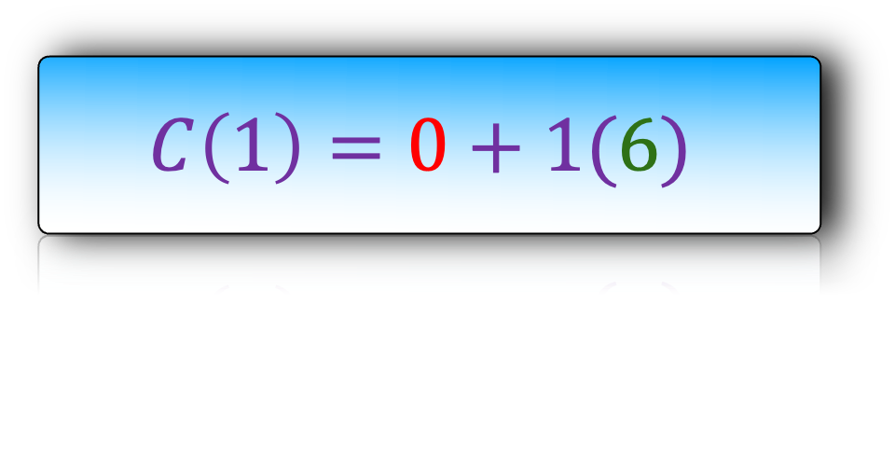
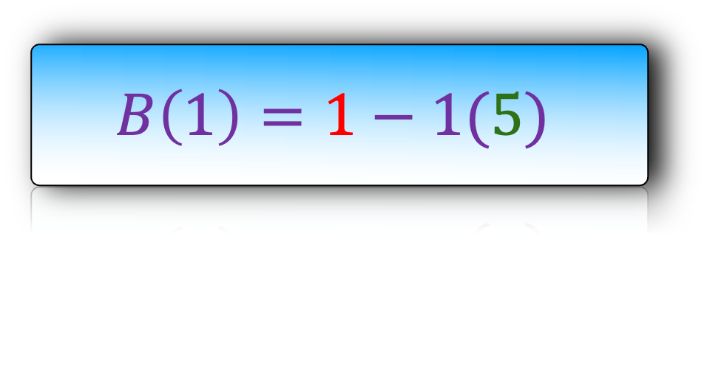
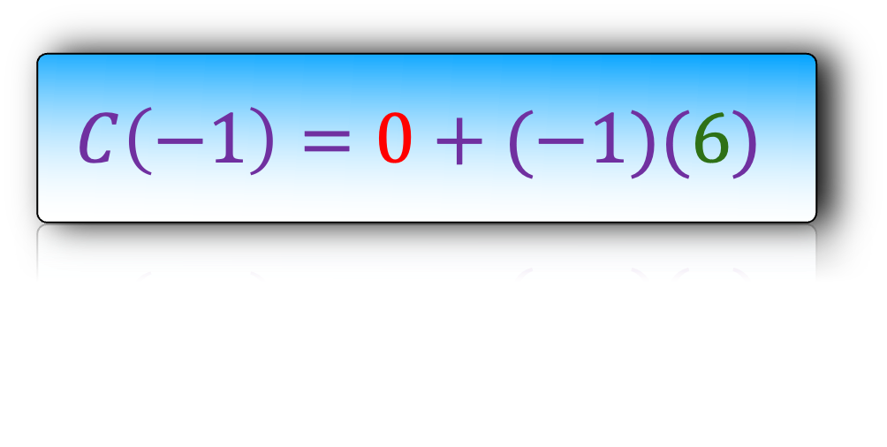
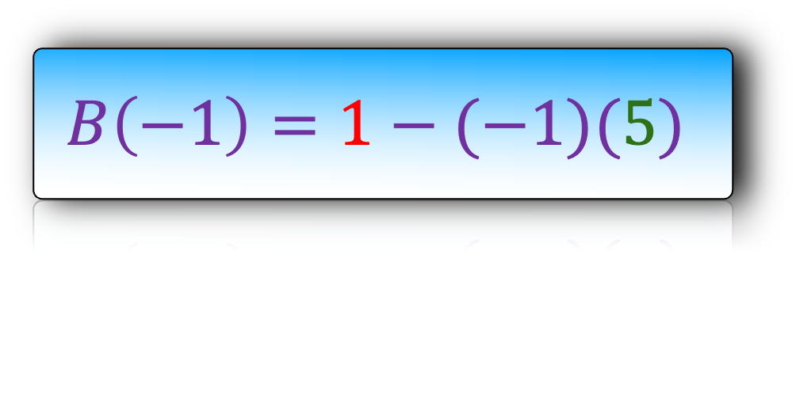
$$A\left(x\right)=x^{8}−3x^{6}+x^{4}+2x^{2}+1+x(8x^{6}+3x^{4}−2x^{2}−3)$$
$$p_{0}=1$$
$$p_{1}=−1$$
$$p_{2}=i$$
$$p_{3}=−i$$
$$p_{4}=1$$
$$p_{5}=−1$$
$$B\left(1\right)=1−1(5)$$
$$B\left(−1\right)=1−(−1)(5)$$
$$C\left(1\right)=0+1(6)$$
$$C\left(−1\right)=0+(−1)(6)$$
$$B_{red}\left(1\right)=1$$
$$C_{red}\left(1\right)=0$$
$$p_{6}=1$$
$$B_{green}\left(1\right)=5$$
$$C_{green}\left(1\right)=6$$

Slide 28
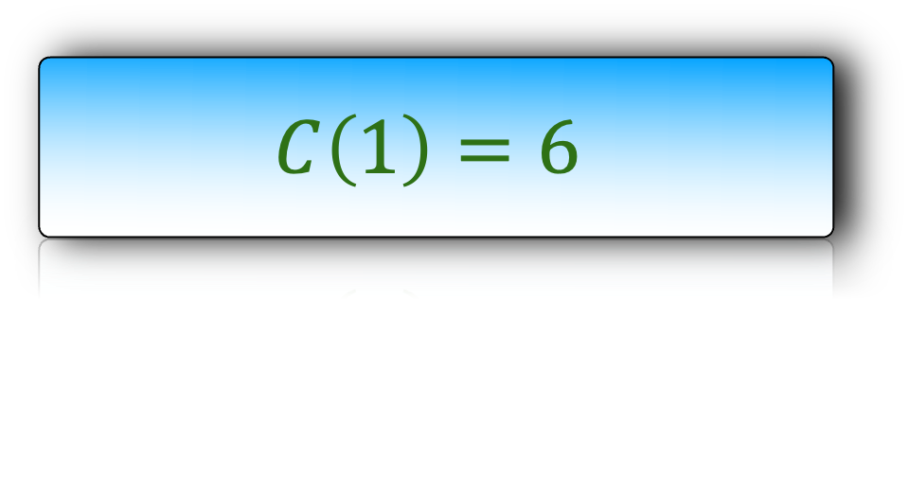
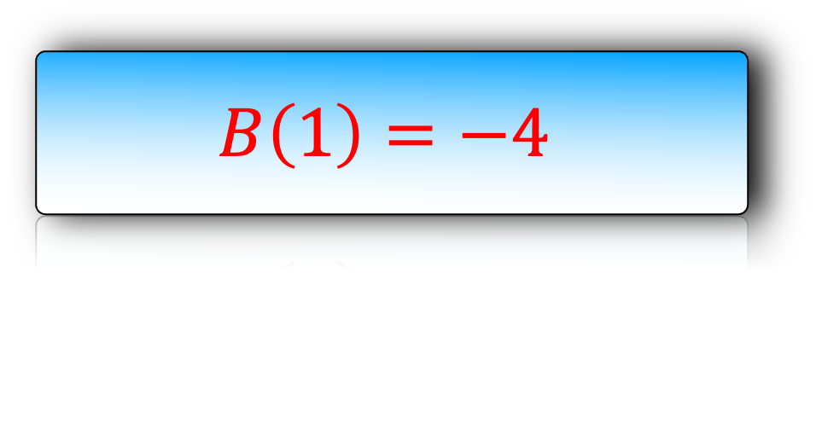

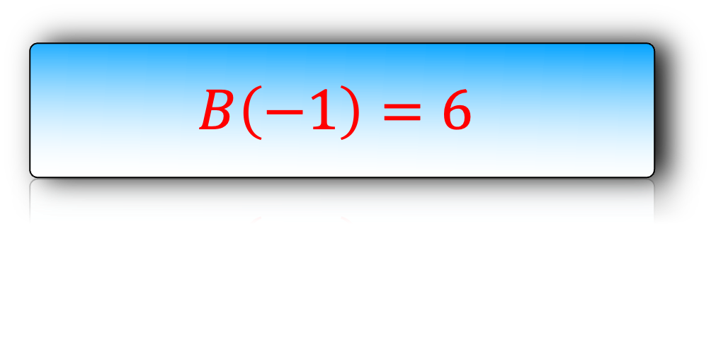
$$A\left(x\right)=x^{8}−3x^{6}+x^{4}+2x^{2}+1+x(8x^{6}+3x^{4}−2x^{2}−3)$$
$$p_{0}=1$$
$$p_{1}=−1$$
$$p_{2}=i$$
$$p_{3}=−i$$
$$p_{4}=1$$
$$p_{5}=−1$$
$$B\left(1\right)=−4$$
$$B\left(−1\right)=6$$
$$C\left(1\right)=6$$
$$C\left(−1\right)=−6$$
$$B_{red}\left(1\right)=1$$
$$C_{red}\left(1\right)=0$$
$$p_{6}=1$$
$$B_{green}\left(1\right)=5$$
$$C_{green}\left(1\right)=6$$

Slide 29


$$A\left(x\right)=−4+x(6)$$
$$A\left(x\right)=6+x(−6)$$
$$p_{0}=1$$
$$p_{1}=−1$$
$$p_{2}=i$$
$$p_{3}=−i$$
$$p_{4}=1$$
$$p_{5}=−1$$
$$B\left(1\right)=−4$$
$$B\left(−1\right)=6$$
$$C\left(1\right)=6$$
$$C\left(−1\right)=−6$$
$$B_{red}\left(1\right)=1$$
$$C_{red}\left(1\right)=0$$
$$p_{6}=1$$
$$B_{green}\left(1\right)=5$$
$$C_{green}\left(1\right)=6$$

Slide 30
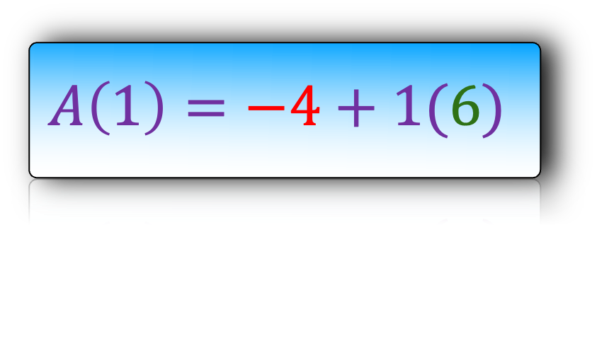
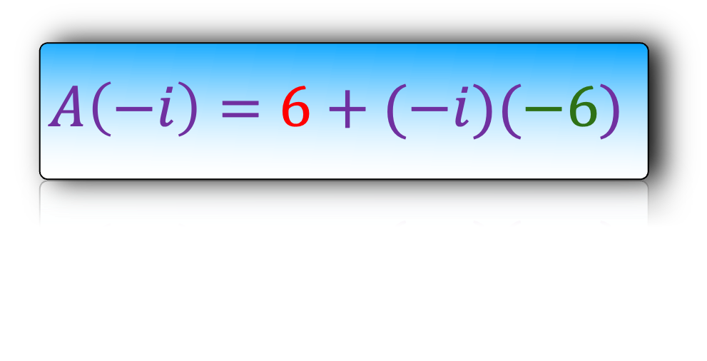
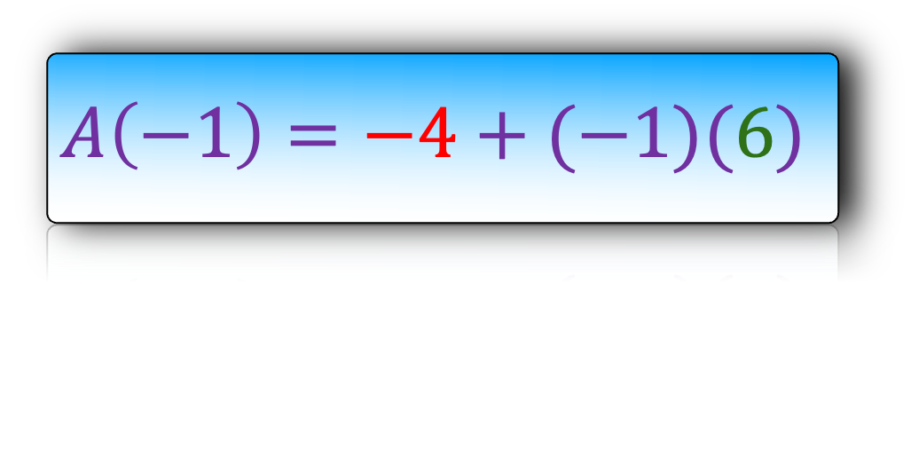
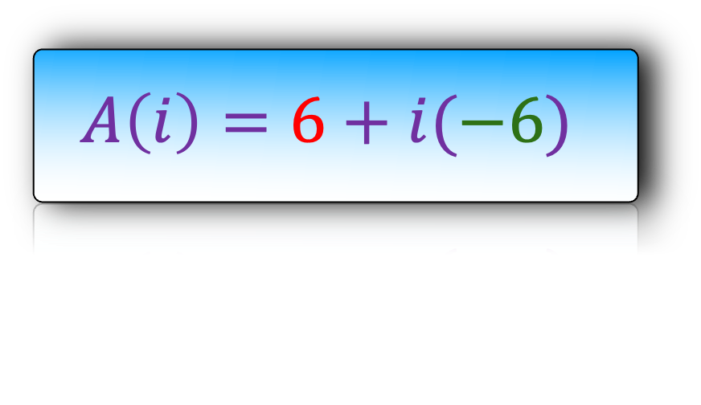
$$A\left(1\right)=−4+1(6)$$
$$A\left(−1\right)=−4+(−1)(6)$$
$$A\left(i\right)=6+i(−6)$$
$$A\left(−i\right)=6+(−i)(−6)$$
$$p_{0}=1$$
$$p_{1}=−1$$
$$p_{2}=i$$
$$p_{3}=−i$$
$$p_{4}=1$$
$$p_{5}=−1$$
$$B\left(1\right)=−4$$
$$B\left(−1\right)=6$$
$$C\left(1\right)=6$$
$$C\left(−1\right)=−6$$
$$B_{red}\left(1\right)=1$$
$$C_{red}\left(1\right)=0$$
$$p_{6}=1$$
$$B_{green}\left(1\right)=5$$
$$C_{green}\left(1\right)=6$$

Slide 31
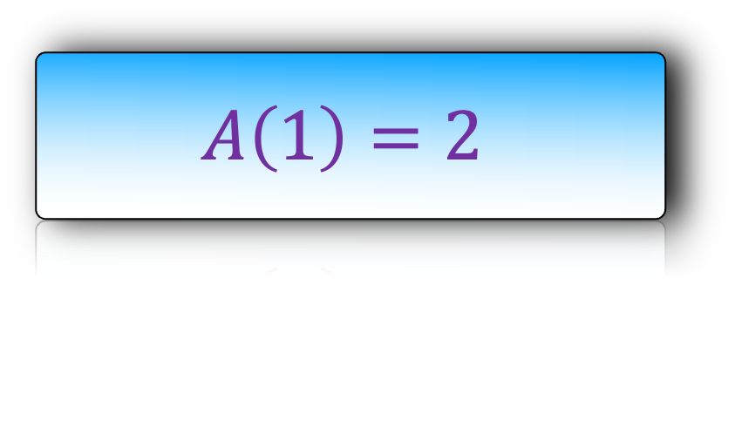
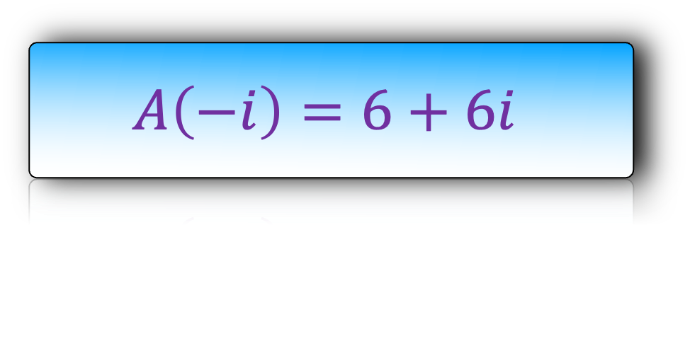


$$A\left(1\right)=2$$
$$A\left(−1\right)=−10$$
$$A\left(i\right)=6−6i$$
$$A\left(−i\right)=6+6i$$
$$p_{0}=1$$
$$p_{1}=−1$$
$$p_{2}=i$$
$$p_{3}=−i$$
$$p_{4}=1$$
$$p_{5}=−1$$
$$B\left(1\right)=−4$$
$$B\left(−1\right)=6$$
$$C\left(1\right)=6$$
$$C\left(−1\right)=−6$$
$$B_{red}\left(1\right)=1$$
$$C_{red}\left(1\right)=0$$
$$p_{6}=1$$
$$B_{green}\left(1\right)=5$$
$$C_{green}\left(1\right)=6$$

Slide 32


To evaluate A(x):
At 2 points, we use $1,−1$
At 4 points, we use $1,−1,i,−i$
If we want to evaluate A(x) at 4,8,…,$2^{k}$ ponts, what should we use?
This will require another insight from complex numbers.

