Slide 1
Median of Median Algorithm

Slide 2

The median of n numbers is the $\left\lceil \frac{n}{2}\right\rceil$-th smallest number.
Given an array A of n numbers, find its median.

Slide 3

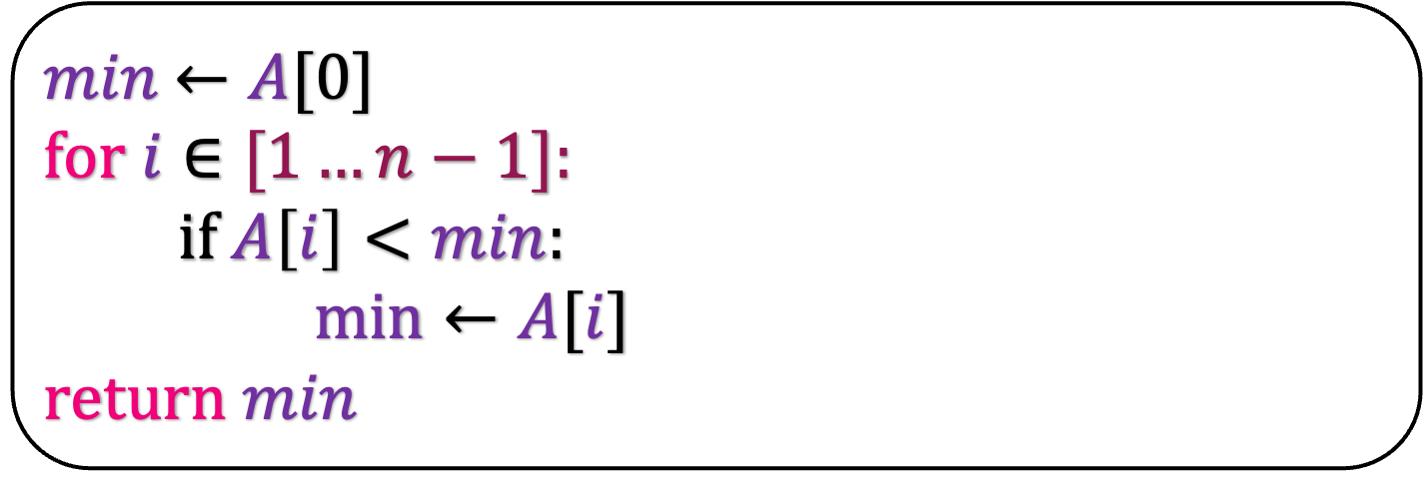
History
A simple problem is finding the minimum
$min$ $←A[0]$
for $i∈[1…n−1]:$
if $A\left[i\right]<min$:
$\min{←A[i]}$
return $min$
Focus on the number of comparisons made by the algorithm
How many comparisons are made by this algorithm?
$$n−1$$

Slide 4


History
Finding the minimum takes $n−1$ comparisons
How many comparisons are required to find the second minimum?
Schreier (1932) showed that second minimum can be found in $n+\log{n}−2$ comparison

Slide 5
10
10
51
1
1
2
15
8
8
11
7
7

Slide 6
10
1
8
7
1
7
10
51
1
2
15
8
11
7

Slide 7
1
7
1
10
1
8
7
10
51
1
2
15
8
11
7

Slide 8
How many comparisoins are made by this algorithm ti find the minmum?
1
$$n−1$$
How will you find the second minimum?
1
7
10
1
8
7
10
51
1
2
15
8
11
7

Slide 9
How many comparisoins are made by this algorithm ti find the minmum?
1
$$n−1$$
How will you find the second minimum?
1
7
Compare the log n numbers that is defeated by the minimum
Finding the second minimum requires
log n-1 comparisons
Second minimum can be found in
n+log n-2 comparisons
10
1
8
7
10
51
1
2
15
8
11
7

Slide 10
History
Schreier (1932) showed that second minimum can be found in n+log n-2 comparison
Hadian and Sobel (1969) showed that k-th minimum can be found in roughly (n-k)+k log(n-k) comparisons
Take a deep look at the above running time.
When k is constant,
  the first term dominates and #comparisons is O(n)
  When k is n-constant,
    the last term dominates and #comparisons is O(n)
    When k=n/2,
    the last term dominates and #comparisons is O(n log n)

Slide 11
Is finding median harder than finding minimum and maximum element in the array?
No
Blum, Floyd, Pratt, Rivest and Tarjan (1972) showed that we can find the k-th element in the array in 5.4305 n comparisons in the worst case.
In this lecture, we will just prove that we can find the k-th element in the array in O(n) time.
Or, we can find the median in an array in O(n) time.

Slide 12
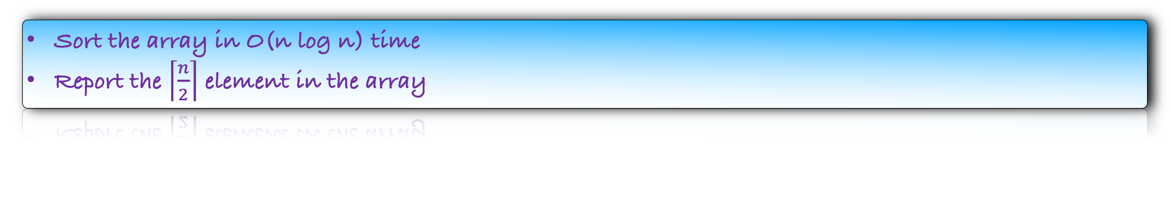
What is the trivial algorithm to find the median?
Sort the array in O(n log n) time
Report the $\left\lceil \frac{n}{2}\right\rceil$ element in the array
Running time is O(n log n)
But we have found the minimum, second minimum, third minimum, …., maximum element in the array
But I asked you to just find the median
Is sorting necessary for this problem?

Slide 13
Remember QuickSort
21
1
31
11
15
35
37
56
3
15
17
93
91
10
51
53

Slide 14
Remember QuickSort
21
1
31
11
15
35
37
56
3
15
17
93
91
10
51
53
Choose a pivot

Slide 15
Remember QuickSort
21
1
31
11
15
35
37
56
3
15
17
93
91
10
51
53
Choose a pivot
Find all the numbers less than the pivot

Slide 16
Remember QuickSort
21
1
31
11
15
35
37
56
3
15
17
93
91
10
51
53
Choose a pivot
Find all the numbers less than the pivot
Find all the numbers greater than the pivot

Slide 17
Remember QuickSort
1
11
15
3
15
17
10
21
31
35
37
56
93
91
51
53
Choose a pivot
Find all the numbers less than the pivot
Find all the numbers greater than the pivot
Rearrange the numbers

Slide 18
Remember QuickSort
1
11
15
3
15
17
10
21
31
35
37
56
93
91
51
53
If the pivot happens to land in the middle, we have found the median

Slide 19
Remember QuickSort
1
11
15
3
15
17
10
21
31
35
37
56
93
91
51
53
55
22
25
99
8
12
If the pivot happens is to the left of the median,

Slide 20
Remember QuickSort
1
11
15
3
15
17
10
21
31
35
37
56
93
91
51
53
55
22
25
99
8
Find the second minimum number in this array

Slide 21
Remember QuickSort
1
11
15
3
15
17
10
21
31
35
37
56
7
5
If the pivot lies to the right of the median

Slide 22
Remember QuickSort
1
11
15
3
15
17
10
21
31
35
37
56
5
Find the 6-th minimum number in this array

Slide 23
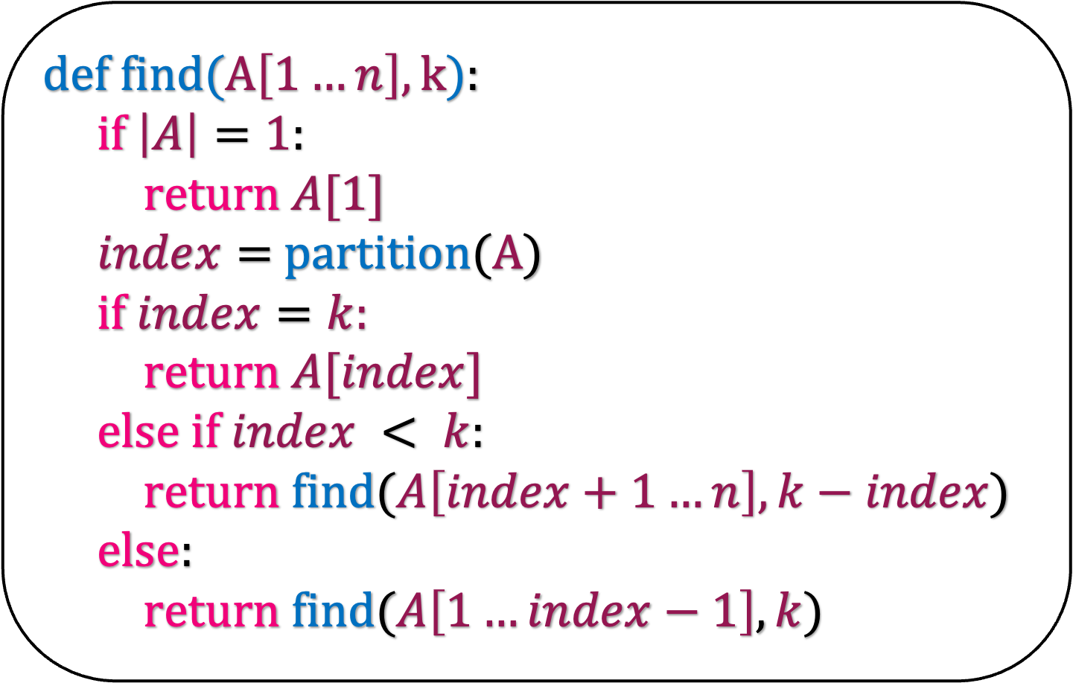
21
1
31
11
15
35
37
56
3
15
17
93
91
10
51
53
def f$ind(A\left[1…n\right],k$):
if $\left|A\right|=1$:
return $A[1]$
$index=$partition($A$)
if $index=k:$
return $A[index]$
else if $index < k$:
return find($A\left[index+1…n\right], k−index$)
else:
return find($A\left[1…index−1\right],k$)

Slide 24
1
11
15
3
15
17
10
21
31
35
37
56
93
91
51
53
def f$ind(A\left[1…n\right],k$):
if $\left|A\right|=1$:
return $A[1]$
$index=$partition($A$)
if $index=k:$
return $A[index]$
else if $index < k$:
return find($A\left[index+1…n\right], k−index$)
else:
return find($A\left[1…index−1\right],k$)

Slide 25
1
11
15
3
15
17
10
21
31
35
37
56
93
91
51
53
def f$ind(A\left[1…n\right],k$):
if $\left|A\right|=1$:
return $A[1]$
$index=$partition($A$)
if $index=k:$
return $A[index]$
else if $index < k$:
return find($A\left[index+1…n\right], k−index$)
else:
return find($A\left[1…index−1\right],k$)

Slide 26
1
11
15
3
15
17
10
31
35
37
56
93
91
51
53
def f$ind(A\left[1…n\right],k$):
if $\left|A\right|=1$:
return $A[1]$
$index=$partition($A$)
if $index=k:$
return $A[index]$
else if $index < k$:
return find($A\left[index+1…n\right], k−index$)
else:
return find($A\left[1…index−1\right],k$)
21

Slide 27
1
11
15
3
15
17
10
21
31
35
37
56
93
91
51
53
55
22
25
99
def f$ind(A\left[1…n\right],k$):
if $\left|A\right|=1$:
return $A[1]$
$index=$partition($A$)
if $index=k:$
return $A[index]$
else if $index < k$:
return find($A\left[index+1…n\right], k−index$)
else:
return find($A\left[1…index−1\right],k$)

Slide 28
find
(
)
1
11
15
3
15
17
10
21
31
35
37
56
93
91
51
53
55
22
25
99
def f$ind(A\left[1…n\right],k$):
if $\left|A\right|=1$:
return $A[1]$
$index=$partition($A$)
if $index=k:$
return $A[index]$
else if $index < k$:
return find($A\left[index+1…n\right], k−index$)
else:
return find($A\left[1…index−1\right],k$)

Slide 29
1
11
15
3
15
17
10
21
31
35
37
56
def f$ind(A\left[1…n\right],k$):
if $\left|A\right|=1$:
return $A[1]$
$index=$partition($A$)
if $index=k:$
return $A[index]$
else if $index < k$:
return find($A\left[index+1…n\right], k−index$)
else:
return find($A\left[1…index−1\right],k$)

Slide 30
(
)
find
1
11
15
3
15
17
10
21
31
35
37
56
def f$ind(A\left[1…n\right],k$):
if $\left|A\right|=1$:
return $A[1]$
$index=$partition($A$)
if $index=k:$
return $A[index]$
else if $index < k$:
return find($A\left[index+1…n\right], k−index$)
else:
return find($A\left[1…index−1\right],k$)

Slide 31
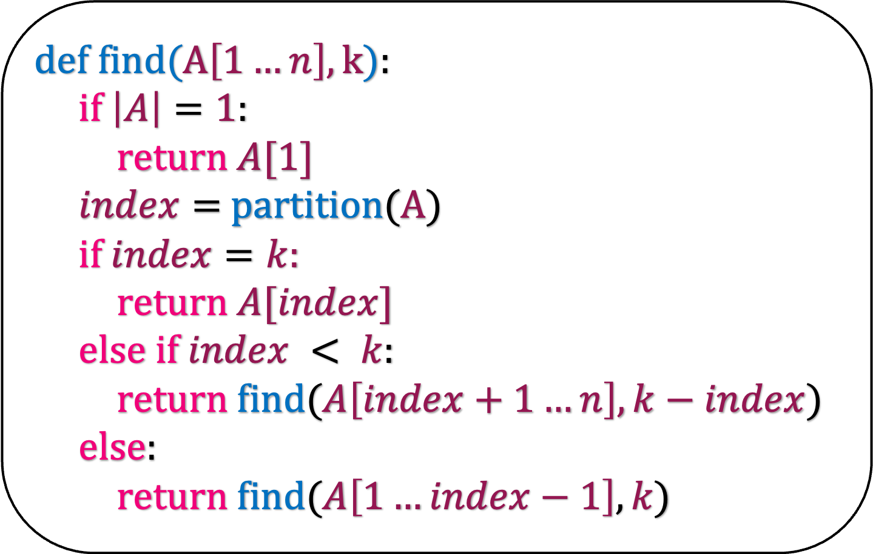
def f$ind(A\left[1…n\right],k$):
if $\left|A\right|=1$:
return $A[1]$
$index=$partition($A$)
if $index=k:$
return $A[index]$
else if $index < k$:
return find($A\left[index+1…n\right], k−index$)
else:
return find($A\left[1…index−1\right],k$)
What is the running time of this algorithm in the worst case?
n
Time taken by partition
…………………….
1
2
3
4
5
6
n-2
n-1
n

Slide 32
def f$ind(A\left[1…n\right],k$):
if $\left|A\right|=1$:
return $A[1]$
$index=$partition($A$)
if $index=k:$
return $A[index]$
else if $index < k$:
return find($A\left[index+1…n\right], k−index$)
else:
return find($A\left[1…index−1\right],k$)
What is the running time of this algorithm in the worst case?
n
Time taken by partition
…………………….
1
2
2
3
3
4
4
5
5
6
6
n-2
n-2
n-1
n-1
n
n

Slide 33
def f$ind(A\left[1…n\right],k$):
if $\left|A\right|=1$:
return $A[1]$
$index=$partition($A$)
if $index=k:$
return $A[index]$
else if $index < k$:
return find($A\left[index+1…n\right], k−index$)
else:
return find($A\left[1…index−1\right],k$)
What is the running time of this algorithm in the worst case?
n
Time taken by partition
…………………….
1
2
3
4
5
6
n-2
n-1
n
n
…………………….
2
3
4
5
6
n-2
n-1
n

Slide 34
def f$ind(A\left[1…n\right],k$):
if $\left|A\right|=1$:
return $A[1]$
$index=$partition($A$)
if $index=k:$
return $A[index]$
else if $index < k$:
return find($A\left[index+1…n\right], k−index$)
else:
return find($A\left[1…index−1\right],k$)
What is the running time of this algorithm in the worst case?
n
Time taken by partition
…………………….
1
2
3
4
5
6
n-2
n-1
n
n
…………………….
2
3
3
4
4
5
5
6
6
n-2
n-2
n-1
n-1
n
n

Slide 35
def f$ind(A\left[1…n\right],k$):
if $\left|A\right|=1$:
return $A[1]$
$index=$partition($A$)
if $index=k:$
return $A[index]$
else if $index < k$:
return find($A\left[index+1…n\right], k−index$)
else:
return find($A\left[1…index−1\right],k$)
What is the running time of this algorithm in the worst case?
n
Time taken by partition
…………………….
1
2
3
4
5
6
n-2
n-1
n
n
…………………….
2
3
4
5
6
n-2
n-1
n
n-1
…………………….
3
4
5
6
n-2
n-1
n

Slide 36
def f$ind(A\left[1…n\right],k$):
if $\left|A\right|=1$:
return $A[1]$
$index=$partition($A$)
if $index=k:$
return $A[index]$
else if $index < k$:
return find($A\left[index+1…n\right], k−index$)
else:
return find($A\left[1…index−1\right],k$)
What is the running time of this algorithm in the worst case?
n
Time taken by partition
…………………….
1
2
3
4
5
6
n-2
n-1
n
n
…………………….
2
3
4
5
6
n-2
n-1
n
n-1
…………………….
3
4
5
6
n-2
n-1
n
n-2
4
5
6
n-2
n-1
n
n-3

Slide 37
Time taken by partition
…………………….
1
2
3
4
5
6
n-2
n-1
n
n
…………………….
2
3
4
5
6
n-2
n-1
n
n-1
…………………….
3
4
5
6
n-2
n-1
n
n-2
4
5
6
n-2
n-1
n
n-3
…….
n-2
n-1
n
3
n-1
n
2
n
1

Slide 38
Worst case running time of Find
n
n-1
n-2
n-3
…….
3
2
1

Slide 39

Worst case running time of Find
n
n-1
n-2
n-3
…….
3
2
1
$$O(n^{2})$$

Slide 40

def f$ind(A\left[1…n\right],k$):
if $\left|A\right|=1$:
return $A[1]$
$index=$partition($A$)
if $index=k:$
return $A[index]$
else if $index < k$:
return find($A\left[index+1…n\right], k−index$)
else:
return find($A\left[1…index−1\right],k$)
What is the best case running time of this algorithm?
Pivot magically land in the middle of the array every time.
Then, this algorithm roughly behaves like a binary search
And the running time is O(n) and not log n

Slide 41
def f$ind(A\left[1…n\right],k$):
if $\left|A\right|=1$:
return $A[1]$
$index=$partition($A$)
if $index=k:$
return $A[index]$
else if $index < k$:
return find($A\left[index+1…n\right], k−index$)
else:
return find($A\left[1…index−1\right],k$)
Can we choose the pivot wisely such that it approximately lands in the middle of the array?

Slide 42
6
25
33
17
39
22
45
7
40
8
21
32
16
34
24
27
36
2
41
20
1
18
15
35
9
10
26
43
3
23
30
14
37
19
11
42
4
31
12
29
28
43
13
38
5
Partition the array in groups of 5

Slide 43
6
25
33
17
39
Partition the array in groups of 5
Sort each group
22
45
7
40
8
21
32
16
34
24
27
36
2
41
20
1
18
15
35
9
10
26
43
3
23
30
14
37
19
11
42
4
31
12
29
28
43
13
38
5

Slide 44
6
17
25
33
39
Partition the array in groups of 5
Sort each group
7
8
22
40
45
16
21
24
32
34
2
20
27
36
41
1
9
15
18
35
3
10
23
26
43
11
14
19
30
37
4
12
29
31
42
5
13
28
38
43

Slide 45
6
17
25
33
39
Partition the array in groups of 5
Sort each group
Consider the middle column
7
8
22
40
45
16
21
24
32
34
2
20
27
36
41
1
9
15
18
35
3
10
23
26
43
11
14
19
30
37
4
12
29
31
42
5
13
28
38
43

Slide 46
6
17
25
33
39
Partition the array in groups of 5
Sort each group
Consider the middle column
Consider at the median of this column
7
8
22
40
45
16
21
24
32
34
2
20
27
36
41
1
9
15
18
35
3
10
23
26
43
11
14
19
30
37
4
12
29
31
42
5
13
28
38
43

Slide 47
6
17
25
33
39
Partition the array in groups of 5
Sort each group
Consider the middle column
Consider at the median of this column
7
8
22
40
45
16
21
24
32
34
2
20
27
36
41
24 is the median of medians (mom)
1
9
15
18
35
If we choose 24 as our pivot, where will it land after partition?
3
10
23
26
43
11
14
19
30
37
4
12
29
31
42
5
13
28
38
43

Slide 48
6
17
25
33
39
Partition the array in groups of 5
Sort each group
Consider the middle column
Consider at the median of this column
7
8
22
40
45
16
21
24
32
34
2
20
27
36
41
24 is the median of medians (mom)
1
9
15
18
35
If we choose 24 as our pivot, where will it land after partition?
3
10
23
26
43
11
14
19
30
37
Look at the number of medians less than mom
4
12
29
31
42
5
13
28
38
43

Slide 49

6
17
25
33
39
Look at the number of medians less than mom
7
8
22
40
45
How many groups are there?
16
21
24
32
34
n/5
2
20
27
36
41
How many medians are less than mom ?
1
9
15
18
35
3
10
23
26
43
$≈$n/10
11
14
19
30
37
How many numbers are less than mom ?
4
12
29
31
42
5
13
28
38
43

Slide 50
6
17
25
33
39
Look at the number of medians less than mom
7
8
22
40
45
How many groups are there?
16
21
24
32
34
n/5
2
20
27
36
41
How many medians are less than mom ?
1
9
15
18
35
3
10
23
26
43
$≈$n/10
11
14
19
30
37
How many numbers are less than mom ?
4
12
29
31
42
5
13
28
38
43

Slide 51

6
17
25
33
39
Look at the number of medians less than mom
7
8
22
40
45
How many numbers are less than mom ?
16
21
24
32
34
2
20
27
36
41
$≈$3n/10
1
9
15
18
35
How many numbers are greater than mom ?
3
10
23
26
43
11
14
19
30
37
4
12
29
31
42
5
13
28
38
43

Slide 52

6
17
25
33
39
Look at the number of medians less than mom
7
8
22
40
45
How many numbers are less than mom ?
16
21
24
32
34
2
20
27
36
41
$≈$3n/10
1
9
15
18
35
How many numbers are greater than mom ?
3
10
23
26
43
11
14
19
30
37
$≈$3n/10
4
12
29
31
42
Imagine what will happen if we partition the array using mom
5
13
28
38
43

Slide 53
25
33
39
7
8
22
1
9
15
3
10
23
40
45
11
14
19
32
34
6
17
16
21
2
20
4
12
5
27
36
41
13
18
35
24
26
43
30
37
29
31
42
28
38
43

Slide 54
25
33
39
7
8
22
1
9
15
3
10
23
40
45
11
14
19
32
34
6
17
16
21
2
20
4
12
5
27
36
41
13
18
35
24
26
43
30
37
29
31
42
28
38
43

Slide 55
7
8
22
1
9
15
3
10
23
11
14
19
Pivot lands somewhere in the middle
In this example, we are very lucky
But what can you say in general?
6
17
16
21
2
20
4
12
5
13
18
24
40
45
32
34
26
43
30
37
35
25
33
39
27
36
41
29
31
42
28
38
43

Slide 56


7
8
22
1
9
15
3
10
23
$≈$3n/10
11
14
19
24
25
33
39
27
36
41
29
31
42
$≈$3n/10
28
38
43

Slide 57

mom cannot lie here
19
8
14
1
9
23
3
11
7
24
22
15
10
$≈$3n/10
25
33
39
27
36
41
29
31
42
$≈$3n/10
28
38
43

Slide 58

mom cannot lie here
mom cannot lie here
19
8
41
14
31
1
9
27
36
23
43
3
38
29
25
11
33
7
24
42
22
28
15
10
39
$≈$3n/10
$≈$3n/10

Slide 59
mom cannot lie here
mom cannot lie here
19
8
41
14
31
1
9
27
36
23
43
3
38
29
25
11
33
7
24
42
22
28
15
10
39
$≈$3n/10
mom lies approximately in the middle
$≈$3n/10

Slide 60
mom cannot lie here
mom cannot lie here
19
8
41
14
31
1
9
27
36
23
43
3
24
38
29
25
11
33
7
42
22
28
15
10
39
$≈$3n/10
mom lies approximately in the middle
$≈$3n/10

Slide 61
mom cannot lie here
mom cannot lie here
19
8
41
14
31
1
9
27
36
23
43
3
38
29
25
11
33
7
24
42
22
28
15
10
39
$≈$3n/10
mom lies approximately in the middle
$≈$3n/10

Slide 62
Lemma: If we use mom as the pivot, then it lies approximately in the range [3n/10,7n/10] after the partition

Slide 63
Implementation

Slide 64
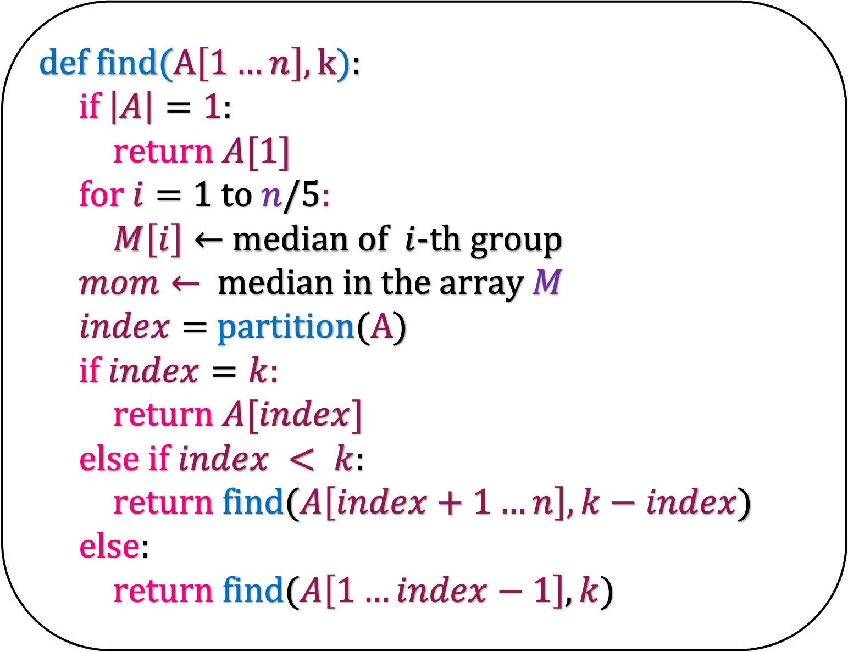
def f$ind(A\left[1…n\right],k$):
if $\left|A\right|=1$:
return $A[1]$
for $i=1$ to $n/5$:
$M\left[i\right]←$ median of $i$-th group
$mom←$median in the array $M$
$index=$partition($A$)
if $index=k:$
return $A[index]$
else if $index < k$:
return find($A\left[index+1…n\right], k−index$)
else:
return find($A\left[1…index−1\right],k$)

Slide 65
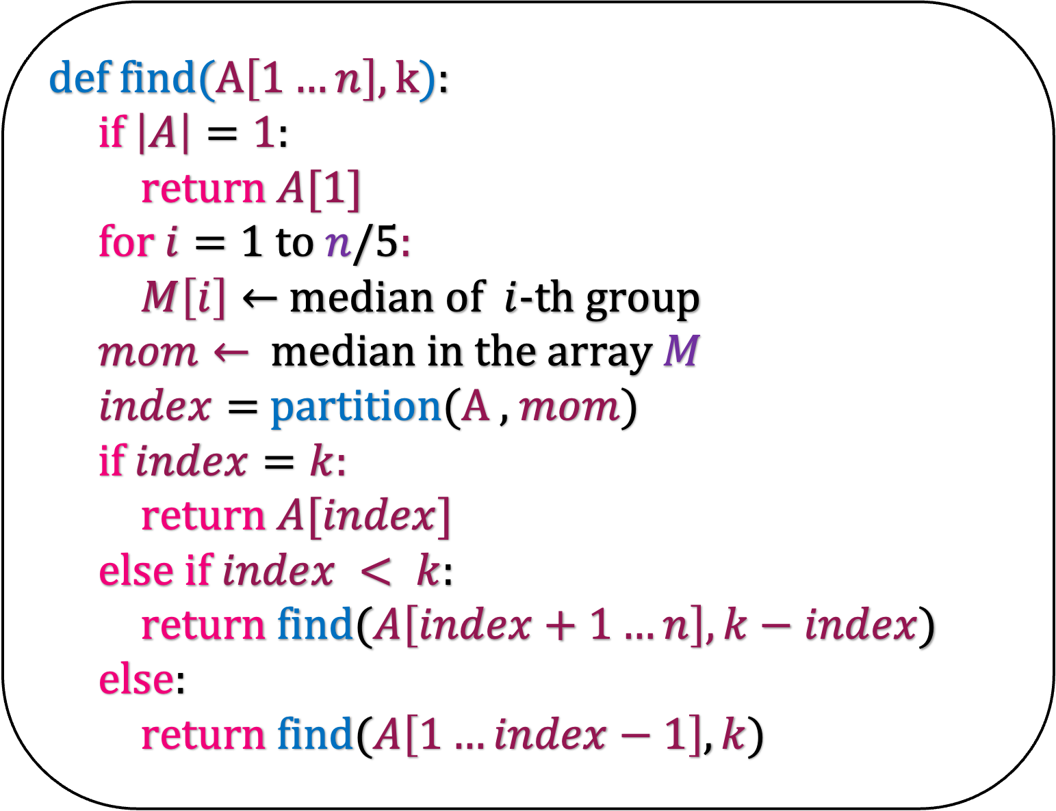
def f$ind(A\left[1…n\right],k$):
if $\left|A\right|=1$:
return $A[1]$
for $i=1$ to $n/5$:
$M\left[i\right]←$ median of $i$-th group
$mom←$median in the array $M$
$index=$partition($A$ , $mom$)
if $index=k:$
return $A[index]$
else if $index < k$:
return find($A\left[index+1…n\right], k−index$)
else:
return find($A\left[1…index−1\right],k$)
But how do you find mom in an array?
Apply our algorithm again

Slide 66
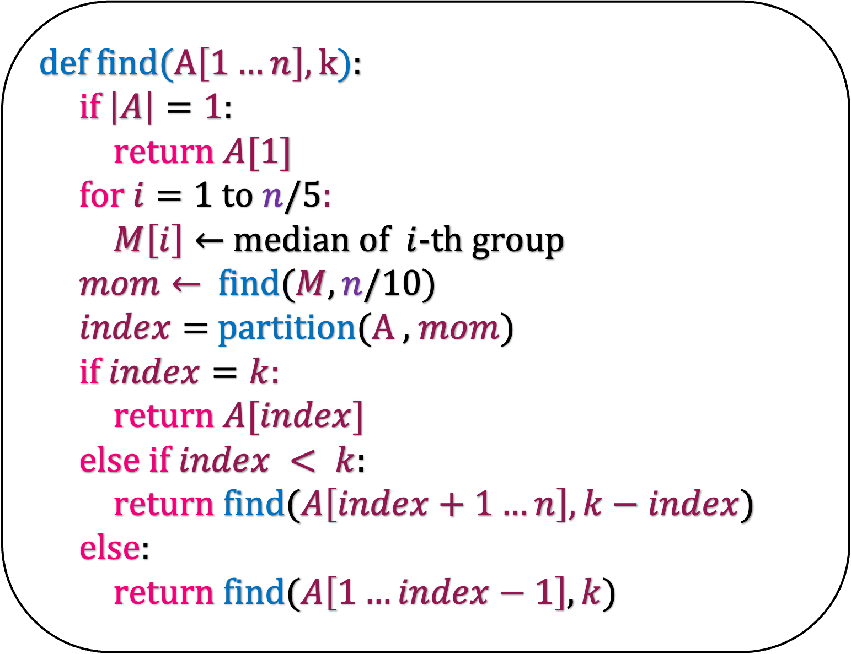
def f$ind(A\left[1…n\right],k$):
if $\left|A\right|=1$:
return $A[1]$
for $i=1$ to $n/5$:
$M\left[i\right]←$ median of $i$-th group
$mom←$find($M,n/10$)
$index=$partition($A$ , $mom$)
if $index=k:$
return $A[index]$
else if $index < k$:
return find($A\left[index+1…n\right], k−index$)
else:
return find($A\left[1…index−1\right],k$)
What is the running time of this algorithm?

Slide 67
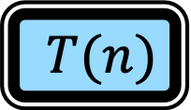
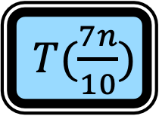



def f$ind(A\left[1…n\right],k$):
if $\left|A\right|=1$:
return $A[1]$
for $i=1$ to $n/5$:
$M\left[i\right]←$ median of $i$-th group
$mom←$find($M,n/10$)
$index=$partition($A$ , $mom$)
if $index=k:$
return $A[index]$
else if $index < k$:
return find($A\left[index+1…n\right], k−index$)
else:
return find($A\left[1…index−1\right],k$)
$T(n)$
$cn$
$T(\frac{n}{5})$
$cn$
$T(\frac{7n}{10})$

Slide 68

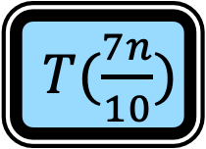
def f$ind(A\left[1…n\right],k$):
if $\left|A\right|=1$:
return $A[1]$
for $i=1$ to $n/5$:
$M\left[i\right]←$ median of $i$-th group
$mom←$find($M,n/10$)
$index=$partition($A$ , $mom$)
if $index=k:$
return $A[index]$
else if $index < k$:
return find($A\left[index+1…n\right], k−index$)
else:
return find($A\left[1…index−1\right],k$)
$T(n)$
$c$
$cn$
$T(\frac{n}{5})$
$cn$
$T(\frac{7n}{10})$

Slide 69

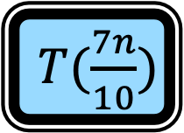
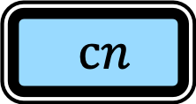
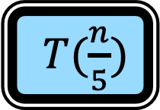
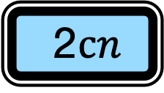
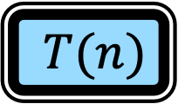

def f$ind(A\left[1…n\right],k$):
if $\left|A\right|=1$:
return $A[1]$
for $i=1$ to $n/5$:
$M\left[i\right]←$ median of $i$-th group
$mom←$find($M,n/10$)
$index=$partition($A$ , $mom$)
if $index=k:$
return $A[index]$
else if $index < k$:
return find($A\left[index+1…n\right], k−index$)
else:
return find($A\left[1…index−1\right],k$)
$T(n)$
$T(\frac{n}{5})$
$T(\frac{7n}{10})$
2$cn$
$cn$
$T(1)$
$c$
How do you solve this recurrence relation?
Guess and Prove

Slide 70

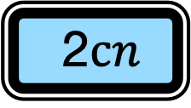
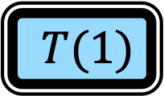
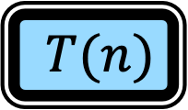

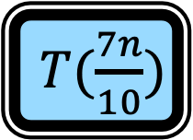
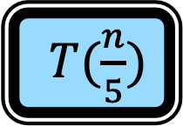
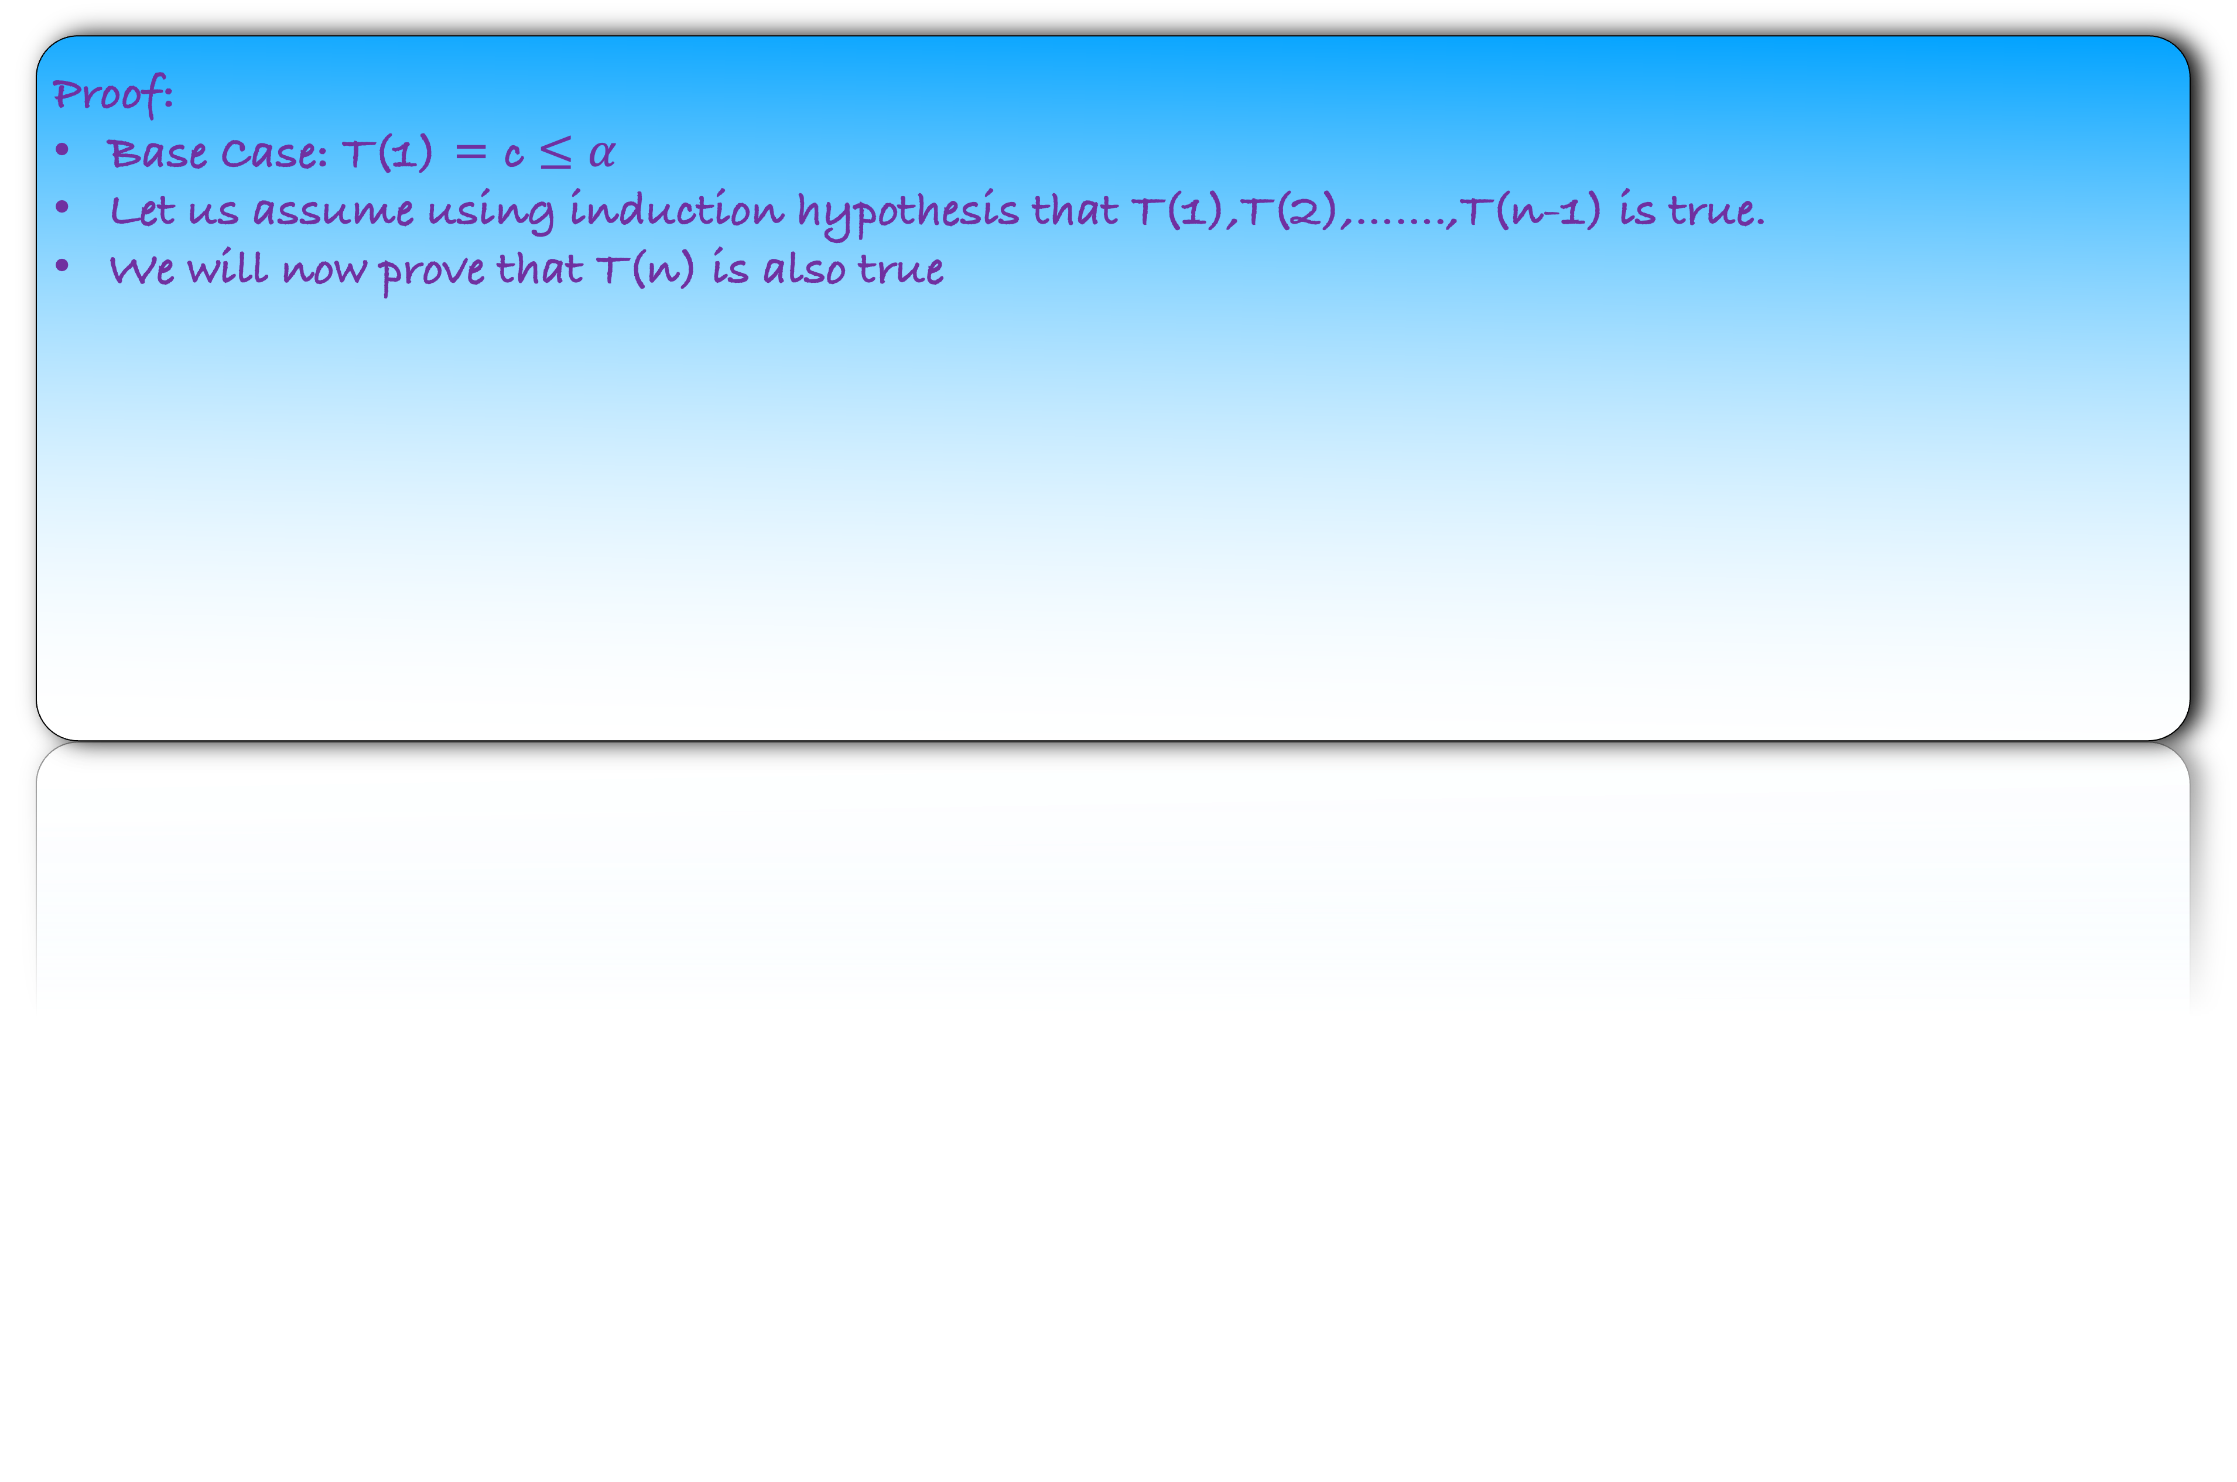
$T(n)$
$T(\frac{n}{5})$
$T(\frac{7n}{10})$
2$cn$
$T(1)$
$c$
Guess: $T\left(n\right)≤αn$ where $α≥c$.
Proof:
Base Case: T(1) = c $≤α$
Let us assume using induction hypothesis that T(1),T(2),…….,T(n-1) is true.
We will now prove that T(n) is also true

Slide 71
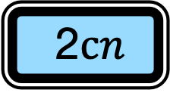
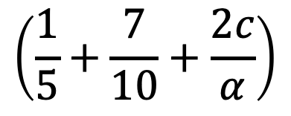
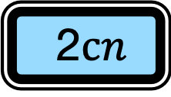
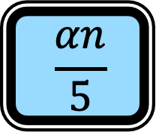
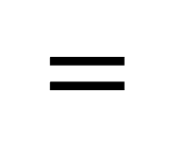
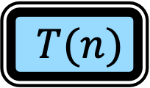

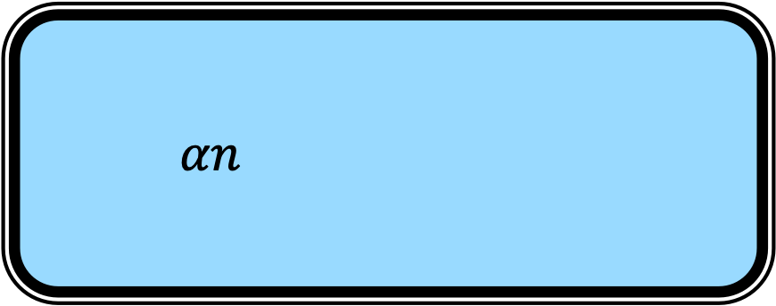
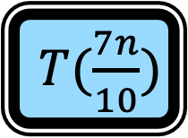

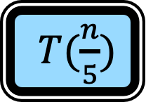
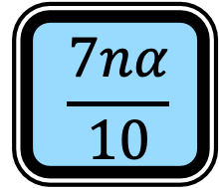
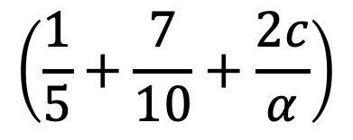
Guess: $T\left(n\right)≤αn$ where $α≥c$.
$T(n)$
$T(\frac{n}{5})$
$T(\frac{7n}{10})$
2$cn$
Using induction hypothesis
$$≤$$
$$\frac{αn}{5}$$
$$\frac{7nα}{10}$$
2$cn$
$$αn$$
$$=$$
$$\left(\frac{1}{5}+\frac{7}{10}+\frac{2c}{α}\right)$$
$$\left(\frac{1}{5}+\frac{7}{10}+\frac{2c}{α}\right)$$

Slide 72

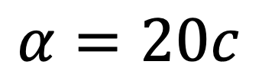
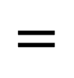
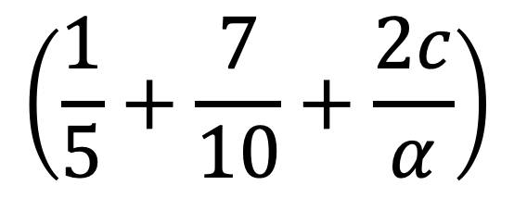
Guess: $T\left(n\right)≤αn$ where $α≥c$.
$T(n)$
$T(\frac{n}{5})$
$T(\frac{7n}{10})$
2$cn$
Using induction hypothesis
$$≤$$
$$\frac{αn}{5}$$
$$\frac{7nα}{10}$$
2$cn$
$$αn$$
$$=$$
$$\left(\frac{1}{5}+\frac{7}{10}+\frac{2c}{α}\right)$$
1
We want
$$\left(\frac{1}{5}+\frac{7}{10}+\frac{2c}{α}\right)$$
$$=$$
Or
$$α=20c$$
Set $α=20c$ and we are done.

