Slide 1
Shortest Path with Negative edges:
Bellman Ford Algorithm

Slide 2
Given a directed weighted graph where each edge has a positive weight, design an algorithm to find the shortest path from a fixed source s to all other vertices in the graph
We have all studies Dijkstra’s algorithm that solves this problem in O((m + n) log n) time.

Slide 3
Given a directed weighted graph where each edge has a
real weight, design an algorithm to find the shortest
path from a fixed source s to all other vertices in the graph
Will Dijkstra’s Algorithm still work?

Slide 4
5
Dijkstra’s Algorithm in a nutshell
Greedy algorithm
Make a ball around s
Repeatedly find the nearest vertex from s and add it to the ball
d
s
10
9
1
b
7
6
3
2
e
8
c
a
4

Slide 5
5
Dijkstra’s Algorithm in a nutshell
Greedy algorithm
Make a ball around s
Repeatedly find the nearest vertex from s and add it to the ball
d
s
10
9
1
b
7
6
3
2
e
8
c
a
4

Slide 6
5
Dijkstra’s Algorithm in a nutshell
Greedy algorithm
Make a ball around s
Repeatedly find the nearest vertex from s and add it to the ball
d
s
10
9
1
b
7
6
3
2
e
8
c
a
4

Slide 7
5
Dijkstra’s Algorithm in a nutshell
Greedy algorithm
Make a ball around s
Repeatedly find the nearest vertex from s and add it to the ball
d
s
10
9
1
b
7
6
3
2
e
8
c
a
4
Why Dijkstra’s algorithm does not work in the presence of negative weights?

Slide 8
5
Dijkstra’s Algorithm in a nutshell
Greedy algorithm
Make a ball around s
Repeatedly find the nearest vertex from s and add it to the ball
d
s
10
9
1
b
7
6
3
-8
e
8
c
a
4

Slide 9
5
Dijkstra’s Algorithm in a nutshell
Greedy algorithm
Make a ball around s
Repeatedly find the nearest vertex from s and add it to the ball
d
s
10
9
1
b
7
6
3
-8
e
8
c
a
4
We have set the shortest path to b as 1. But the shortest path from s to b is -2.

Slide 10
-8
x
y
1
1
s
a
b
c
d
1
t
1
1
1
1
Another problem of cycle with negative weight
We can go through the cycle repeatedly and decrease the shortest path to t
Therefore, let us make our problem slightly simpler
Let us assume that there is no cycle of negative weight in the graph

Slide 11
Another problem of cycle with negative weight
We can go through the cycle repeatedly and decrease the shortest path to t
Therefore, let us make our problem slightly simpler
Let us assume that there is no cycle of negative weight in the graph
How would you solve this problem?
Let's try the most obvious approach: Modify Dijkstra’s algorithm

Slide 12
5
Why Dijkstra’s fails
Once we reach b, Dijkstra’s algorithm fixes the shortest path from s to b
It assumes that we will not see any other shorter path from s to b
And this assumption is true when all the weights are positive
d
s
10
9
5
1
b
7
6
3
-8
e
8
c
a
4
How would you change Dijkstra’s algorithm?

Slide 13
5
Modified Dijkstra’s
Maintain an estimate of the shortest path from s to b
If the estimate decreases, tell each neighbour of b about the new estimate
d
s
10
9
5
1
b
7
6
3
-8
e
8
c
a
4

Slide 14





5
d
s
Estimate
10
5
9
1
s
0
b
7
a
$$∞$$
6
3
b
$$∞$$
-8
e
8
c
$$∞$$
c
a
4
d
$$∞$$
Edges in the graph
e
$$∞$$
Shortest path tree edges

Slide 15


5
d
s
Estimate
10
5
9
1
s
0
0
b
7
a
$$∞$$
6
6
3
b
$$∞$$
1
-8
e
8
c
$$∞$$
$$∞$$
c
a
4
d
$$∞$$
5
Edges in the graph
e
$$∞$$
$$∞$$
Shortest path tree edges

Slide 16
5
d
s
Estimate
10
5
9
1
s
0
0
0
b
7
a
$$∞$$
6
6
6
3
b
$$∞$$
1
-2
-8
e
8
c
$$∞$$
$$∞$$
3
c
a
4
d
$$∞$$
5
5
Edges in the graph
e
$$∞$$
$$∞$$
8
Shortest path tree edges

Slide 17
5
d
s
Estimate
10
5
9
1
s
0
0
0
0
b
7
a
$$∞$$
6
6
6
6
3
b
$$∞$$
1
-2
-2
-8
e
8
c
$$∞$$
$$∞$$
3
1
c
a
4
d
$$∞$$
5
5
3
Edges in the graph
e
$$∞$$
$$∞$$
8
5
Shortest path tree edges

Slide 18
5
d
s
Estimate
10
5
9
1
s
0
0
0
0
0
b
7
a
$$∞$$
6
6
6
6
6
3
b
$$∞$$
1
-2
-2
-2
-8
e
8
c
$$∞$$
$$∞$$
3
1
1
c
a
4
d
$$∞$$
5
5
3
3
Edges in the graph
e
$$∞$$
$$∞$$
8
5
5
Shortest path tree edges
No change

Slide 19







Estimate
s
0
0
0
0
0
Our algorithm stop when it sees no change in the estimates
a
$$∞$$
6
6
6
6
b
$$∞$$
1
-2
-2
-2
c
$$∞$$
$$∞$$
3
1
1
d
$$∞$$
5
5
3
3
e
$$∞$$
$$∞$$
8
5
5

Slide 20
Home Work
Try to code this algorithm
Show that the algorithm is correct (not trivial)
Prove that the running time of this algorithm is O(mn)
But is this a dynamic programming algorithm?
Yes.
Let us formalize the algorithm using the lens of dynamic programming
The dynamic programming approach will make the argument of correctness and running time trivial.

Slide 21







d
s
Estimate
10
5
9
1
s
0
0
0
0
0
b
7
6
a
$$∞$$
6
6
6
6
3
-8
b
$$∞$$
1
-2
-2
-2
e
8
c
$$∞$$
$$∞$$
3
1
1
c
a
4
d
$$∞$$
5
5
3
3
Think about our algorithm again
e
$$∞$$
$$∞$$
8
5
5
What does the first column contain?
The shortest path from s to all other vertices with edge length 0

Slide 22








d
s
Estimate
10
5
9
1
s
0
0
0
0
0
b
7
6
a
$$∞$$
6
6
6
6
3
-8
b
$$∞$$
1
-2
-2
-2
e
8
c
$$∞$$
$$∞$$
3
1
1
c
a
4
d
$$∞$$
5
5
3
3
What does the second column contain?
e
$$∞$$
$$∞$$
8
5
5
The shortest path from s to all other vertices with edge length $≤$ 1

Slide 23

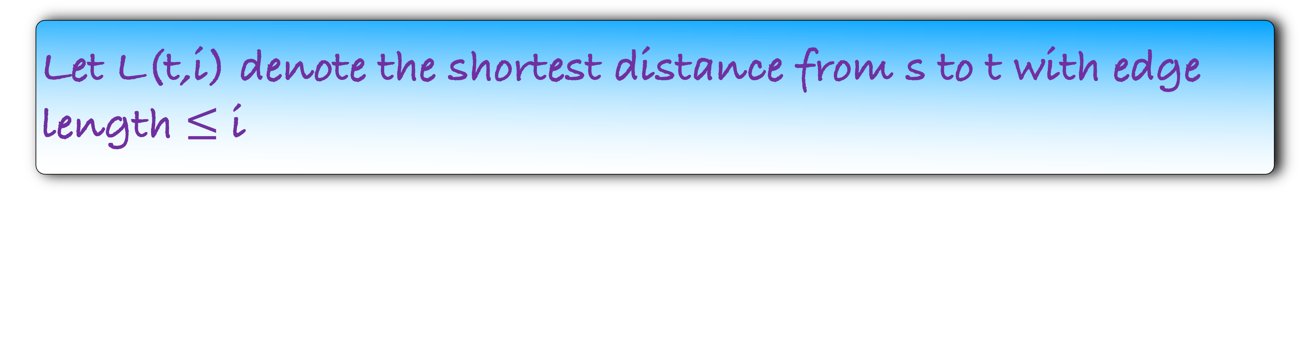
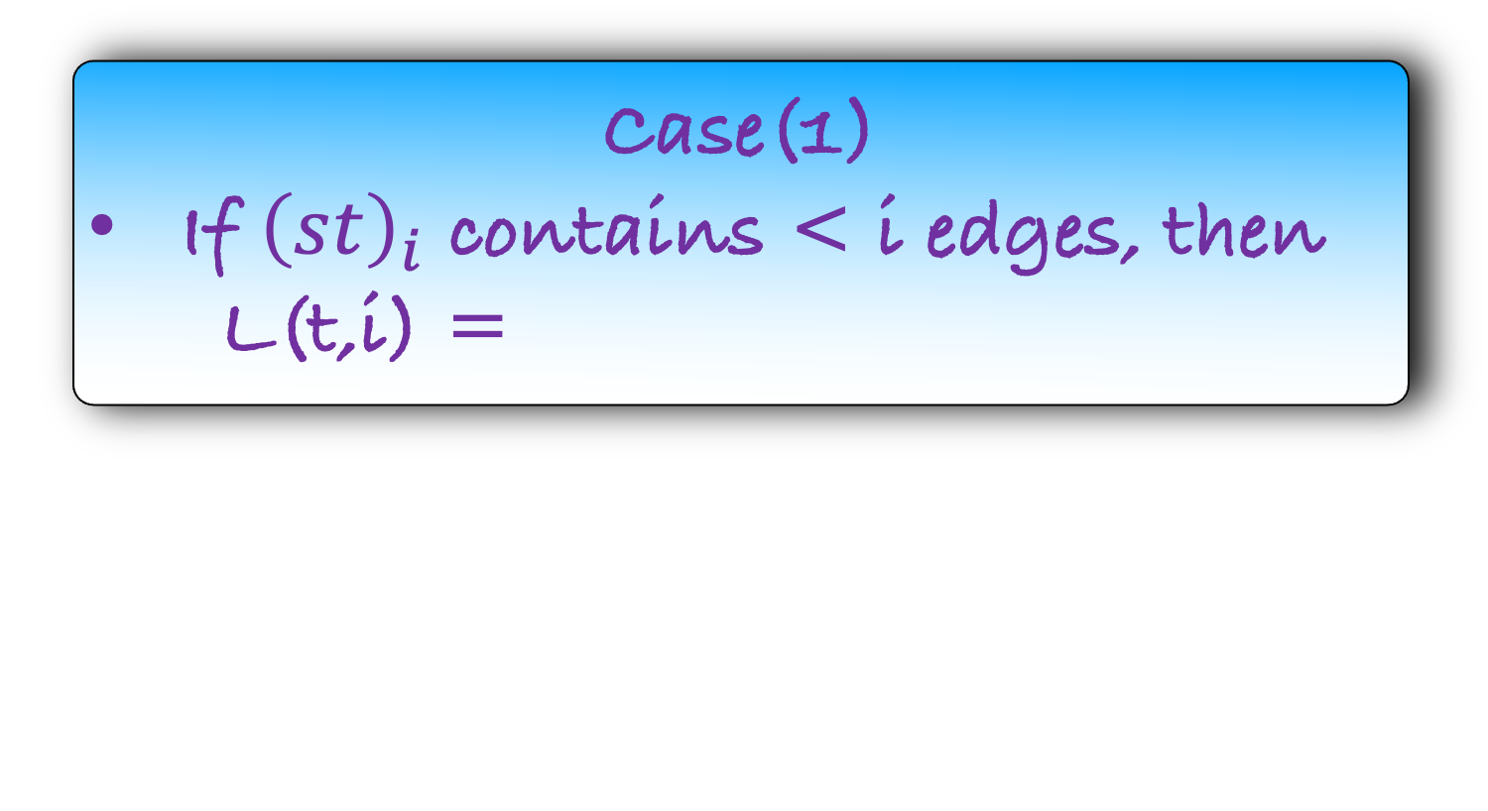
Let L(t,i) denote the shortest distance from s to t with edge length $≤$ i
How will you find L(t,i)?
Consider the shortest path ${\left(st\right)}_{i}$, from s to t that contains $≤$ i edges.
Case(1)
If ${\left(st\right)}_{i}$ contains < i edges, then
L(t,i) =

Slide 24
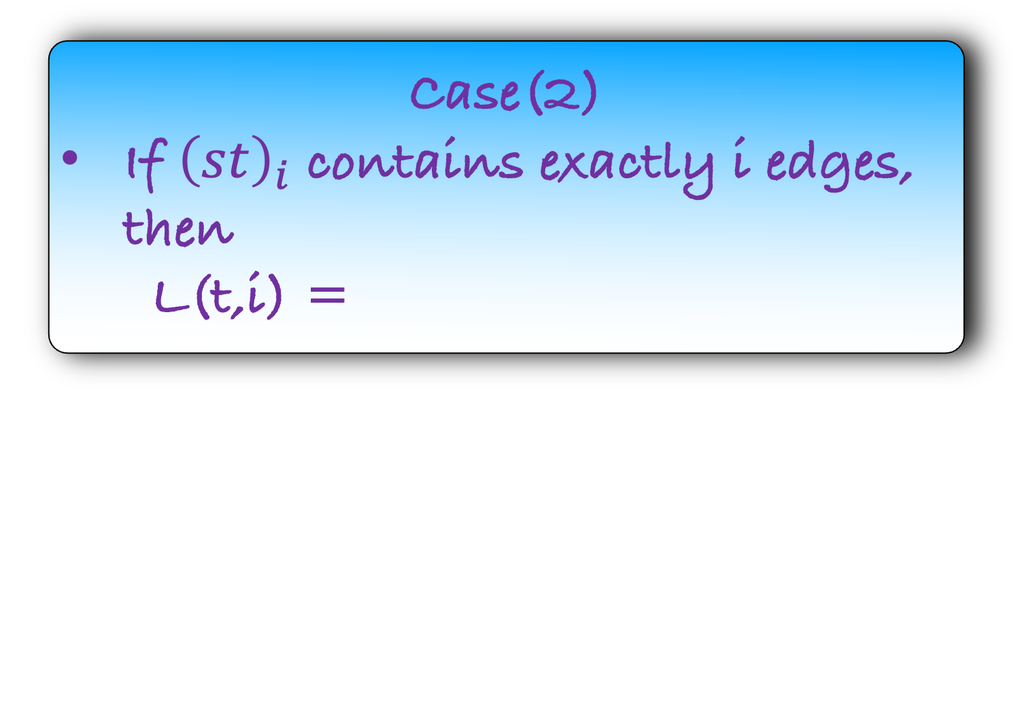
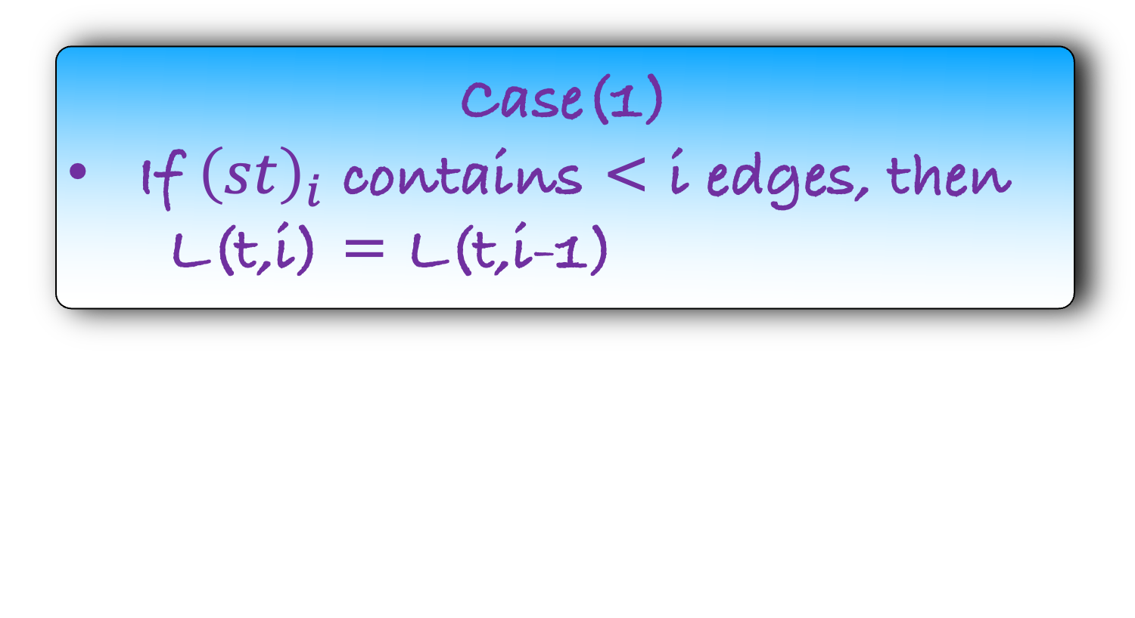
Let L(t,i) denote the shortest distance from s to t with edge length $≤$ i
How will you find L(t,i)?
Consider the shortest path ${\left(st\right)}_{i}$, from s to t that contains $≤$ i edges.
Case(1)
If ${\left(st\right)}_{i}$ contains < i edges, then
L(t,i) = L(t,i-1)
s
a
b
c
d
t
Case(2)
If ${\left(st\right)}_{i}$ contains exactly i edges, then
L(t,i) =

Slide 25
Let L(t,i) denote the shortest distance from s to t with edge length $≤$ i
How will you find L(t,i)?
Consider the shortest path ${\left(st\right)}_{i}$, from s to t that contains $≤$ i edges.
Case(1)
If ${\left(st\right)}_{i}$ contains < i edges, then
L(t,i) = L(t,i-1)
w(d,t)
s
a
b
c
d
t
Case(2)
If ${\left(st\right)}_{i}$ contains exactly i edges, then
L(t,i) =
L(d,i-1)

Slide 26
Let L(t,i) denote the shortest distance from s to t with edge length $≤$ i
How will you find L(t,i)?
Consider the shortest path ${\left(st\right)}_{i}$, from s to t that contains $≤$ i edges.
Case(1)
If ${\left(st\right)}_{i}$ contains < i edges, then
L(t,i) = L(t,i-1)
s
a
b
c
d
t
Case(2)
If ${\left(st\right)}_{i}$ contains exactly i edges, then
L(t,i) =
L(d,i-1)
w(d,t)

Slide 27

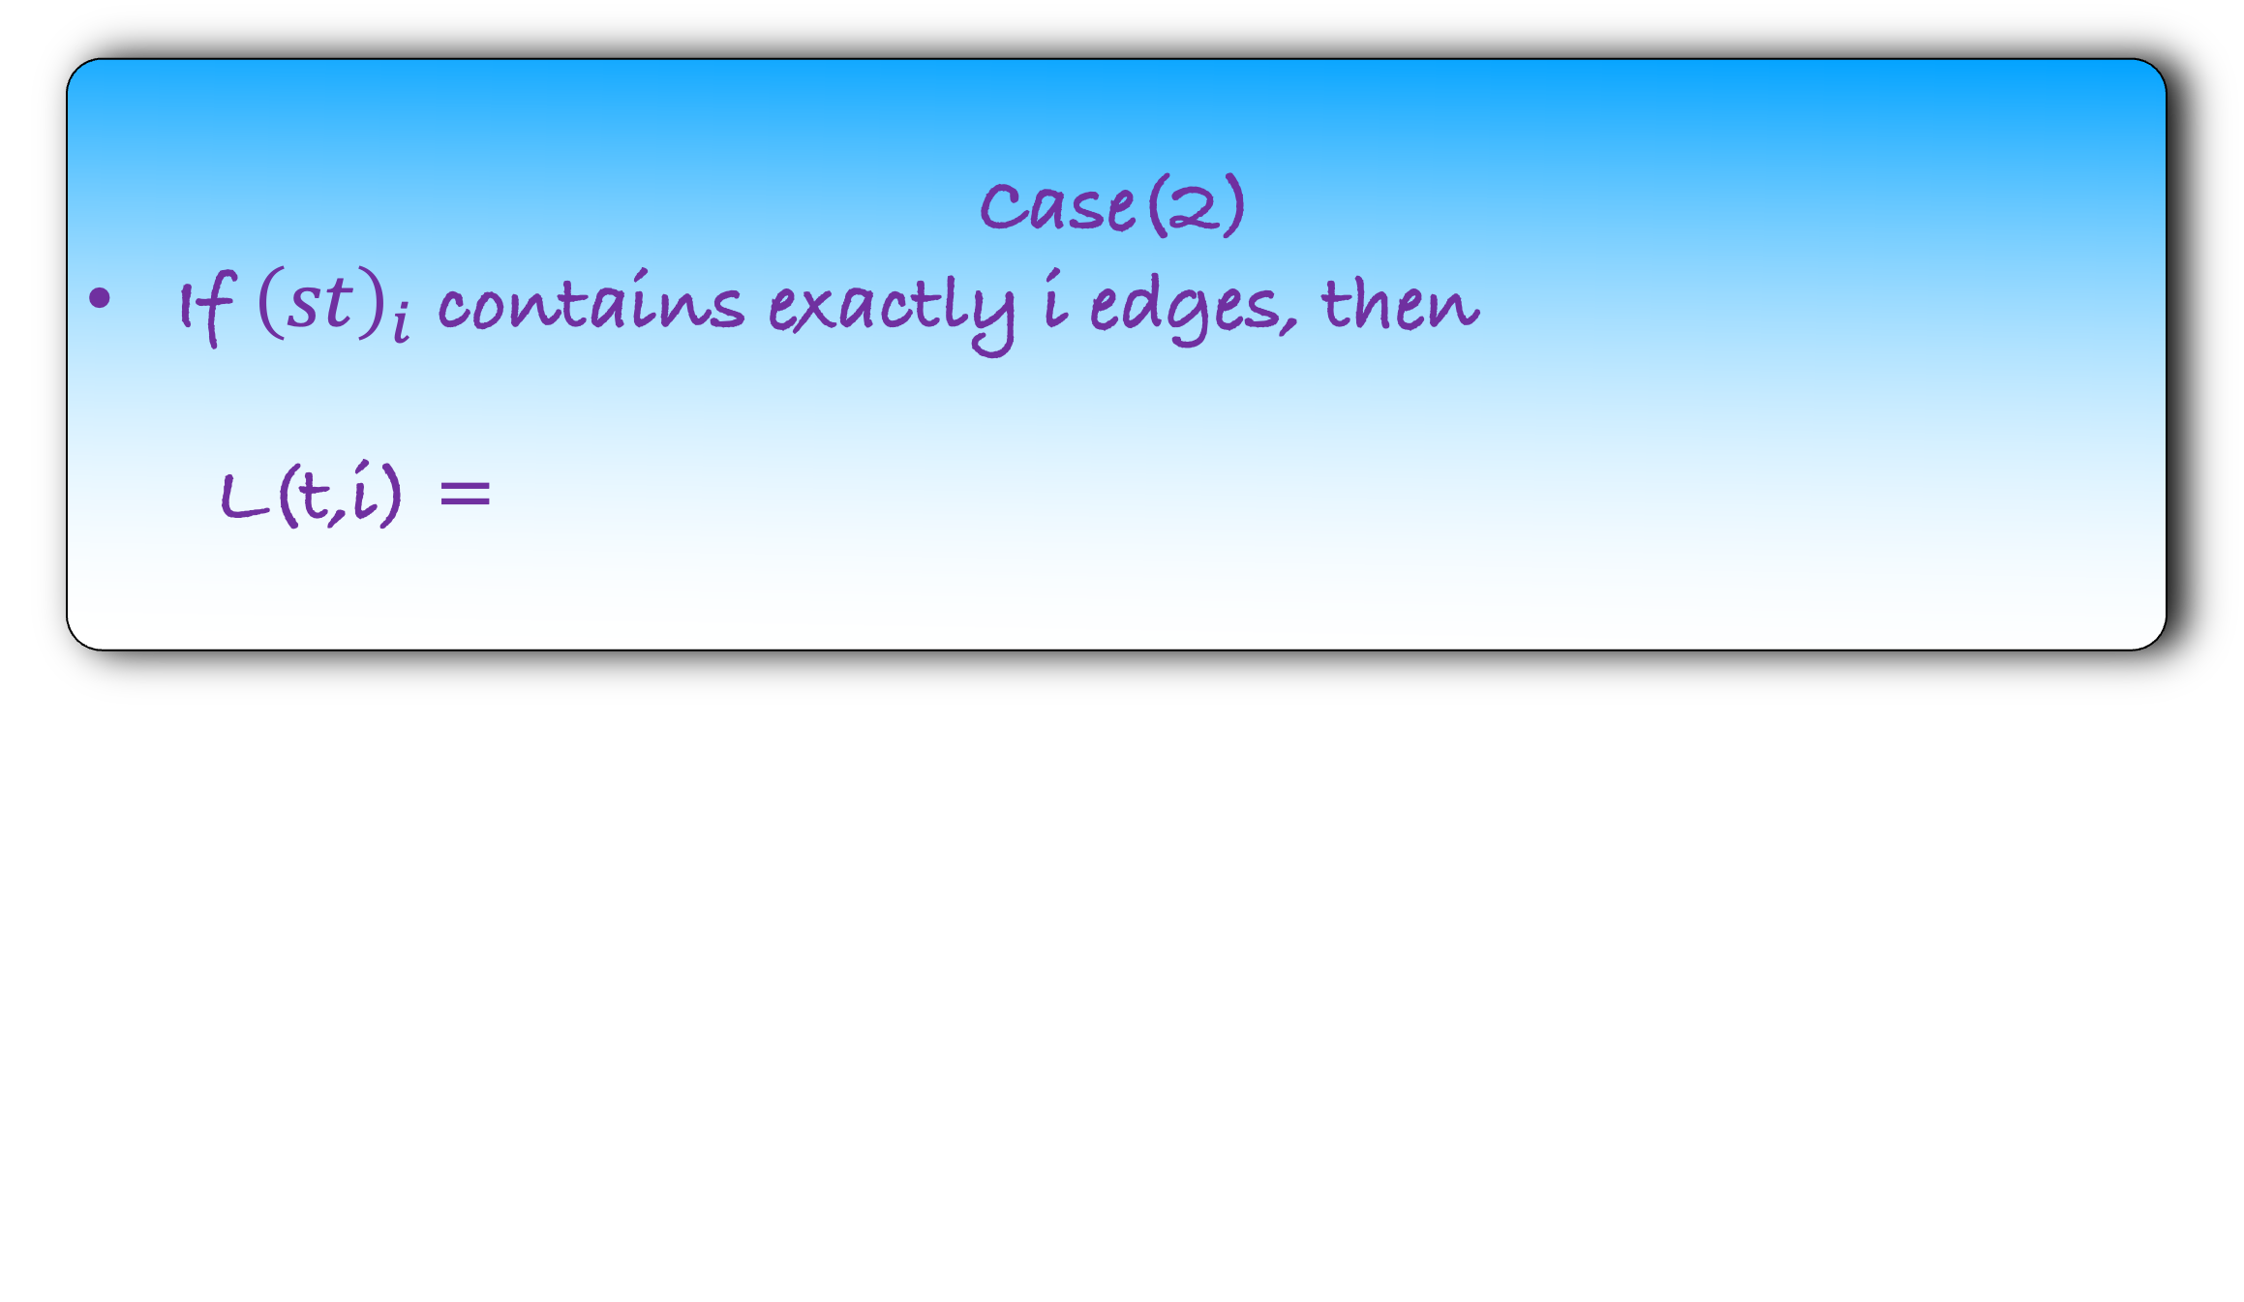
Case(2)
If ${\left(st\right)}_{i}$ contains exactly i edges, then
L(t,i) =
L(d,i-1)
w(d,t)
s
a
b
c
d
t
But we don’t know the second last vertex in ${\left(st\right)}_{i}$?
Try all possible incoming vertex to t. One of them will give is the correct answer

Slide 28
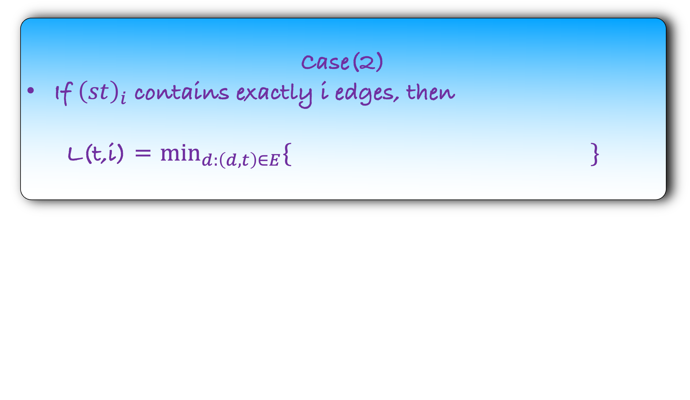
Case(2)
If ${\left(st\right)}_{i}$ contains exactly i edges, then
L(t,i) = $\min_{d:\left(d,t\right)∈E}{\{ \} }$
L(d,i-1)
w(d,t)
s
a
b
c
d
t
But we don’t know the second last vertex in ${\left(st\right)}_{i}$?
Try all possible incoming vertex to t. One of them will give is the correct answer

Slide 29
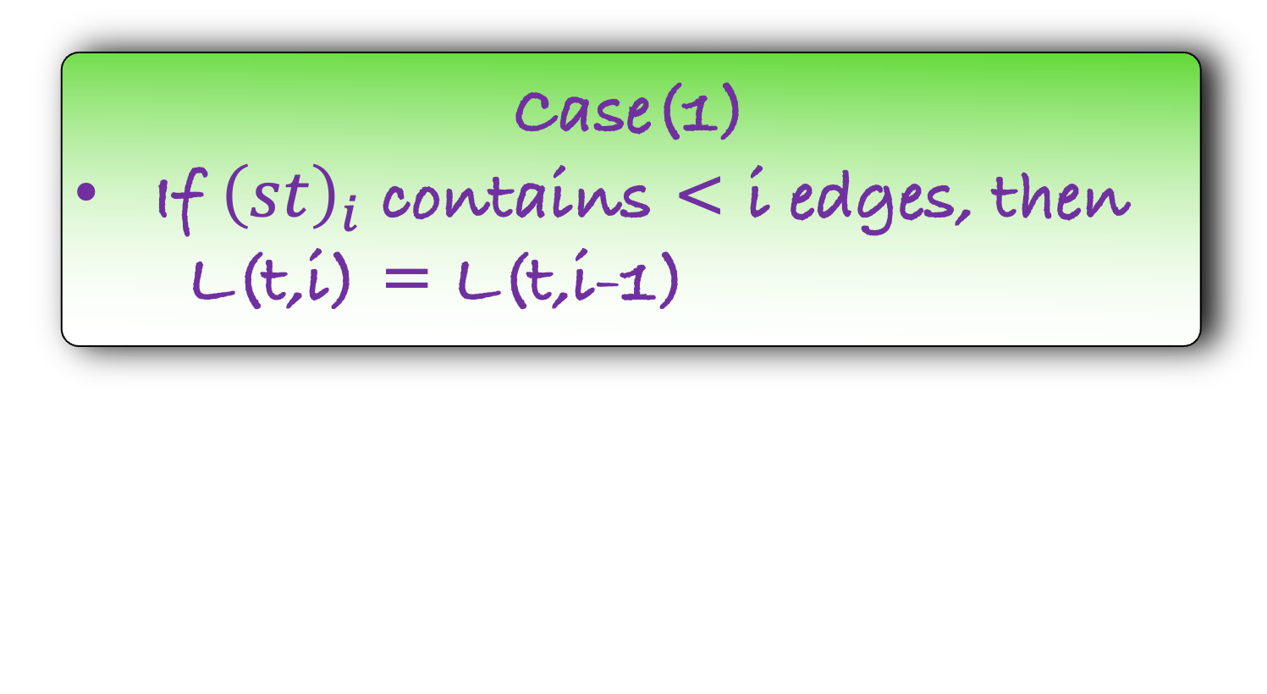
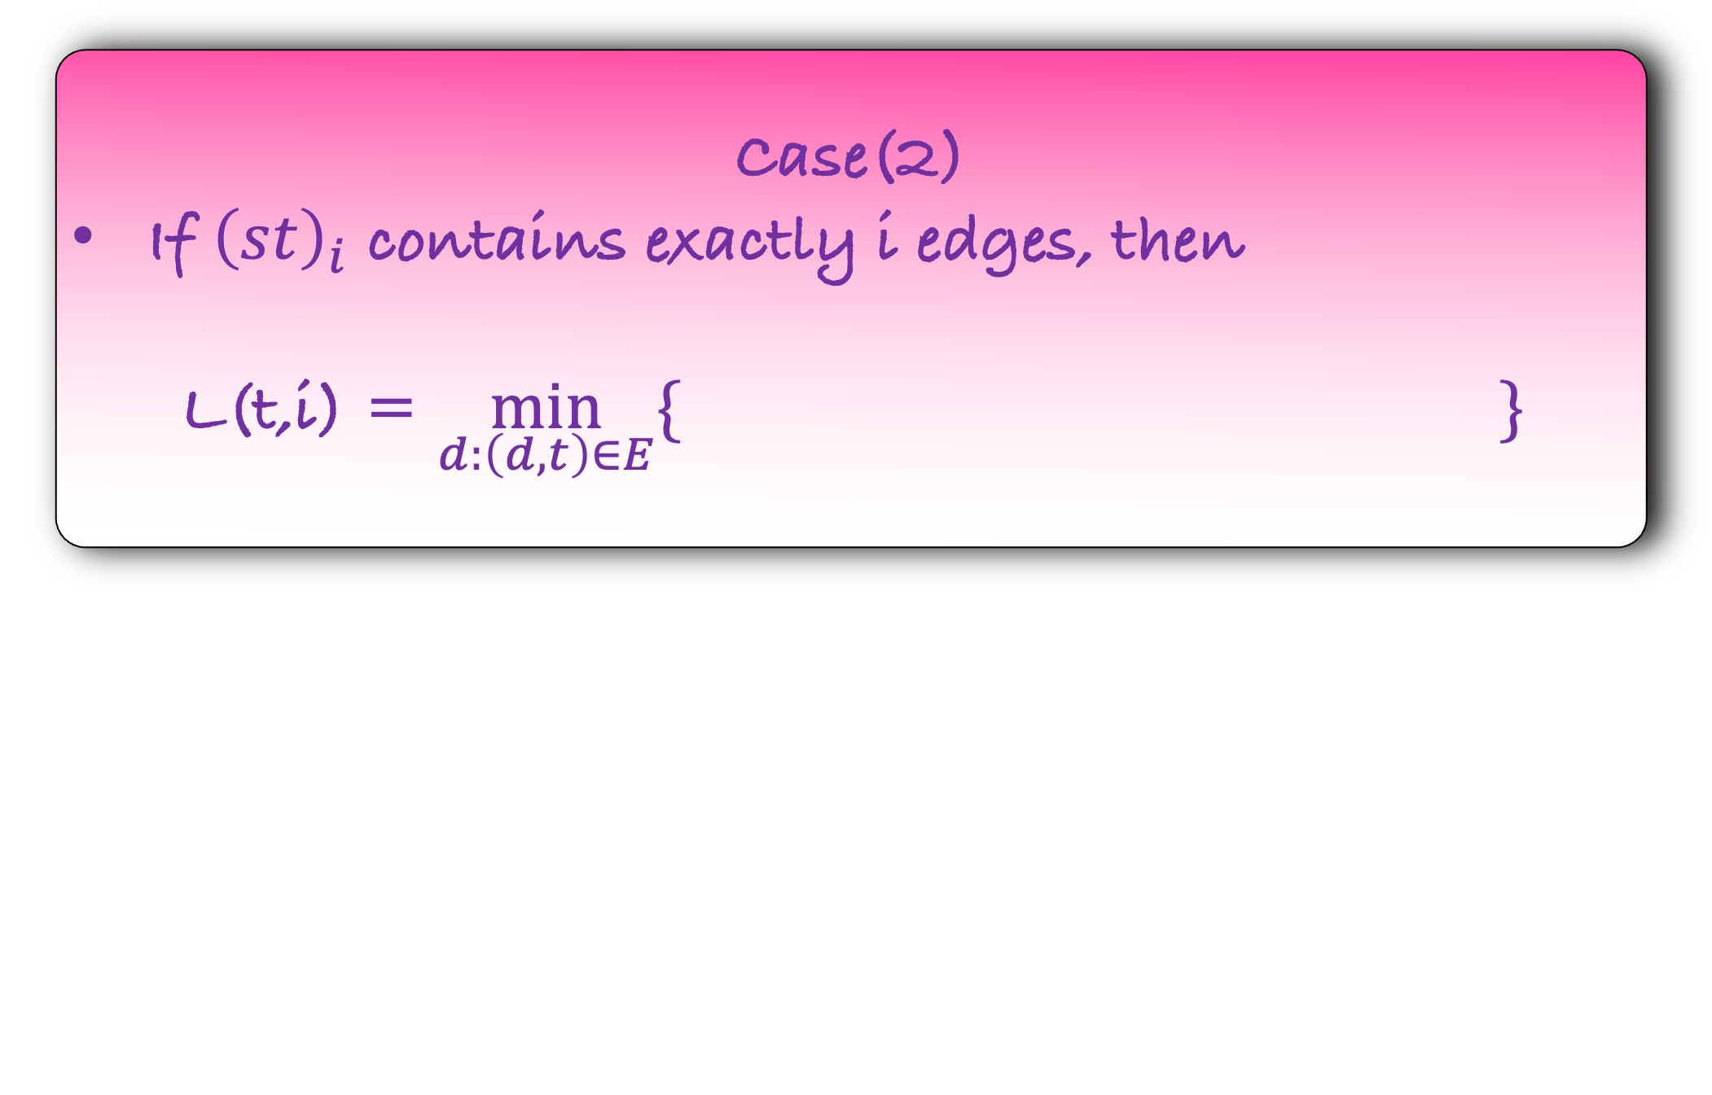
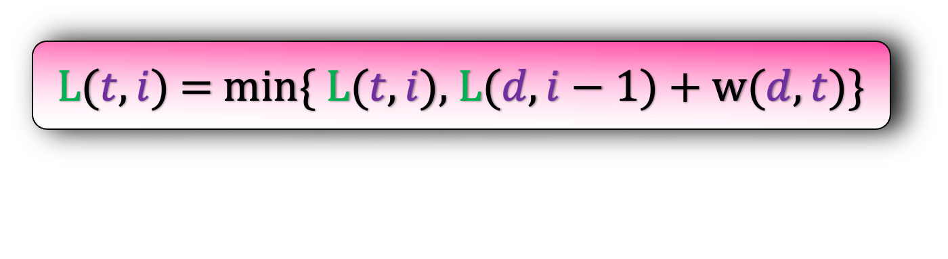
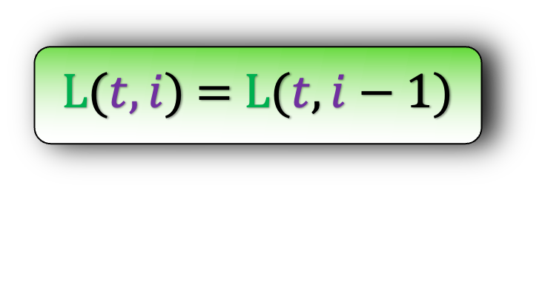
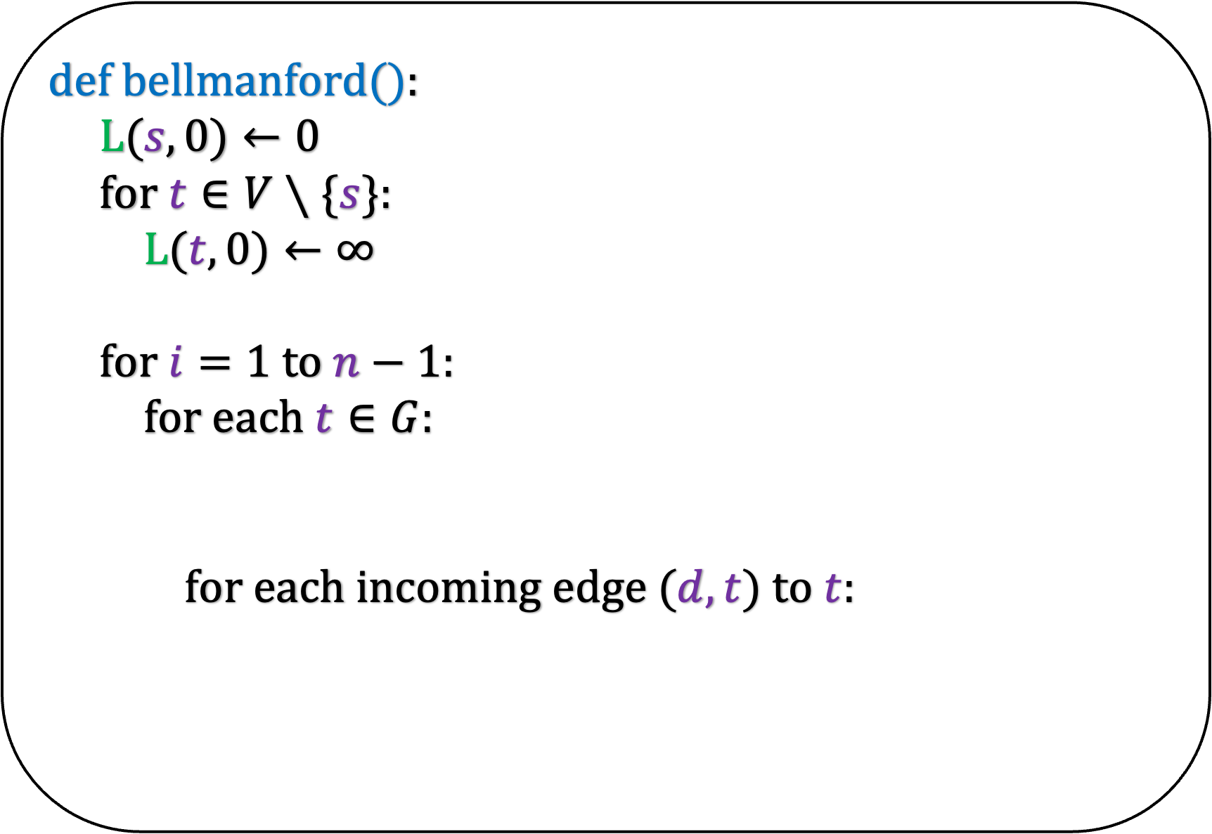
def b$ellmanford($):
L($s,0)←0$
for $t∈V∖\{s\}$:
L($t,0)←∞$
for $i=1$ to $n−1$:
for each $t∈G$:
for each incoming edge $(d,t)$ to $t$:
Case(1)
If ${\left(st\right)}_{i}$ contains < i edges, then
L(t,i) = L(t,i-1)
Case(2)
If ${\left(st\right)}_{i}$ contains exactly i edges, then
L(t,i) = $\min_{d:\left(d,t\right)∈E}{\{ \} }$
L($t,i$) = L($t,i−1$)
L(d,i-1)
w(d,t)
L($t,i$) = min{ L($t,i$), L($d,i−1$) + w($d,t$)}

Slide 30


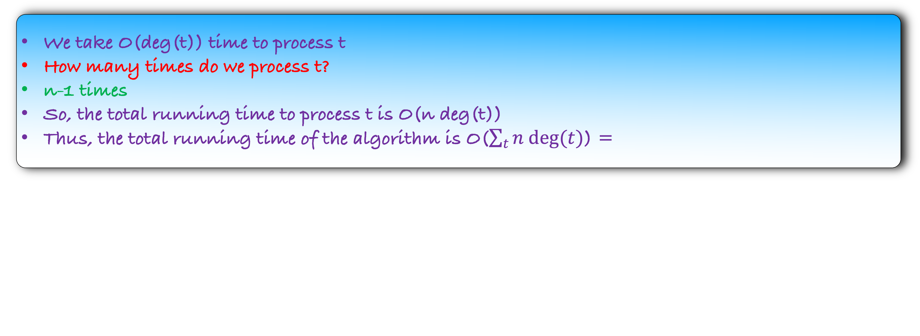
def b$ellmanford($):
L($s,0)←0$
for $t∈V∖\{s\}$:
L($t,0)←∞$
for $i=1$ to $n−1$:
for each $t∈G$:
for each incoming edge $(d,t)$ to $t$:
What is the running time of this algorithm?
O($n$)
L($t,i$) = L($t,i−1$)
O($deg⁡(t)$)
L($t,i$) = min{ L($t,i$), L($d,i−1$) + w($d,t$)}
We take O(deg(t)) time to process t
How many times do we process t?
n-1 times
So, the total running time to process t is O(n deg(t))
Thus, the total running time of the algorithm is O($\sum_{t}{n deg(t)}$) =

Slide 31
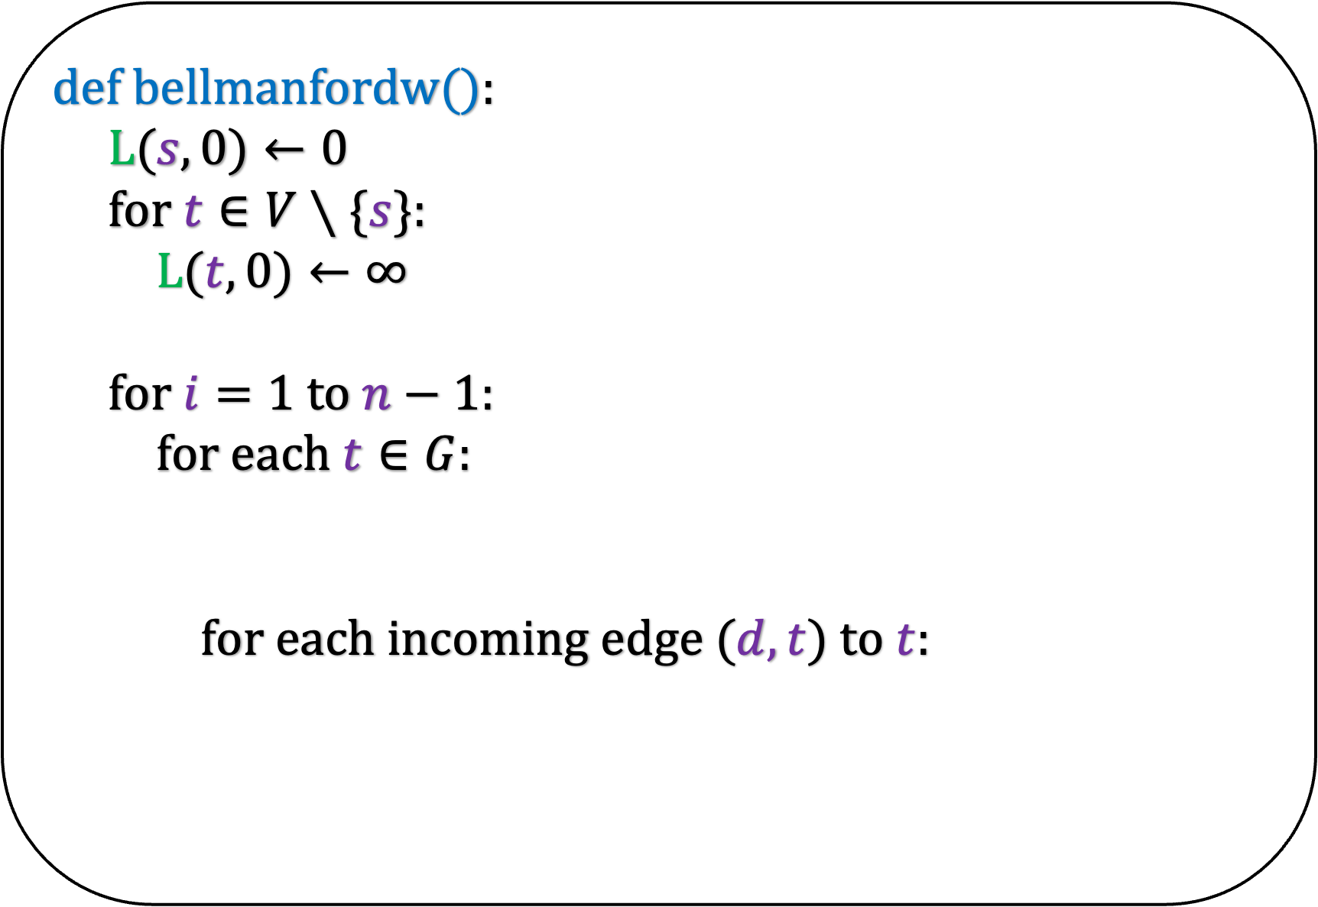

def b$ellmanfordw($):
L($s,0)←0$
for $t∈V∖\{s\}$:
L($t,0)←∞$
for $i=1$ to $n−1$:
for each $t∈G$:
for each incoming edge $(d,t)$ to $t$:
What is the running time of this algorithm?
O($n$)
L($t,i$) = L($t,i−1$)
O($deg⁡(t)$)
L($t,i$) = min{ L($t,i$), L($d,i−1$) + w($d,t$)}
We take O(deg(t)) time to process t
How many times do we process t?
n-1 times
So, the total running time to process t is O(n deg(t))
Thus, the total running time of the algorithm is O($\sum_{t}{n deg(t)}$) = O(mn)

Slide 32
Proof

Slide 33
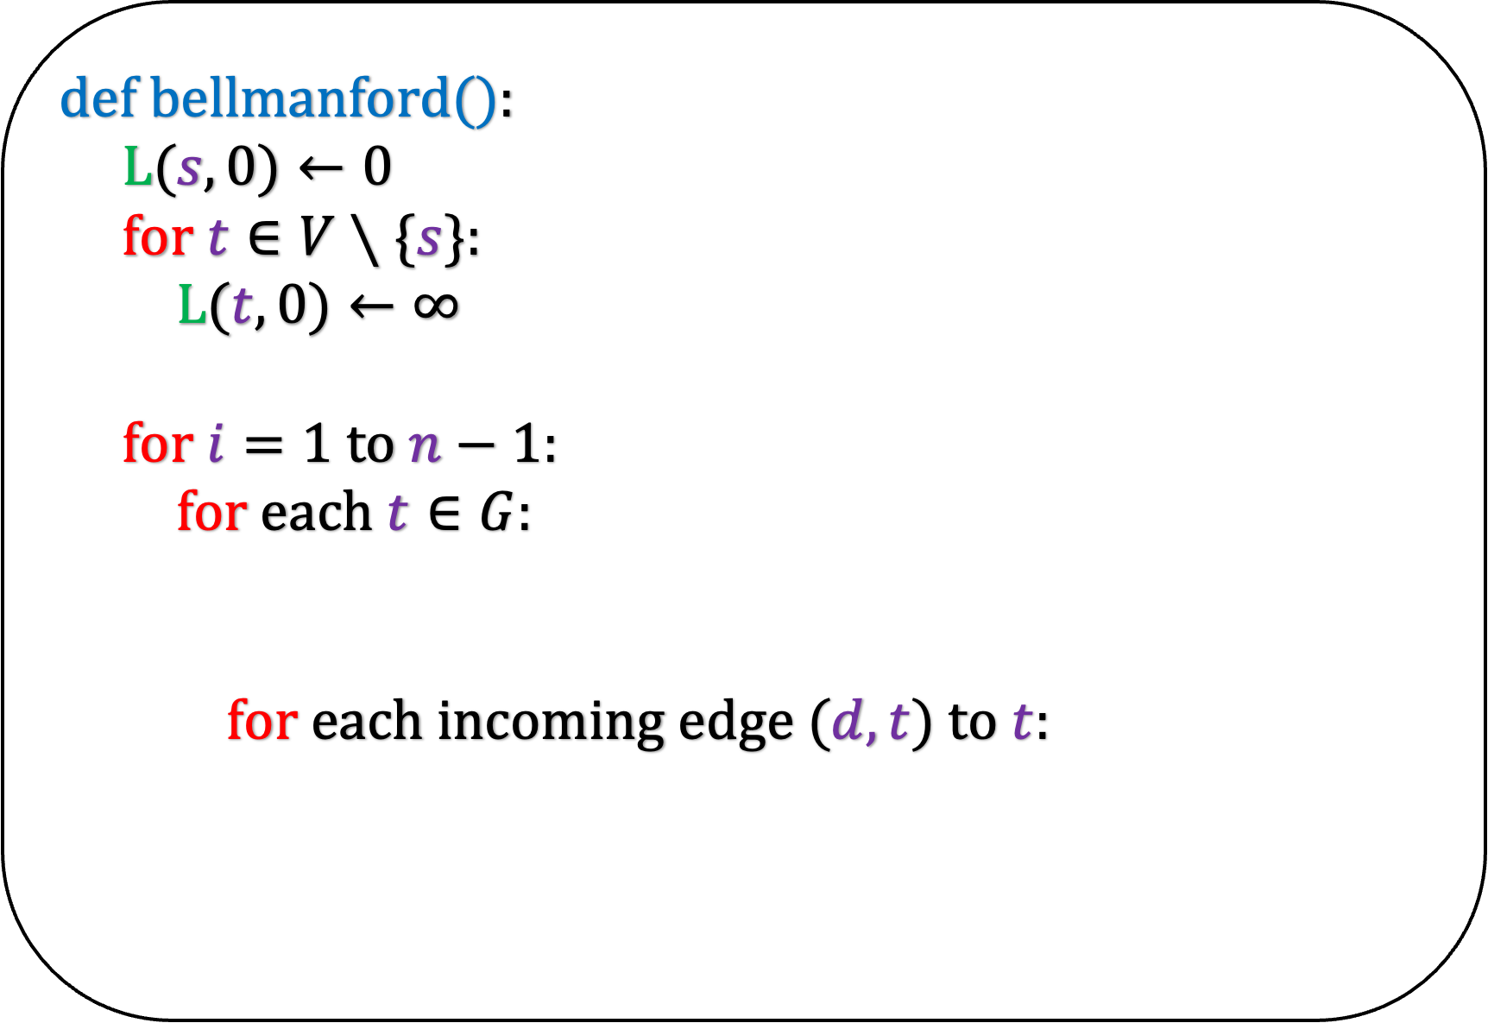

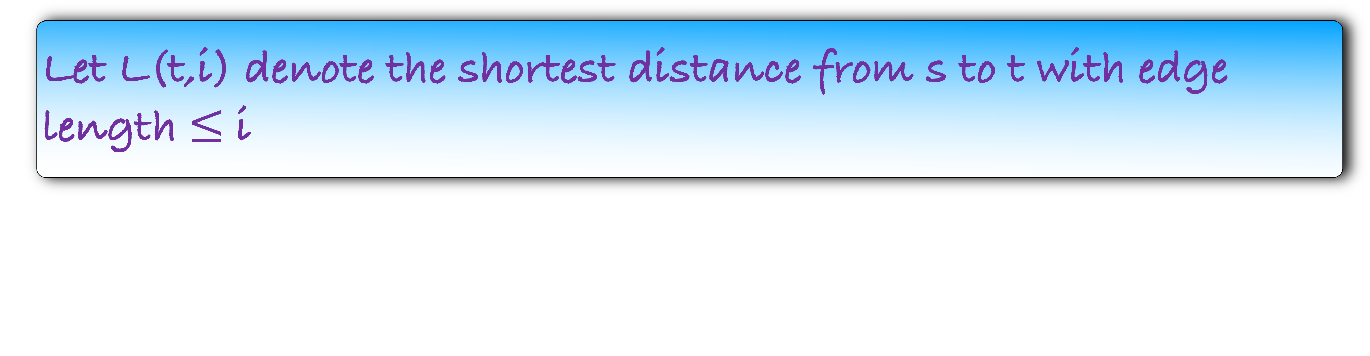
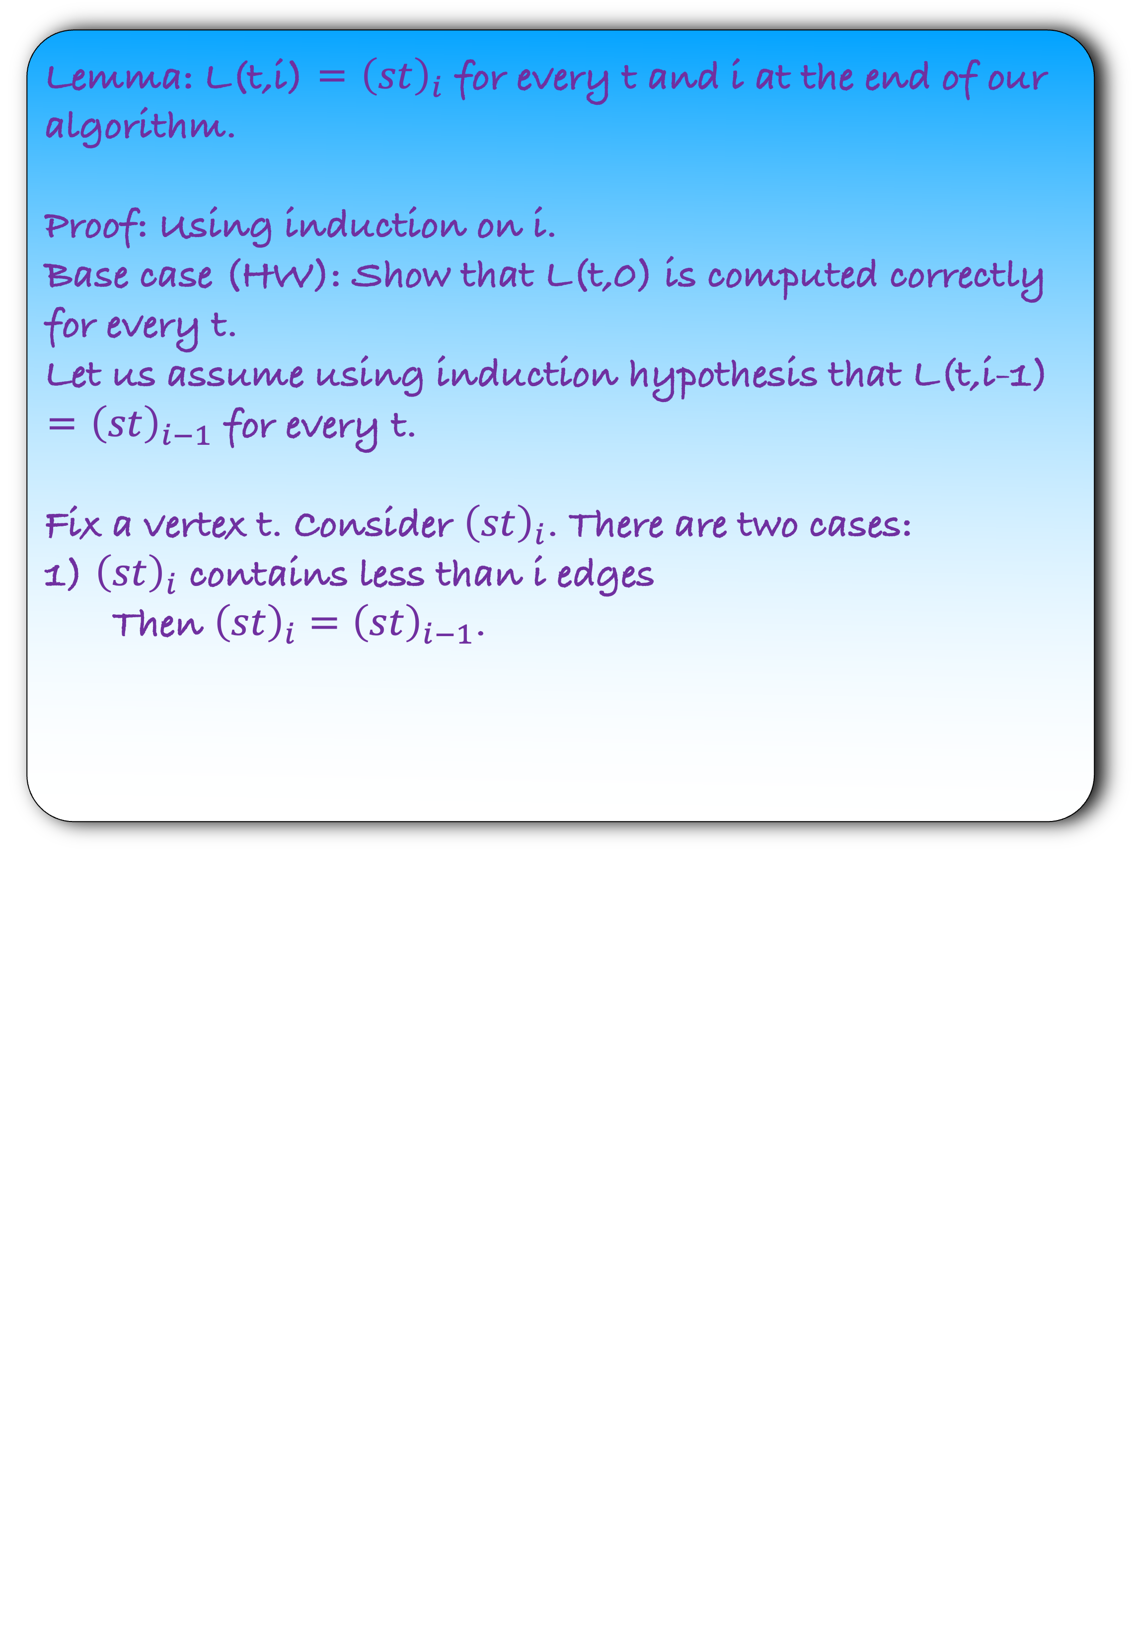

Let L(t,i) denote the shortest distance from s to t with edge length $≤$ i
def b$ellmanford($):
L($s,0)←0$
for $t∈V∖\{s\}$:
L($t,0)←∞$
for $i=1$ to $n−1$:
for each $t∈G$:
for each incoming edge $(d,t)$ to $t$:
Lemma: L(t,i) = ${\left(st\right)}_{i}$ for every t and i at the end of our algorithm.
Proof: Using induction on i.
Base case (HW): Show that L(t,0) is computed correctly for every t.
Let us assume using induction hypothesis that L(t,i-1) = ${\left(st\right)}_{i−1}$ for every t.
Fix a vertex t. Consider ${\left(st\right)}_{i}$. There are two cases:
1) ${\left(st\right)}_{i}$ contains less than i edges
Then ${\left(st\right)}_{i}={\left(st\right)}_{i−1}$.
L($t,i$) = L($t,i−1$)
L($t,i$) = min{ L($t,i$), L($d,i−1$) + w($d,t$)}

Slide 34
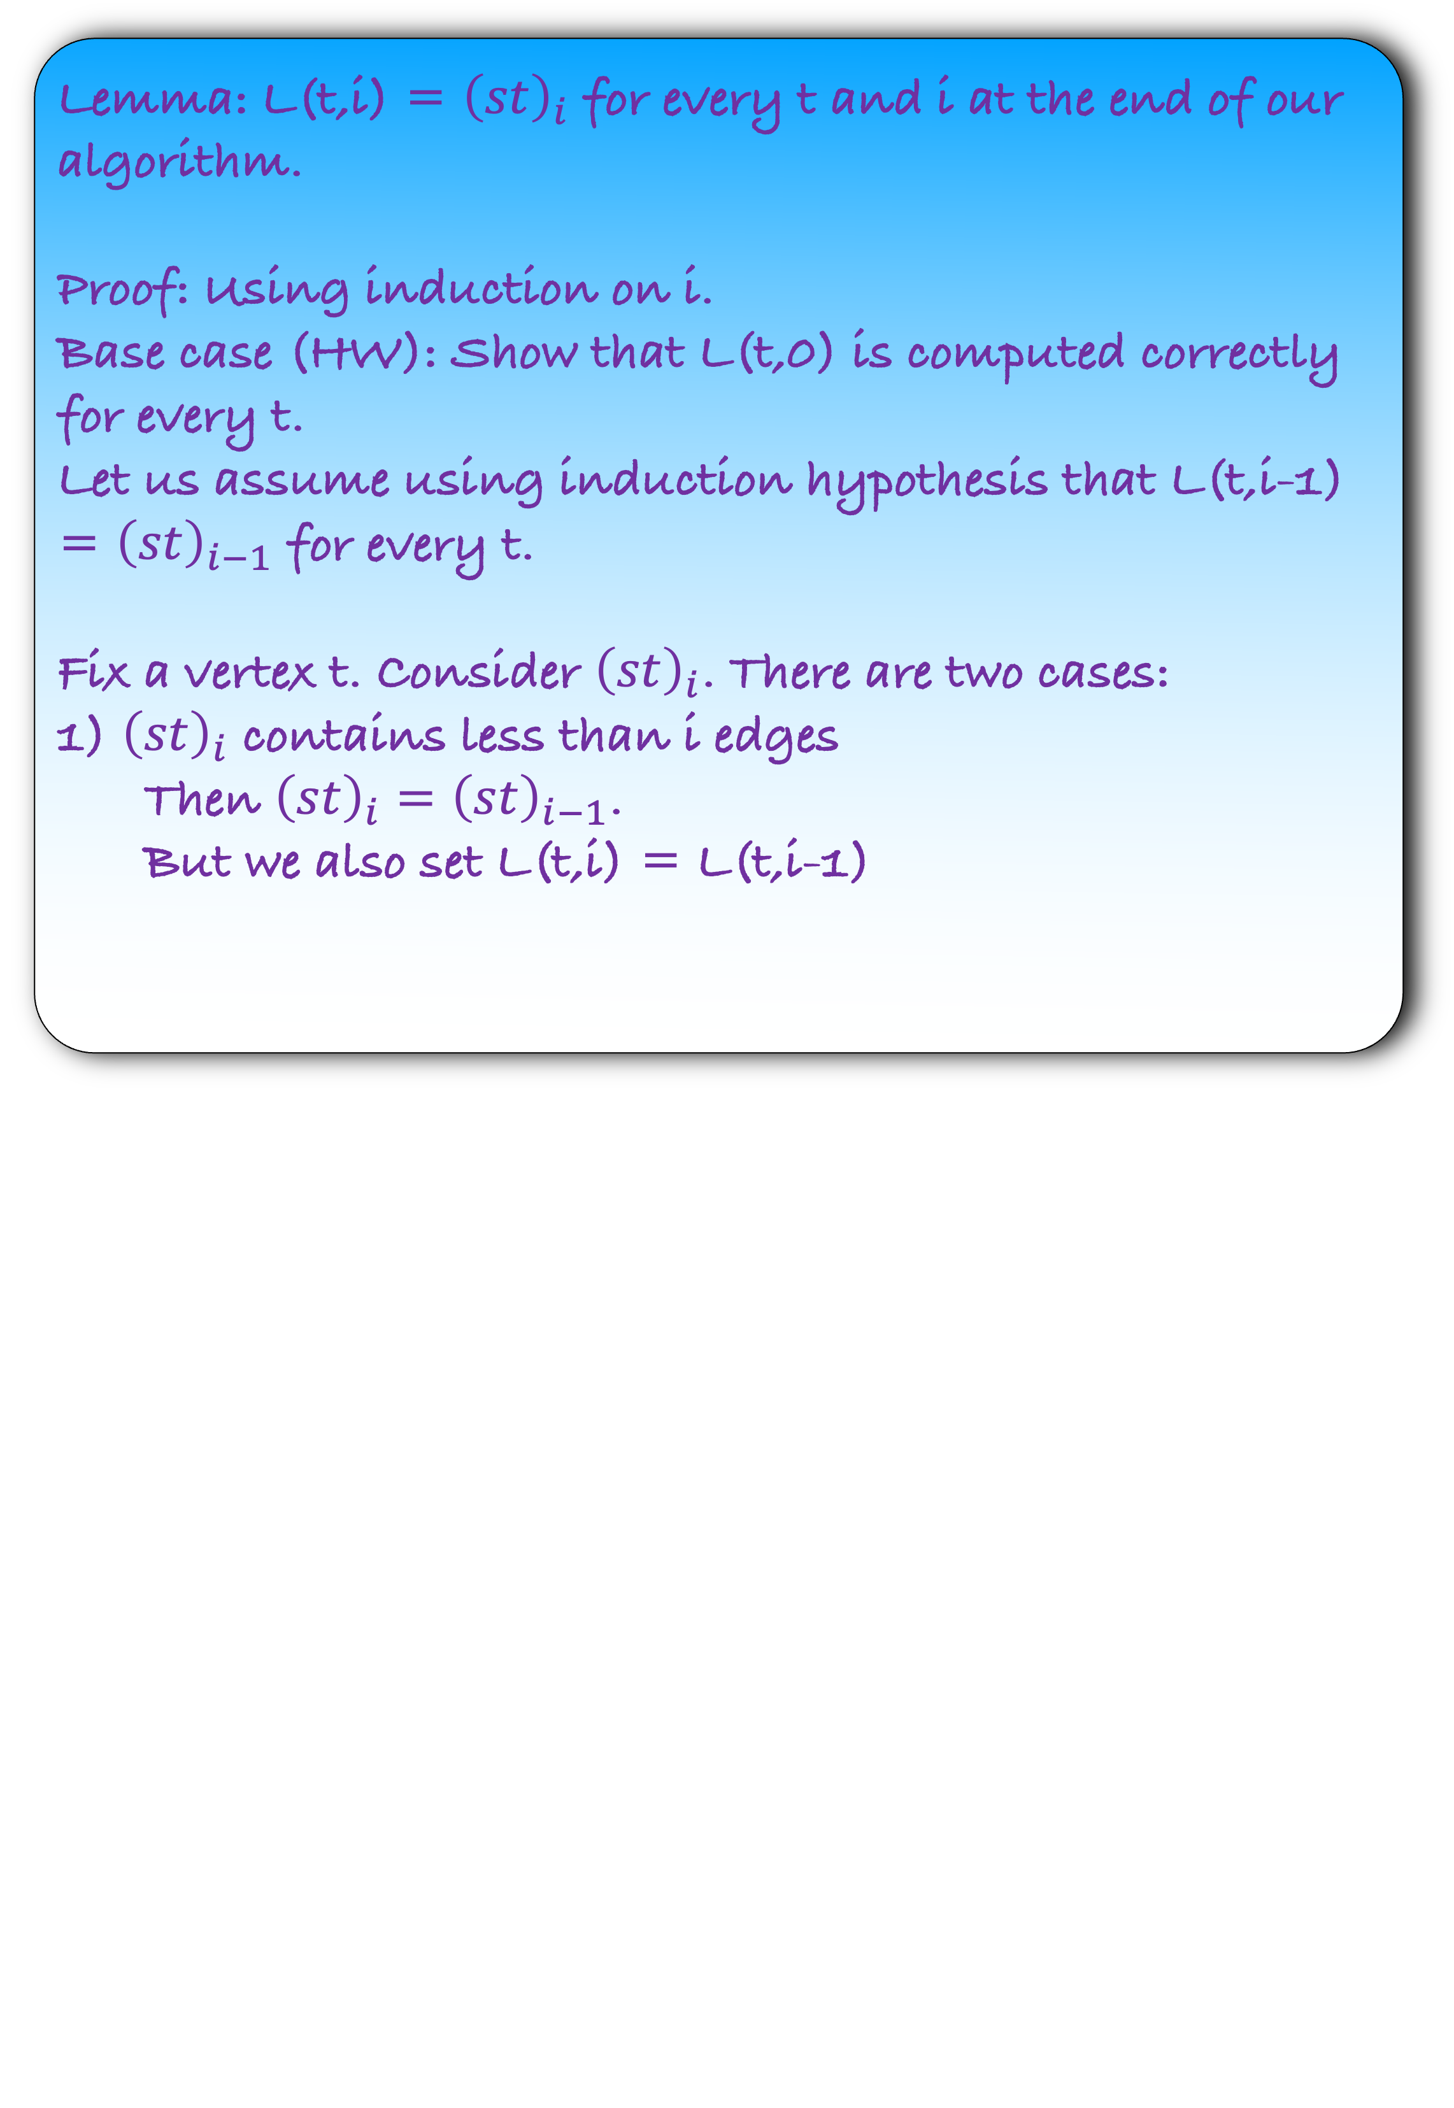
Let L(t,i) denote the shortest distance from s to t with edge length $≤$ i
def b$ellmanford($):
L($s,0)←0$
for $t∈V∖\{s\}$:
L($t,0)←∞$
for $i=1$ to $n−1$:
for each $t∈G$:
for each incoming edge $(d,t)$ to $t$:
Lemma: L(t,i) = ${\left(st\right)}_{i}$ for every t and i at the end of our algorithm.
Proof: Using induction on i.
Base case (HW): Show that L(t,0) is computed correctly for every t.
Let us assume using induction hypothesis that L(t,i-1) = ${\left(st\right)}_{i−1}$ for every t.
Fix a vertex t. Consider ${\left(st\right)}_{i}$. There are two cases:
1) ${\left(st\right)}_{i}$ contains less than i edges
Then ${\left(st\right)}_{i}={\left(st\right)}_{i−1}$.
But we also set L(t,i) = L(t,i-1)
L($t,i$) = L($t,i−1$)
L($t,i$) = min{ L($t,i$), L($d,i−1$) + w($d,t$)}

Slide 35
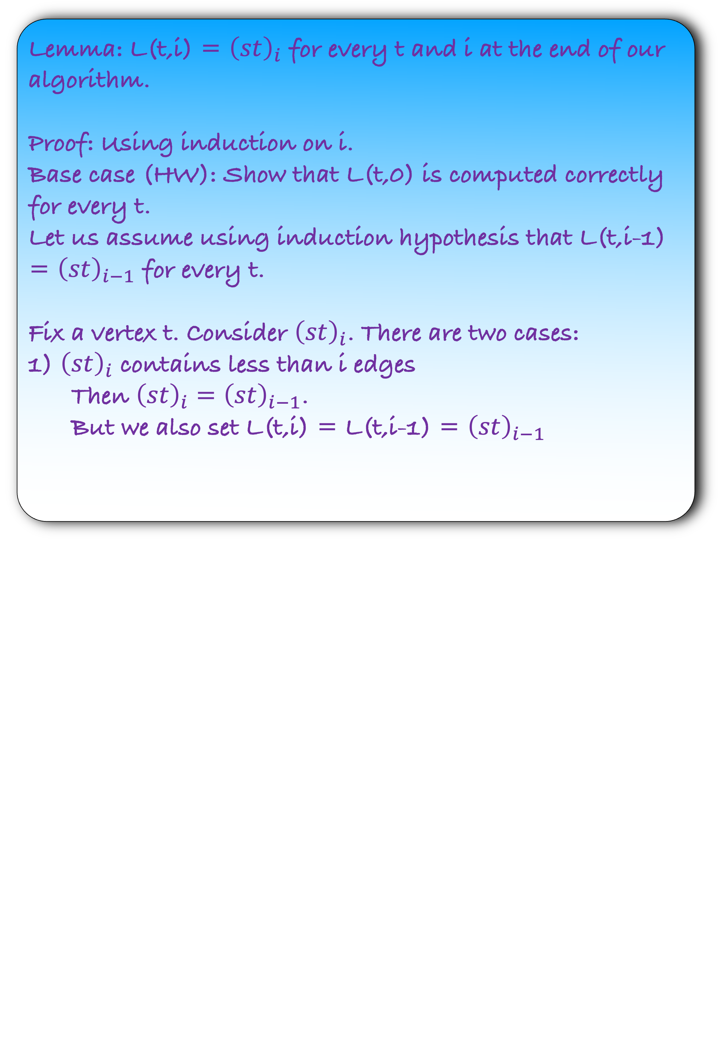
Let L(t,i) denote the shortest distance from s to t with edge length $≤$ i
def b$ellmanford($):
L($s,0)←0$
for $t∈V∖\{s\}$:
L($t,0)←∞$
for $i=1$ to $n−1$:
for each $t∈G$:
for each incoming edge $(d,t)$ to $t$:
Lemma: L(t,i) = ${\left(st\right)}_{i}$ for every t and i at the end of our algorithm.
Proof: Using induction on i.
Base case (HW): Show that L(t,0) is computed correctly for every t.
Let us assume using induction hypothesis that L(t,i-1) = ${\left(st\right)}_{i−1}$ for every t.
Fix a vertex t. Consider ${\left(st\right)}_{i}$. There are two cases:
1) ${\left(st\right)}_{i}$ contains less than i edges
Then ${\left(st\right)}_{i}={\left(st\right)}_{i−1}$.
But we also set L(t,i) = L(t,i-1) = ${\left(st\right)}_{i−1}$
L($t,i$) = L($t,i−1$)
L($t,i$) = min{ L($t,i$), L($d,i−1$) + w($d,t$)}

Slide 36
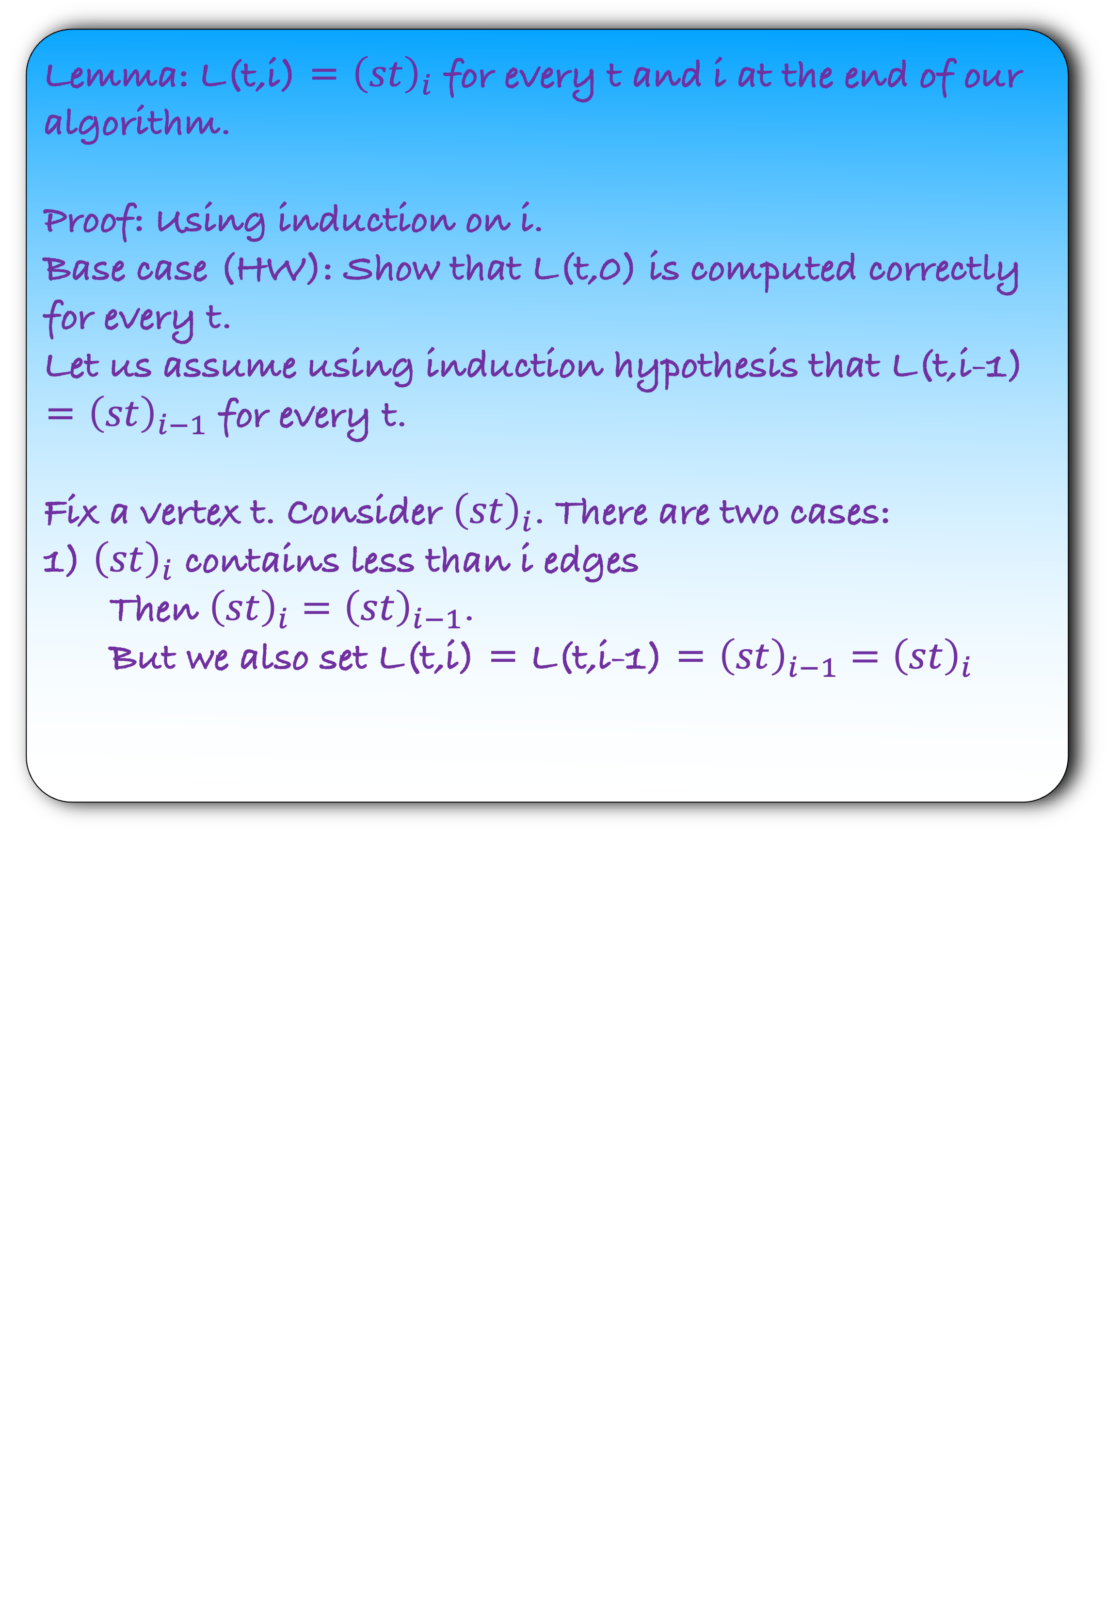
Let L(t,i) denote the shortest distance from s to t with edge length $≤$ i
def b$ellmanford($):
L($s,0)←0$
for $t∈V∖\{s\}$:
L($t,0)←∞$
for $i=1$ to $n−1$:
for each $t∈G$:
for each incoming edge $(d,t)$ to $t$:
Lemma: L(t,i) = ${\left(st\right)}_{i}$ for every t and i at the end of our algorithm.
Proof: Using induction on i.
Base case (HW): Show that L(t,0) is computed correctly for every t.
Let us assume using induction hypothesis that L(t,i-1) = ${\left(st\right)}_{i−1}$ for every t.
Fix a vertex t. Consider ${\left(st\right)}_{i}$. There are two cases:
1) ${\left(st\right)}_{i}$ contains less than i edges
Then ${\left(st\right)}_{i}={\left(st\right)}_{i−1}$.
But we also set L(t,i) = L(t,i-1) = ${\left(st\right)}_{i−1}={\left(st\right)}_{i}$
L($t,i$) = L($t,i−1$)
L($t,i$) = min{ L($t,i$), L($d,i−1$) + w($d,t$)}

Slide 37
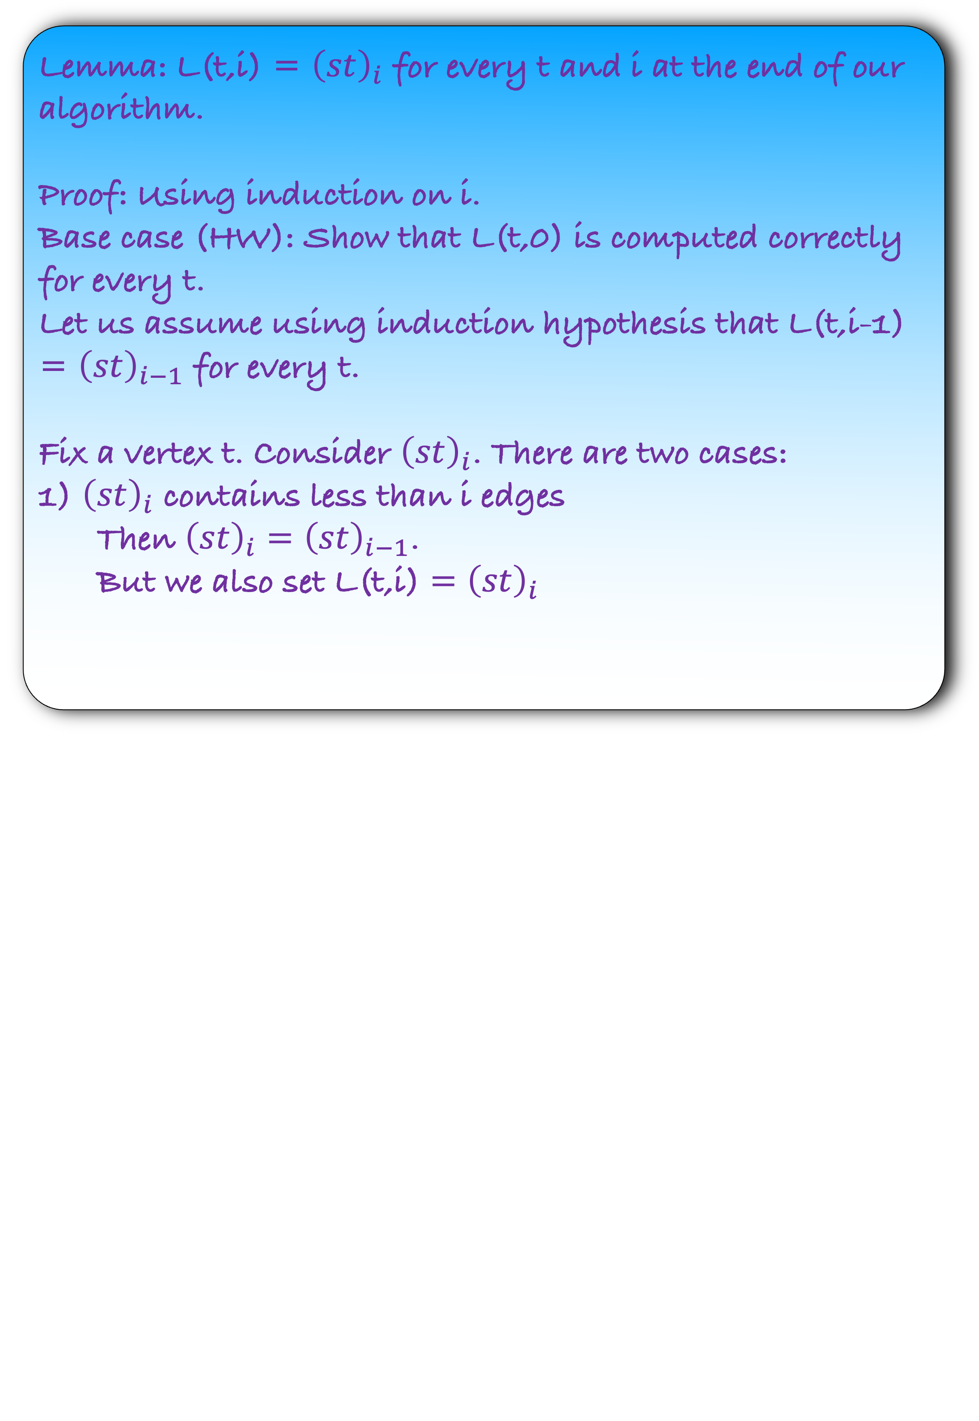
Let L(t,i) denote the shortest distance from s to t with edge length $≤$ i
def b$ellmanford($):
L($s,0)←0$
for $t∈V∖\{s\}$:
L($t,0)←∞$
for $i=1$ to $n−1$:
for each $t∈G$:
for each incoming edge $(d,t)$ to $t$:
Lemma: L(t,i) = ${\left(st\right)}_{i}$ for every t and i at the end of our algorithm.
Proof: Using induction on i.
Base case (HW): Show that L(t,0) is computed correctly for every t.
Let us assume using induction hypothesis that L(t,i-1) = ${\left(st\right)}_{i−1}$ for every t.
Fix a vertex t. Consider ${\left(st\right)}_{i}$. There are two cases:
1) ${\left(st\right)}_{i}$ contains less than i edges
Then ${\left(st\right)}_{i}={\left(st\right)}_{i−1}$.
But we also set L(t,i) $={\left(st\right)}_{i}$
L($t,i$) = L($t,i−1$)
L($t,i$) = min{ L($t,i$), L($d,i−1$) + w($d,t$)}

Slide 38
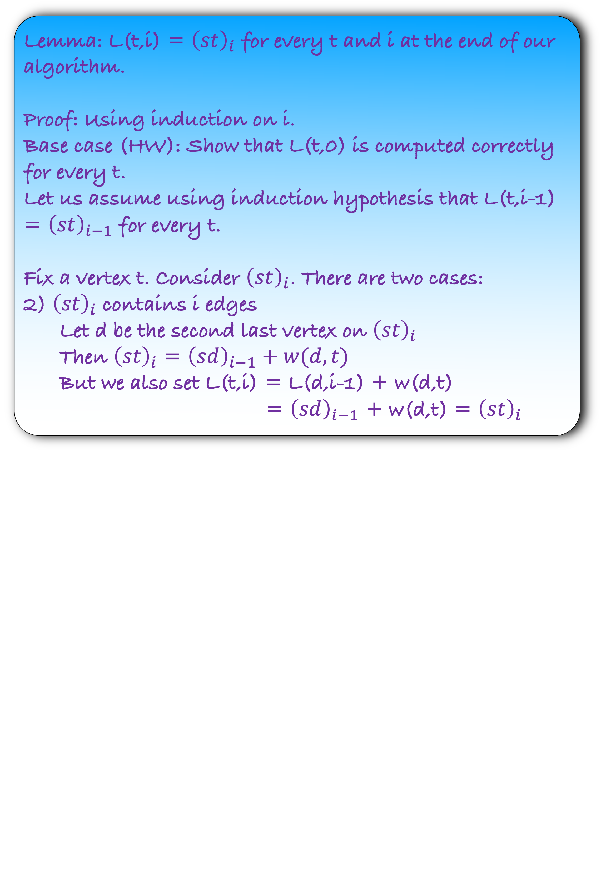
Let L(t,i) denote the shortest distance from s to t with edge length $≤$ i
def b$ellmanford($):
L($s,0)←0$
for $t∈V∖\{s\}$:
L($t,0)←∞$
for $i=1$ to $n−1$:
for each $t∈G$:
for each incoming edge $(d,t)$ to $t$:
Lemma: L(t,i) = ${\left(st\right)}_{i}$ for every t and i at the end of our algorithm.
Proof: Using induction on i.
Base case (HW): Show that L(t,0) is computed correctly for every t.
Let us assume using induction hypothesis that L(t,i-1) = ${\left(st\right)}_{i−1}$ for every t.
Fix a vertex t. Consider ${\left(st\right)}_{i}$. There are two cases:
2) ${\left(st\right)}_{i}$ contains i edges
Let d be the second last vertex on ${\left(st\right)}_{i}$
Then ${\left(st\right)}_{i}$ = ${\left(sd\right)}_{i−1}+w(d,t)$
But we also set L(t,i) = L(d,i-1) + w(d,t)
= ${\left(sd\right)}_{i−1}$ + w(d,t) = ${\left(st\right)}_{i}$
L($t,i$) = L($t,i−1$)
L($t,i$) = min{ L($t,i$), L($d,i−1$) + w($d,t$)}

Slide 39
Applications of Bellman Ford Algorithm: Finding negative cycle

Slide 40
Given a directed weighted graph where each edge has a positive weight, design an algorithm to find if there exists a negative cycle in the graph
Fortunately, Bellman Ford algorithm already answers this problem.
But how?

Slide 41





5
d
s
Estimate
10
5
9
1
s
0
0
0
0
0
6
b
7
a
$$∞$$
6
6
6
6
-8
3
b
$$∞$$
1
-2
-2
-2
e
8
c
$$∞$$
$$∞$$
3
1
1
c
a
4
d
$$∞$$
5
5
3
3
Edges in the graph
Shortest path tree edges
e
$$∞$$
$$∞$$
8
5
5
No change
After some iterations, there are no changes in estimate

Slide 42
5
d
s
Estimate
10
5
9
1
s
0
0
0
0
0
6
b
7
a
$$∞$$
6
6
6
6
-8
3
b
$$∞$$
1
-2
-2
-2
e
8
c
$$∞$$
$$∞$$
3
1
1
c
a
4
d
$$∞$$
5
5
3
3
Edges in the graph
Shortest path tree edges
e
$$∞$$
$$∞$$
8
5
5
No change
After n-1 iterations, there are no changes in estimate
Will the same thing happen if the graph contains negative cycle?

Slide 43
s
Estimate
1
s
0
b
a
$$∞$$
-8
3
b
$$∞$$
c
$$∞$$
c
a
4
Edges in the graph
Shortest path tree edges

Slide 44


s
Estimate
1
s
0
0
b
a
$$∞$$
$$∞$$
-8
3
b
$$∞$$
1
c
$$∞$$
$$∞$$
c
a
4
Edges in the graph
Shortest path tree edges

Slide 45

s
Estimate
1
s
0
0
0
b
a
$$∞$$
$$∞$$
-7
-8
3
b
$$∞$$
1
1
c
$$∞$$
$$∞$$
$$∞$$
c
a
4
Edges in the graph
Shortest path tree edges

Slide 46
s
Estimate
1
s
0
0
0
0
b
a
$$∞$$
$$∞$$
-7
-7
-8
3
b
$$∞$$
1
1
1
c
$$∞$$
$$∞$$
$$∞$$
-3
c
a
4
Edges in the graph
Shortest path tree edges

Slide 47
s
Estimate
1
s
0
0
0
0
0
b
a
$$∞$$
$$∞$$
-7
-7
-7
-8
3
b
$$∞$$
1
1
1
0
c
$$∞$$
$$∞$$
$$∞$$
-3
-3
c
a
4
Edges in the graph
Shortest path tree edges

Slide 48
s
Estimate
1
s
0
0
0
0
0
0
b
a
$$∞$$
$$∞$$
-7
-7
-7
-8
-8
3
b
$$∞$$
1
1
1
0
0
c
$$∞$$
$$∞$$
$$∞$$
-3
-3
-3
c
a
4
Observation: If the graph contains a cycle then Bellman Ford algorithm does not stabilize after n-1 iterations.
Edges in the graph
Shortest path tree edges

Slide 49
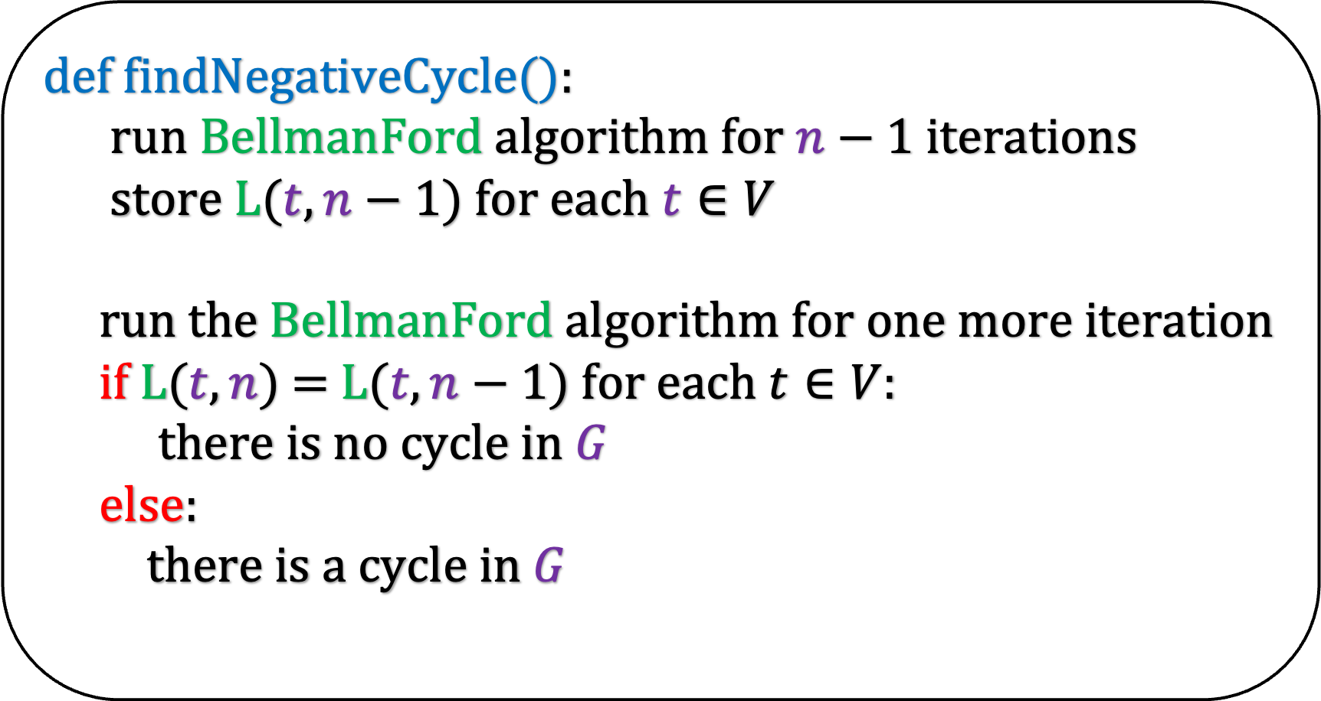
Observation: If the graph contains a cycle then Bellman Ford algorithm does not stabilize after n iterations.
def f$indNegativeCycle($):
run BellmanFord algorithm for $n−1$ iterations
store L($t,n−1$) for each $t∈V$
run the BellmanFord algorithm for one more iteration
if L($t,n$) = L($t,n−1$) for each $t∈V$:
there is no cycle in $G$
else:
there is a cycle in $G$

Slide 50
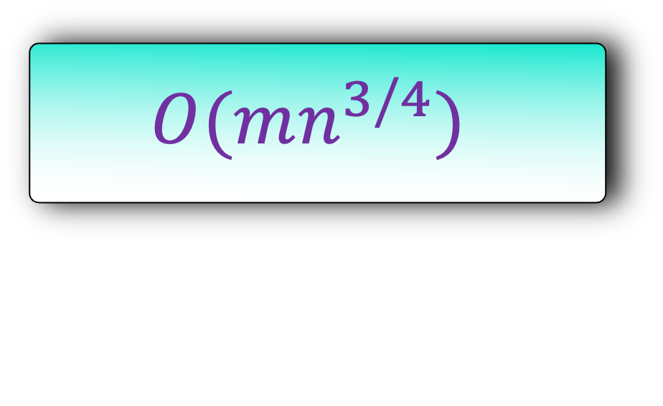
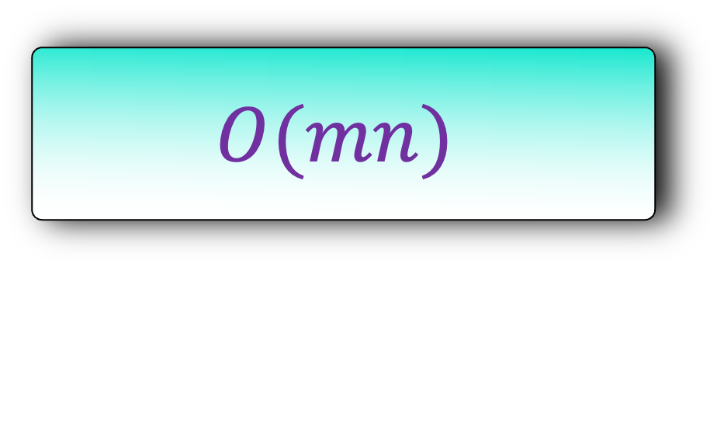
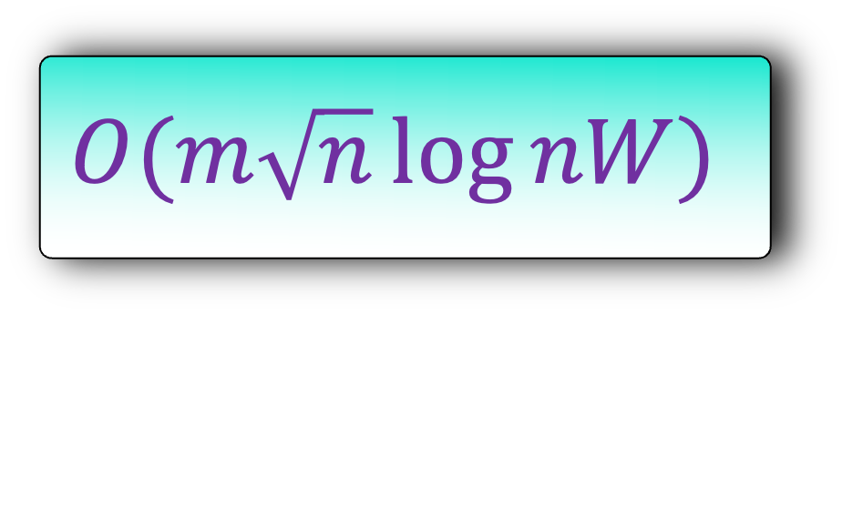
History of Shortest Path with Negative Weights
Reference
Running Time
Remark
Shimbel(1955), Ford(1956),
Bellman(1958),Moore(1959)
$$O(mn)$$
Gabow(1985)
$$O(mn^{3/4})$$
Edge weights integers and maximum weight edge is W
Gabow and Tarjan(1985), Goldberg(1995)
$$O(m\sqrt{n}\log{nW})$$
It will come as a surprise to you the the current best algorithm for this problem was discovered in 2023.

Slide 51

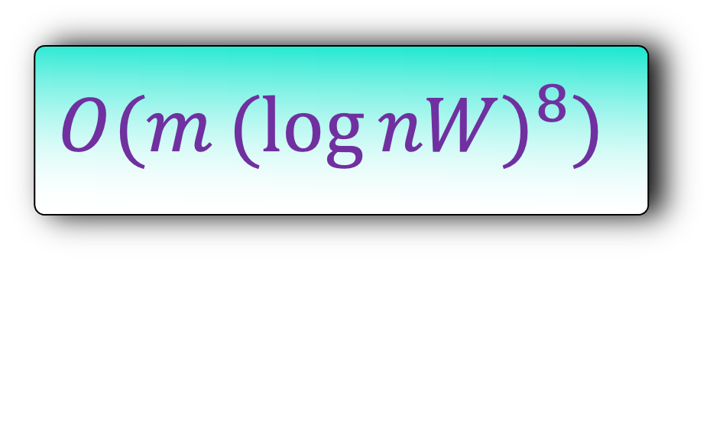
History of Shortest Path with Negative Weights
Reference
Running Time
Remark
Shimbel(1955), Ford(1956),
Bellman(1958),Moore(1959)
$$O(mn)$$
Gabow(1985)
$$O(mn^{3/4})$$
Edge weights integers and maximum weight edge is W
Gabow and Tarjan(1985), Goldberg(1995)
$$O(m\sqrt{n}\log{nW})$$
Bernstein, Nanongkai and Wulff-Nilsen (2023)
$$O(m{(log{nW)}}^{8})$$
Fineman (2024)
$$O(mn^{8/9})$$

Slide 52

History of Shortest Path with Negative Weights
Fineman (2024)
$$O(mn^{8/9})$$
Research Question: Can you improve Fineman’s result on graphs that contain negative real weights?

