Slide 1
Morrill Act (1862) to IIGN (2008) (Experience Gained and Question unanswered)
R Sharan
Visiting Professor IITGN
30/12/2016

Slide 2
Morrill Act and IIT Act
Officially titled "An Act Donating Public Lands to the Several States and Territories which may provide Colleges for the Benefit of Agriculture and the Mechanic Arts," the Morrill Act (1862)
IITGN was included in The Institutes of Technology (Amendment) Act, 2011. The Act was passed in the Lok Sabha on 24 March 2011

Slide 3
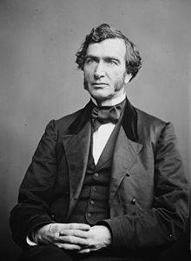
Justin Smith Morrill

Slide 4
Justin Smith Morrill
Born: April 14, 1810 in Strafford, Vermont, US
Died: December 28, 1898 (aged 88)
Profession: Businessman
Member of the U.S. House of Representatives
March 4, 1855 – March 3, 1867

Slide 5
Morrill Land-Grant Acts…
Other short titles: Land-Grant Agricultural and Mechanical College Act of 1862
Long title: An Act donating Public Lands to the several States and Territories which may provide Colleges for the Benefit of Agriculture and the Mechanic Arts.
Nicknames: Morrill Act of 1862
Enacted by the 37th United States Congress
Effective: July 2, 1862

Slide 6
Morrill Land-Grant Acts
Legislative history
Introduced in the Senate as S. 298 by Justin Smith Morrill (R–VT) on May 5, 1862
Passed the Senate on June 10, 1862 (32-7)
Passed the House on June 17, 1862 (91-25)
Signed into law by President Abraham Lincoln on July 2, 1862

Slide 7
IIT Kharagpur

Slide 8
IIT Kharagpur

Slide 10
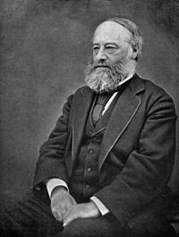
James Prescott Joule

Slide 11
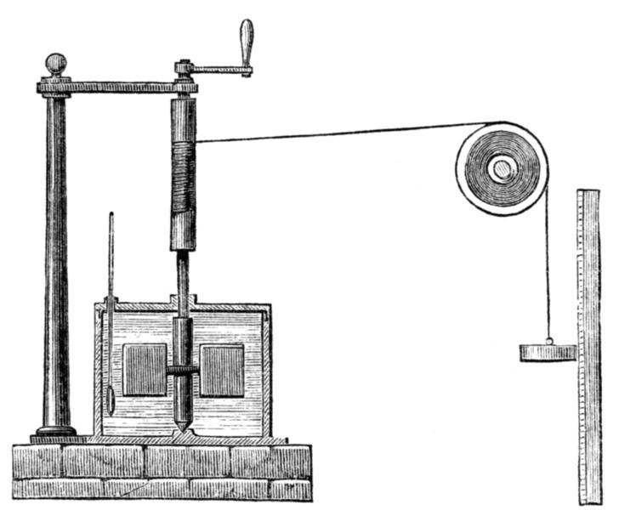
Joule Apparatus: Mechanical Equivalent of Heat (Engraving of Joule's apparatus for measuring the mechanical equivalent of heat. Harper's New Monthly Magazine, No. 231, August, 1869).

Slide 12
Born: 24 December 1818, Salford, Lancashire, England, United Kingdom
Citizenship: British
Fields: Physics
Known for: First law of thermodynamics; Disproving Caloric Theory
About: James Prescott Joule was an English physicist and brewer, born in Salford, Lancashire.
Joule studied nature of heat & discovered its relationship to mechanical work.
This led to law of conservation of energy, which led to development of first law of thermodynamics.
The SI derived unit of energy, the Joule, is named after James Joule.
He worked with Lord Kelvin to develop the absolute scale of temperature.
Joule also made observations of magnetostriction,& found relationship between current through a resistor & heat dissipated, which is now called Joule's first law.

Slide 13
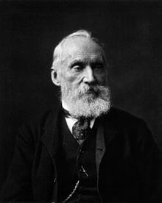
The Lord Kelvin (William Thomson, 1st Baron Kelvin)

Slide 14
Born: 26 June 1824, Belfast, Ireland, United Kingdom
Citizenship: British
Fields: Mathematical Physicist
Known for: Joule–Thomson effect; Thomson effect (thermoelectric); Mirror galvanometer; Siphon recorder; Kelvin material; Kelvin water dropper; Kelvin wave; Kelvin–Helmholtz; Kelvin transform; Absolute Zero Kelvin's circulation theorem; Stokes' Theorem; Kelvin bridge; Kelvin sensing; Kelvin equation; Kelvin-Varley divider; Magnetoresistance; Coining the term 'kinetic energy‘
About: Scots-Irish mathematical physicist and engineer.
At University of Glasgow he did important work in mathematical analysis of electricity & formulation of the first & second laws of thermodynamics, and did much to unify the emerging discipline of physics in its modern form.
He worked closely with mathematics professor Hugh Blackburn in his work.
He also had a career as an electric telegraph engineer & inventor, which propelled him into the public eye & ensured his wealth, fame and honour.
For his work on transatlantic telegraph project, he was knighted by Queen Victoria, becoming Sir William Thomson.
He had extensive maritime interests & was most noted for his work on mariner's compass, which had previously been limited in reliability.

Slide 15
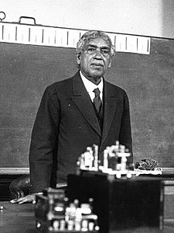
Sir Jagadish Chandra Bose

Slide 16
Born: 30 November 1858, Munshiganj, Bengal Presidency
Fields: Physics; biophysics; biology; botany; archaeology; Bengali literature; Bengali science fiction
Known for: Millimetre waves; Radio; Crescograph; Contributions to Plant biology
About: Sir Jagadish Chandra Bose was a Bengali polymath, physicist, biologist, biophysicist, botanist, archaeologist & an early writer of science fiction.
He pioneered investigation of radio and microwave optics, made significant contributions to plant science & laid foundations of experimental science in Indian subcontinent.
IEEE named him one of the fathers of radio science.
Bose is considered father of Bengali science fiction & also invented crescograph, a device for measuring growth of plants.
A crater on the moon has been named in his honour.

Slide 17
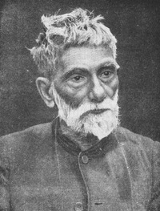
Acharya Sir Prafulla Chandra Ray

Slide 18
Born: 2 August 1861, Raruli, Bengal Presidency
Fields: Chemistry
About: Acharya Sir Prafulla Chandra Ray was a Bengali chemist, educator and entrepreneur.
The Royal Society of Chemistry honoured his life & work with first ever Chemical Landmark Plaque outside Europe.
He was the founder of Bengal Chemicals & Pharmaceuticals, India's first pharmaceutical company.
He is the author of A History of Hindu Chemistry from the Earliest Times to the Middle of Sixteenth Century (1902).

Slide 19
Part I-Questions facing any newly independent country. India in 1947
How to build the Nation in a way that old mistakes are not repeated?
How to make up for the lost time ?
Basic Question (John Steinbeck and Mortimer Adler)

Slide 20
Part I-Choices made in 1940’s
Constitutional Democracy with Universal Suffrage.
Use Science and technology for removal of hunger (famine) and poverty.
The GRAND INDIAN EXPERIMENT in REVERSE ENGINEERING:
SET up Institutes of Technology first and hope that these would spawn Industrial Growth

Slide 21
SET up Institutes of Technology first and hope that these would spawn Industrial Growth (ASSUMPTIONS MADE)
Recommendation of Sarkar Committee
(1) Not less than four Higher Technical Institutions, one in North, one in the East, one in the South and one in the West will be necessary to satisfy the post-war requirements.
(2) One in the East should be set up in or near Calcutta at an early date.
(3) Establishment of the Western Institution which should be in or near Bombay should be taken in hand concurrently with the eastern Institution or failing that as soon as possible.

Slide 22
John Steinbeck
“It has always seemed strange to me...The things we admire in men, kindness and generosity, openness, honesty, understanding and feeling, are the concomitants of failure in our system. And those traits we detest, sharpness, greed, acquisitiveness, meanness, egotism and self-interest, are the traits of success.”

