Slide 1
Quick Sort

Slide 2
9
2
4
10
5
Take the number 9 and put it at its correct place in the sorted array
All the numbers less than 9 should be to the left of 9 and all the numbers greater than 9 should be at the right.
Implement this algorithm in python.

Slide 3









9
9
2
5
10
4
$$A$$
2
5
10
4
$$i=1$$
$$i=2$$
$$i=3$$
$$i=4$$
$$i=5$$
$$A_{1}$$
$$A_{2}$$
$$B$$

Slide 4
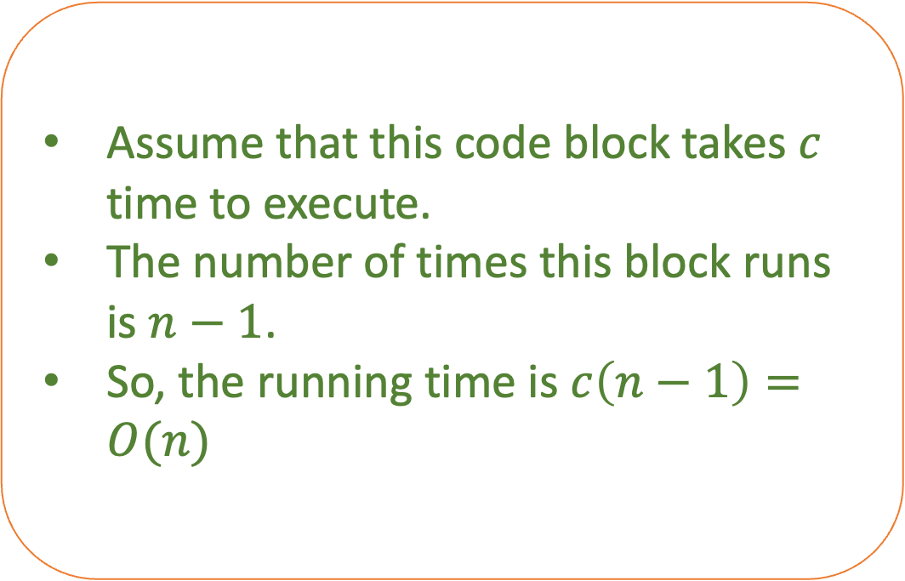
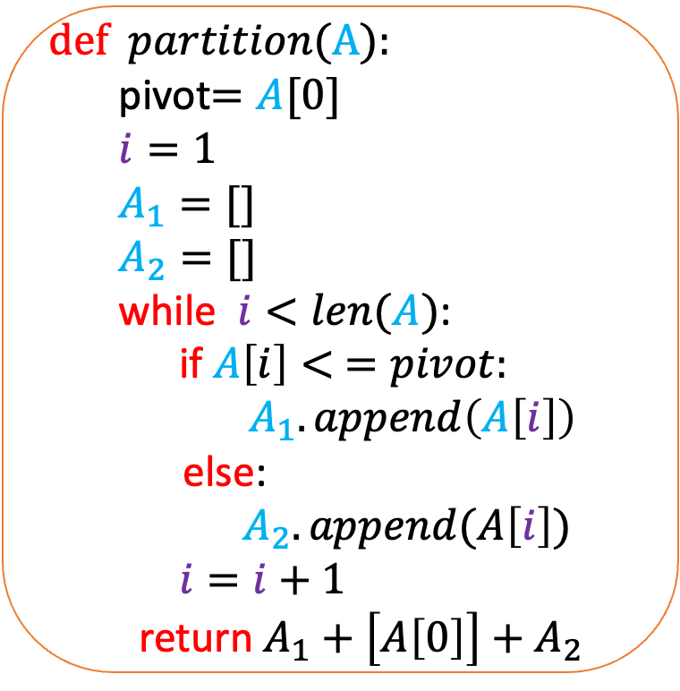
def $partition$(A):
pivot$=A[0]$
$i=1$
$A_{1}=[]$
$A_{2}=[]$
while $i<len(A)$:
if $A\left[i\right]< =pivot:$
$A_{1}.append\left(A\left[i\right]\right)$
else:
$A_{2}.append(A\left[i\right])$
$i=i+1$
return $A_{1}+\left[A\left[0\right]\right]+A_{2}$
Assume that this code block takes $c$ time to execute.
The number of times this block runs is $n−1$.
So, the running time is $c\left(n−1\right)=O(n)$
What is the running time of the algorithm?

Slide 5
How would you use the partition function to sort the array?
Recursion

Slide 6
9
2
4
13
5
15
12
3

Slide 7
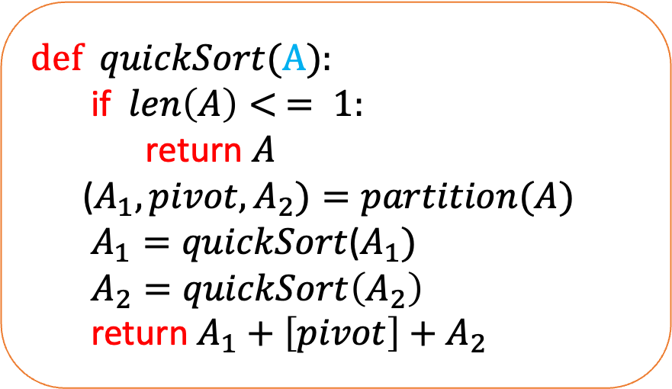
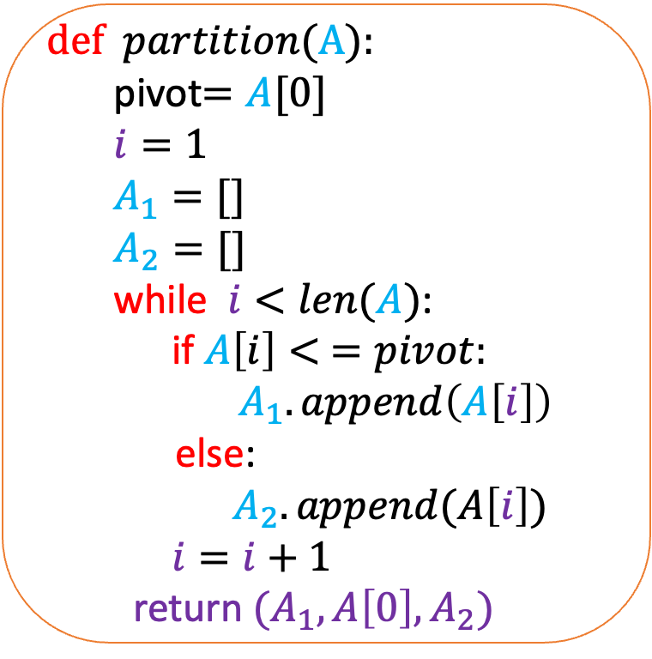
def $partition$(A):
pivot$=A[0]$
$i=1$
$A_{1}=[]$
$A_{2}=[]$
while $i<len(A)$:
if $A\left[i\right]< =pivot:$
$A_{1}.append\left(A\left[i\right]\right)$
else:
$A_{2}.append(A\left[i\right])$
$i=i+1$
return $(A_{1}, A\left[0\right],A_{2})$
def $quickSort$(A):
if $len\left(A\right)< = 1:$
return $A$
($A_{1},pivot,A_{2})=partition(A)$
$A_{1}=quickSort$($A_{1})$
$A_{2}=quickSort\left(A_{2}\right)$
return $A_{1}+\left[pivot\right]+A_{2}$

Slide 8
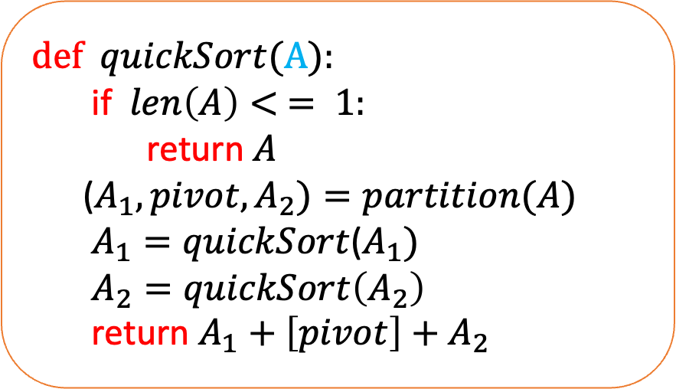
def $quickSort$(A):
if $len\left(A\right)< = 1:$
return $A$
($A_{1},pivot,A_{2})=partition(A)$
$A_{1}=quickSort$($A_{1})$
$A_{2}=quickSort\left(A_{2}\right)$
return $A_{1}+\left[pivot\right]+A_{2}$
What is the worst input for this algorithm?

Slide 9









1
2
3
4
5
$$… …. …. …. …$$
$$n−2$$
$$n−1$$
$$n$$
Time
$$cn$$
$$c(n−1)$$
$$c(n−2)$$
$$c(n−3)$$
.
.
.
1
$\frac{cn\left(n+1\right)}{2}$

Slide 10
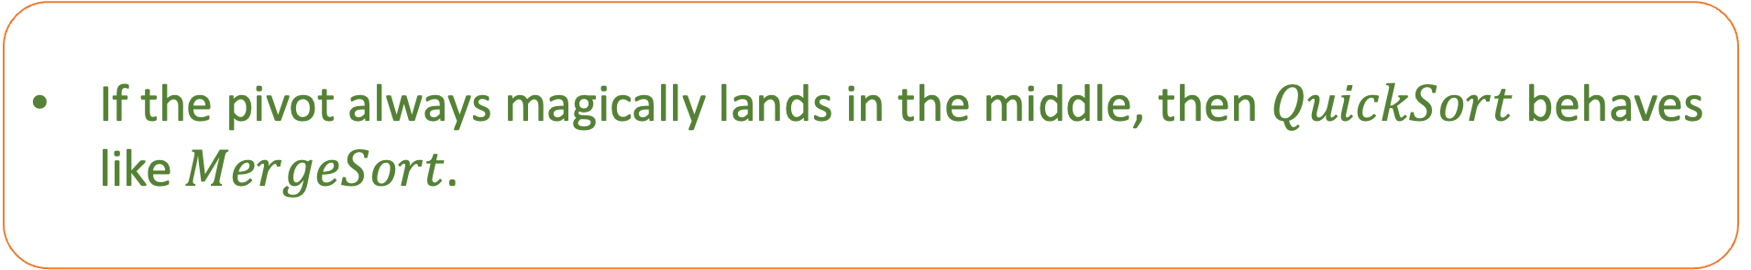
def $quickSort$(A):
if $len\left(A\right)< = 1:$
return $A$
($A_{1},pivot,A_{2})=partition(A)$
$A_{1}=quickSort$($A_{1})$
$A_{2}=quickSort\left(A_{2}\right)$
return $A_{1}+\left[pivot\right]+A_{2}$
What is the best input for this algorithm?
If the pivot always magically lands in the middle, then $QuickSort$ behaves like $MergeSort$.

Slide 11
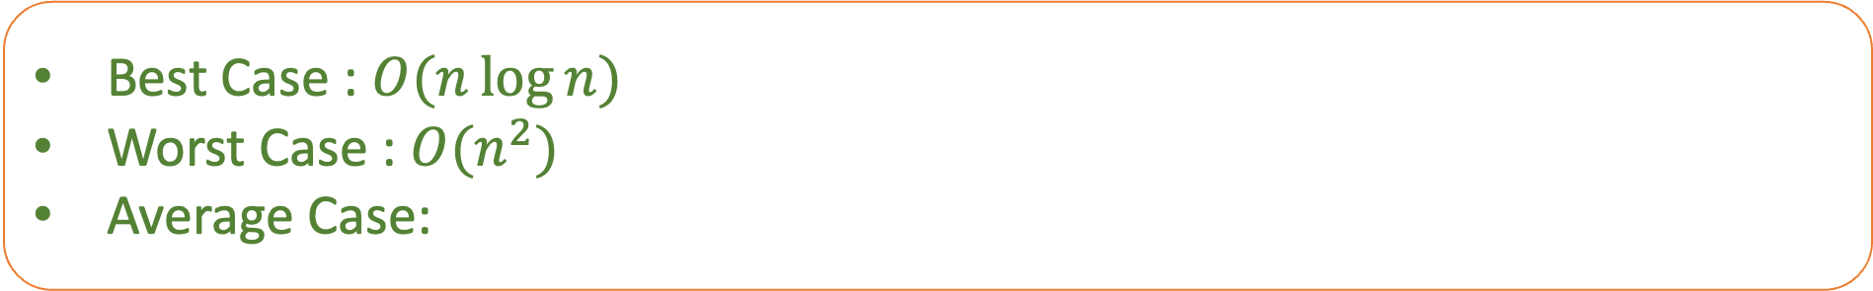
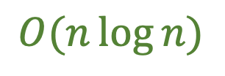
def $quickSort$(A):
if $len\left(A\right)< = 1:$
return $A$
($A_{1},pivot,A_{2})=partition(A)$
$A_{1}=quickSort$($A_{1})$
$A_{2}=quickSort\left(A_{2}\right)$
return $A_{1}+\left[pivot\right]+A_{2}$
Best Case : $O(n\log{n)}$
Worst Case : $O(n^{2})$
Average Case:
$$O(n\log{n)}$$

Slide 12
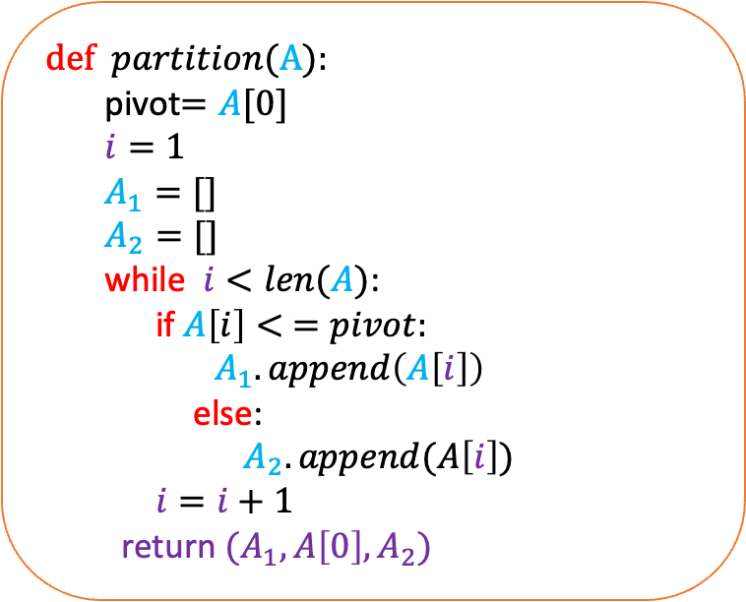
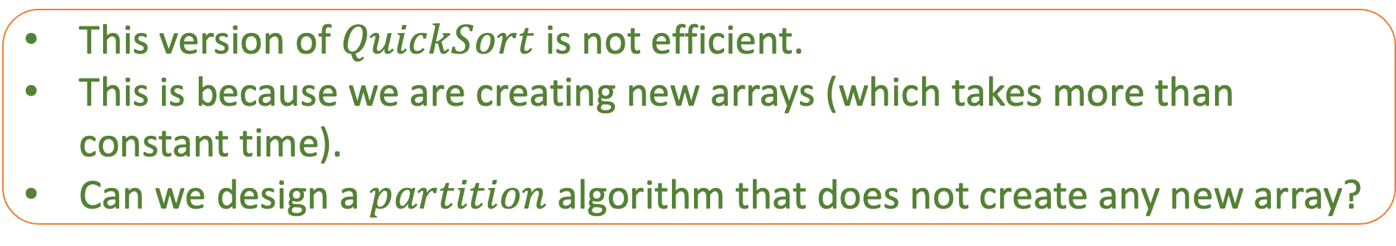
def $partition$(A):
pivot$=A[0]$
$i=1$
$A_{1}=[]$
$A_{2}=[]$
while $i<len(A)$:
if $A\left[i\right]< =pivot:$
$A_{1}.append\left(A\left[i\right]\right)$
else:
$A_{2}.append(A\left[i\right])$
$i=i+1$
return $(A_{1}, A\left[0\right],A_{2})$
This version of $QuickSort$ is not efficient.
This is because we are creating new arrays (which takes more than constant time).
Can we design a $partition$ algorithm that does not create any new array?
Such an algorithm is called in-place algorithm.

Slide 13
def $partition$(A):
pivot$=A[0]$
$i=1$
$A_{1}=[]$
$A_{2}=[]$
while $i<len(A)$:
if $A\left[i\right]< =pivot:$
$A_{1}.append\left(A\left[i\right]\right)$
else:
$A_{2}.append(A\left[i\right])$
$i=i+1$
return $(A_{1}, A\left[0\right],A_{2})$
Can you rewrite this algorithm to make it in-place?

Slide 14






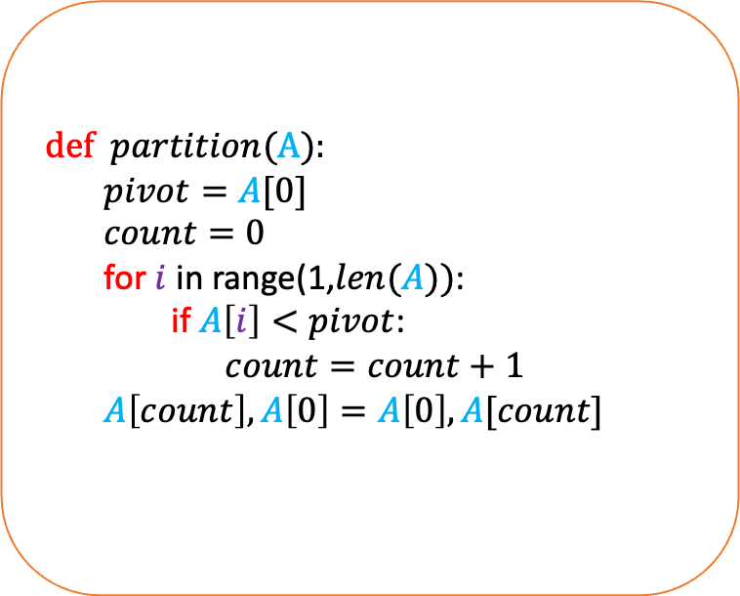


def $partition$(A):
$pivot=A[0]$
$count=0$
for $i$ in range(1,$len(A))$:
if $A\left[i\right]<pivot$:
$count=count+1$
$A\left[count\right],A\left[0\right]=A\left[0\right],A[count]$
9
2
4
11
5
15
12
3
$$i=1$$
$$i=2$$
$$i=8$$
$$4$$
$$count=$$
$$2$$
$$1$$
$$0$$

Slide 15



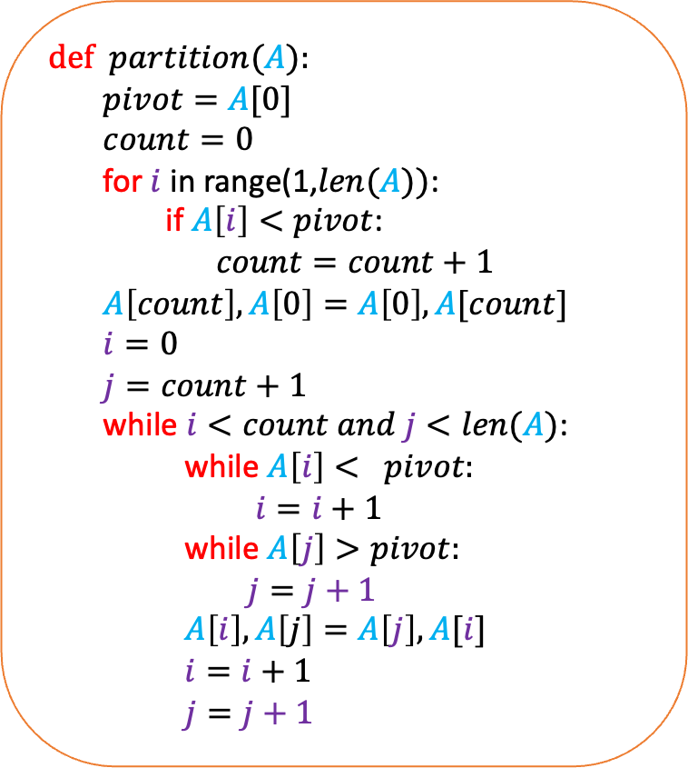





def $partition$($A$):
$pivot=A[0]$
$count=0$
for $i$ in range(1,$len(A))$:
if $A\left[i\right]<pivot$:
$count=count+1$
$A\left[count\right],A\left[0\right]=A\left[0\right],A[count]$
$i=0$
$j=count+1$
while $i<count and j<len(A)$:
while $A\left[i\right]< pivot:$
$i=i+1$
while $A\left[j\right]>pivot:$
$j=j+1$
$A\left[i\right],A\left[j\right]=A\left[j\right],A[i]$
$i=i+1$
$j=j+1$
5
2
4
11
9
15
12
3
$$i=0$$
$$i=1$$
$$i=2$$
$$i=3$$
$$i=4$$
$$j=5$$
$$j=6$$
$$j=7$$
Is this code correct?

Slide 16
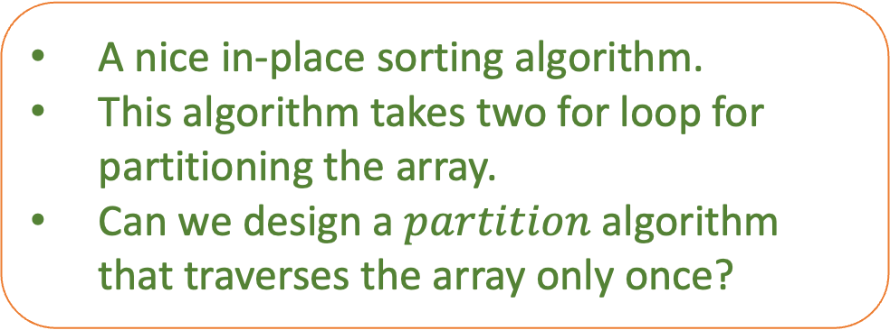
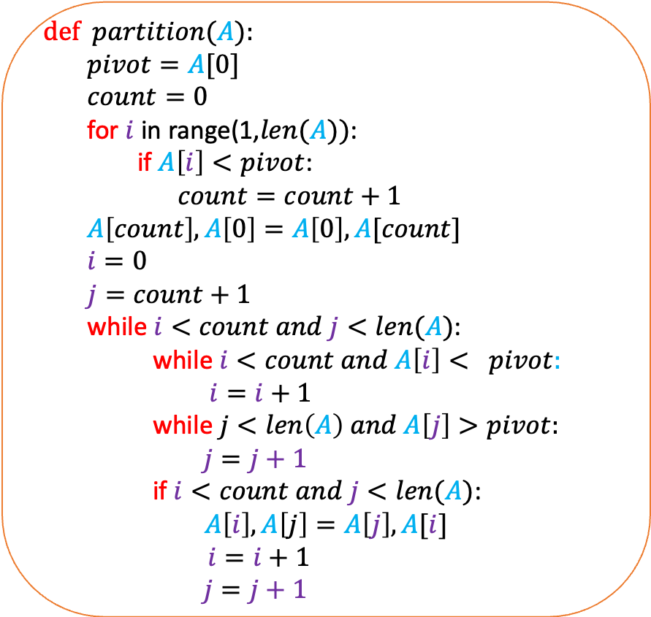
def $partition$($A$):
$pivot=A[0]$
$count=0$
for $i$ in range(1,$len(A))$:
if $A\left[i\right]<pivot$:
$count=count+1$
$A\left[count\right],A\left[0\right]=A\left[0\right],A[count]$
$i=0$
$j=count+1$
while $i<count and j<len(A)$:
while$i<count and A\left[i\right]< pivot:$
$i=i+1$
while$j<len\left(A\right) and A\left[j\right]>pivot:$
$j=j+1$
if $i<count and j<len(A)$:
$$A\left[i\right],A\left[j\right]=A\left[j\right],A[i]$$
$i=i+1$
$j=j+1$
A nice in-place sorting algorithm.
This algorithm takes two for loop for partitioning the array.
Can we design a $partition$ algorithm that traverses the array only once?

Slide 17








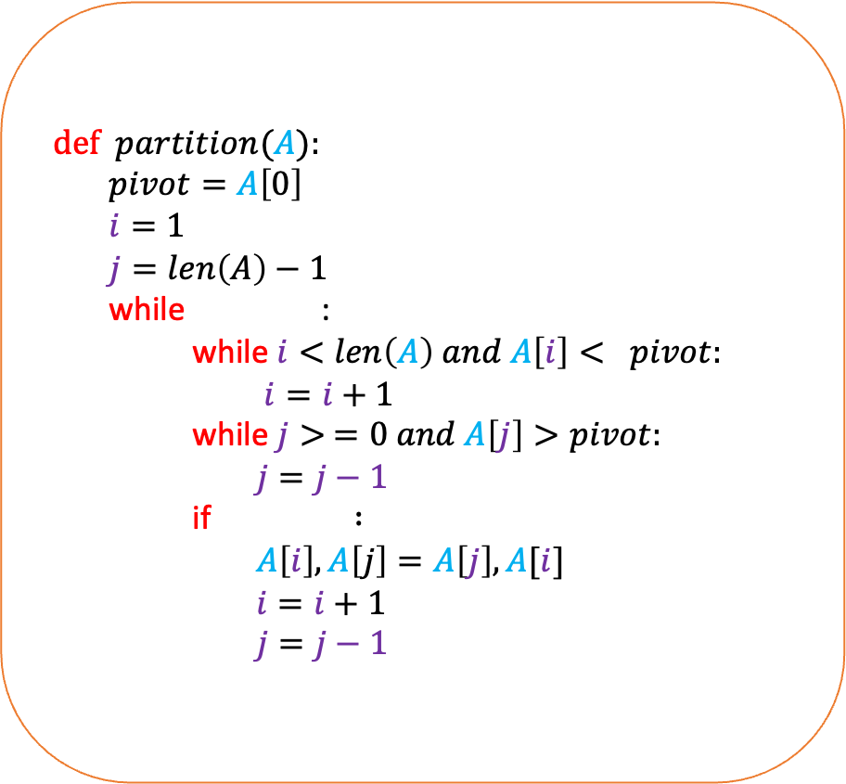


def $partition$($A$):
$pivot=A\left[0\right]$
$i=1$
$j=len\left(A\right)−1$
while :
while$i<len\left(A\right) and A\left[i\right]< pivot:$
$i=i+1$
while$j> =0 and A\left[j\right]>pivot:$
$j=j−1$
if $:$
$A\left[i\right],A\left[j\right]=A\left[j\right],A[i]$
$i=i+1$
$j=j−1$
9
2
4
11
5
15
12
3
$$i=1$$
$$i=2$$
$$i=3$$
$$i=4$$
$$i=5$$
$$j=6$$
$$j=7$$
$$j=5$$
$$i< =j$$
$$i< = j$$

Slide 18
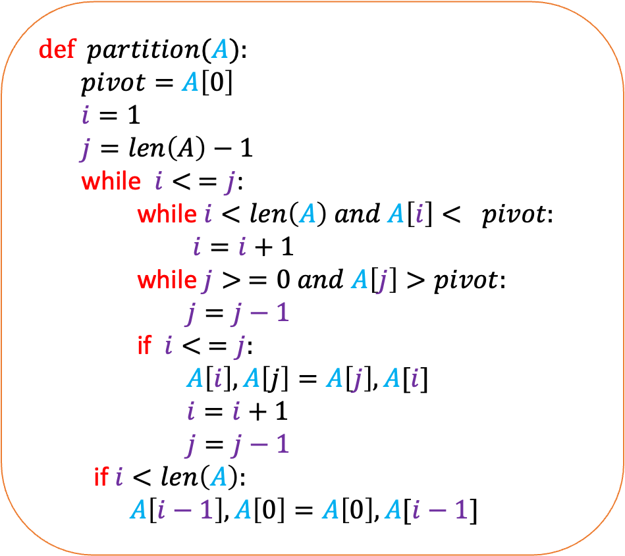
def $partition$($A$):
$pivot=A\left[0\right]$
$i=1$
$j=len\left(A\right)−1$
while $i< =j$:
while $i<len\left(A\right) and A\left[i\right]< pivot:$
$i=i+1$
while$j> =0 and A\left[j\right]>pivot:$
$j=j−1$
if $i< =j:$
$A\left[i\right],A\left[j\right]=A\left[j\right],A[i]$
$i=i+1$
$j=j−1$
if $i<len\left(A\right):$
$A\left[i−1\right],A\left[0\right]=A\left[0\right],A[i−1]$
9
2
4
3
5
15
12
11
$$i=5$$
$$j=5$$
Is this code correct?

Slide 19

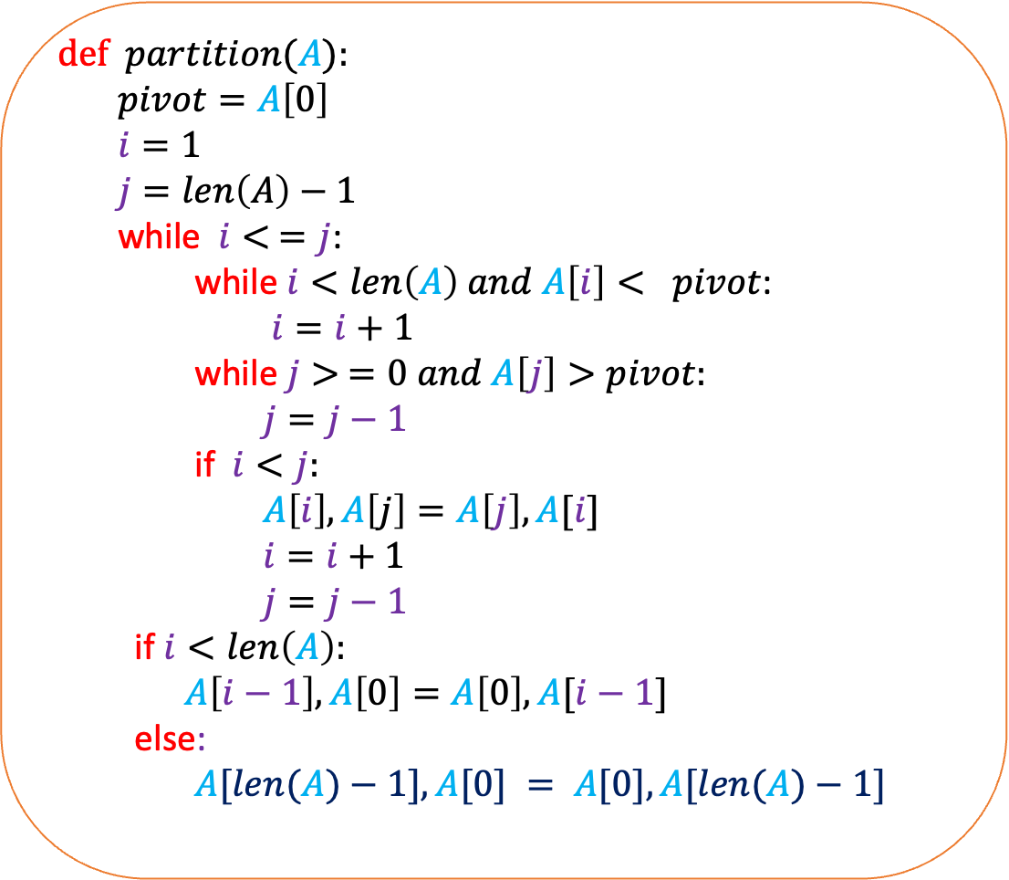




def $partition$($A$):
$pivot=A\left[0\right]$
$i=1$
$j=len\left(A\right)−1$
while $i< =j$:
while $i<len\left(A\right) and A\left[i\right]< pivot$:
$i=i+1$
while$j> =0 and A\left[j\right]>pivot:$
$j=j−1$
if $i<j:$
$A\left[i\right],A\left[j\right]=A\left[j\right],A[i]$
$i=i+1$
$j=j−1$
if $i<len\left(A\right):$
$A\left[i−1\right],A\left[0\right]=A\left[0\right],A[i−1]$
else:
$A[len(A)−1],A[0] = A[0],A[len(A)−1]$
9
2
4
5
6
$$i=1$$
$$i=2$$
$$i=3$$
$$i=4$$
$$i=5$$
No swap happens

Slide 20
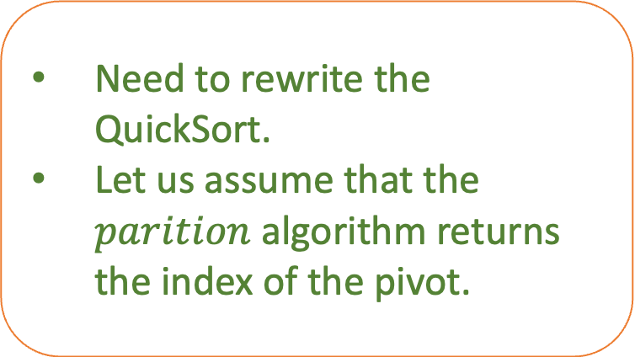
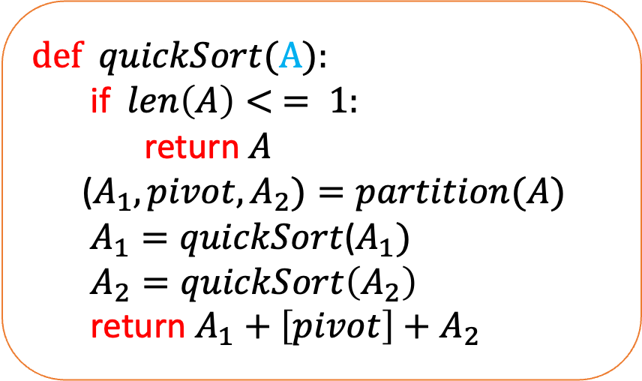
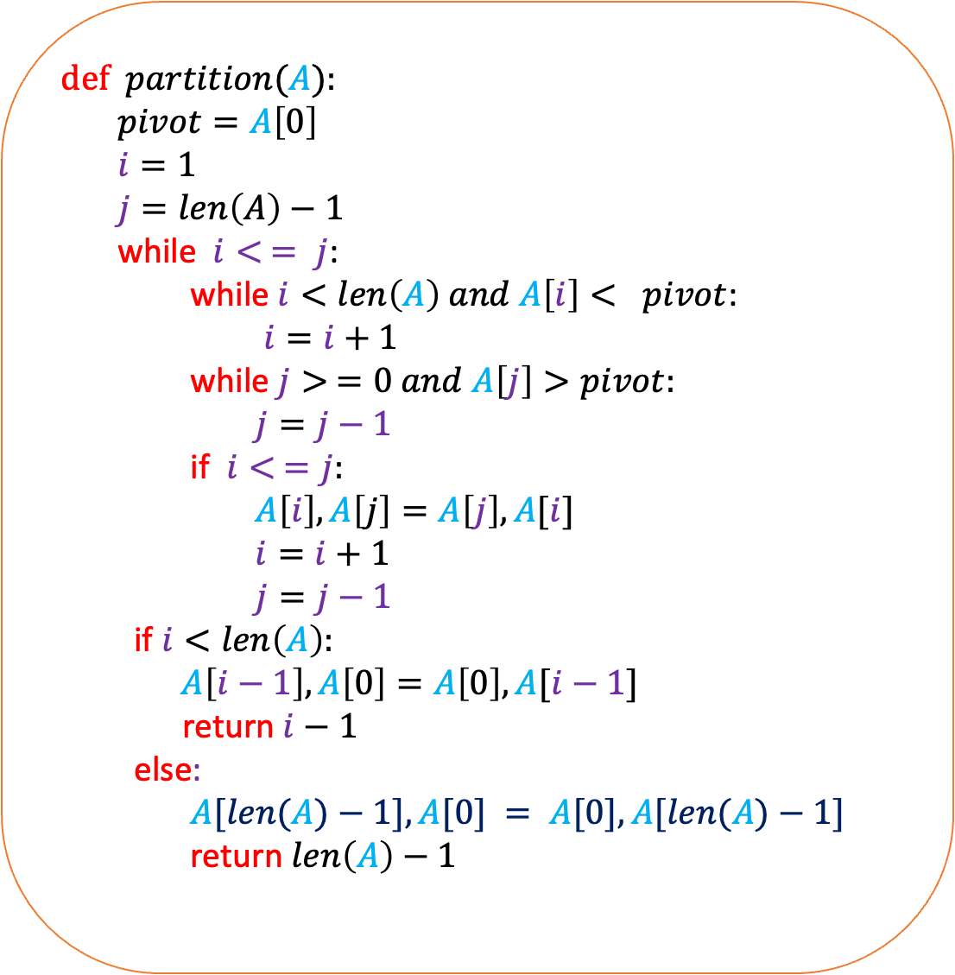
def $partition$($A$):
$pivot=A\left[0\right]$
$i=1$
$j=len\left(A\right)−1$
while $i< = j$:
while $i<len\left(A\right) and A\left[i\right]< pivot$:
$i=i+1$
while $j> =0 and A\left[j\right]>pivot:$
$j=j−1$
if $i< =j:$
$A\left[i\right],A\left[j\right]=A\left[j\right],A[i]$
$i=i+1$
$j=j−1$
if $i<len\left(A\right):$
$A\left[i−1\right],A\left[0\right]=A\left[0\right],A[i−1]$
return $i−1$
else:
$A[len(A)−1],A[0] = A[0],A[len(A)−1]$
return $len\left(A\right)−1$
def $quickSort$(A):
if $len\left(A\right)< = 1:$
return $A$
($A_{1},pivot,A_{2})=partition(A)$
$A_{1}=quickSort$($A_{1})$
$A_{2}=quickSort\left(A_{2}\right)$
return $A_{1}+\left[pivot\right]+A_{2}$
Need to rewrite the QuickSort.
Let us assume that the $parition$ algorithm returns the index of the pivot.

Slide 21
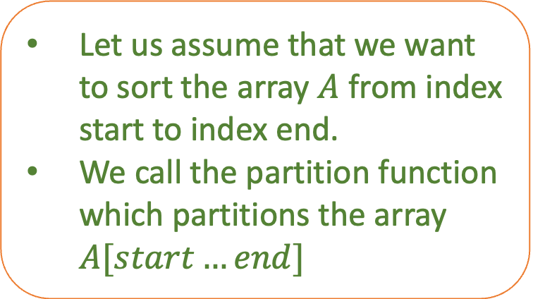
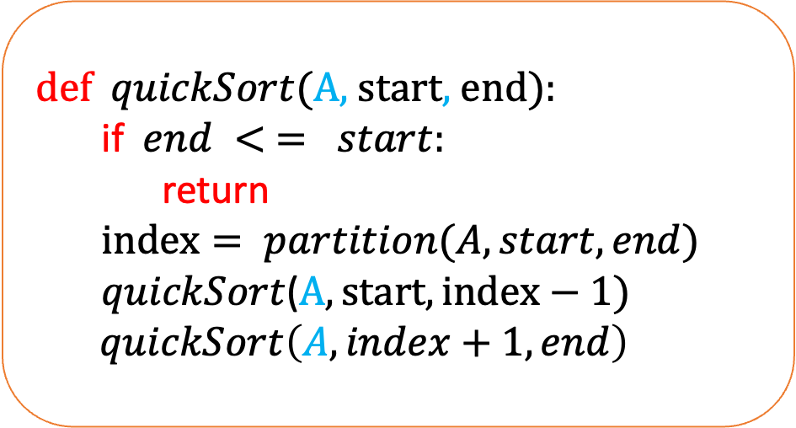

def $partition$($A$):
$pivot=A\left[0\right]$
$i=1$
$j=len\left(A\right)−1$
while $i< =j$:
while $i<len\left(A\right) and A\left[i\right]< pivot$:
$i=i+1$
while $j> =0 and A\left[j\right]>pivot:$
$j=j−1$
if $i<j:$
$A\left[i\right],A\left[j\right]=A\left[j\right],A[i]$
$i=i+1$
$j=j−1$
if $i<len\left(A\right):$
$A\left[i−1\right],A\left[0\right]=A\left[0\right],A[i−1]$
return $i−1$
else:
$A[len(A)−1],A[0] = A[0],A[len(A)−1]$
return $len\left(A\right)−1$
def $quickSort$(A, start, end):
if $end < = start:$
return
$index= partition(A, start,end)$
$quickSort$($A,start,index−1)$
$quickSort\left(A, index+1, end\right)$
Let us assume that we want to sort the array $A$ from index start to index end.
We call the partition function which partitions the array $A[start…end]$

Slide 22
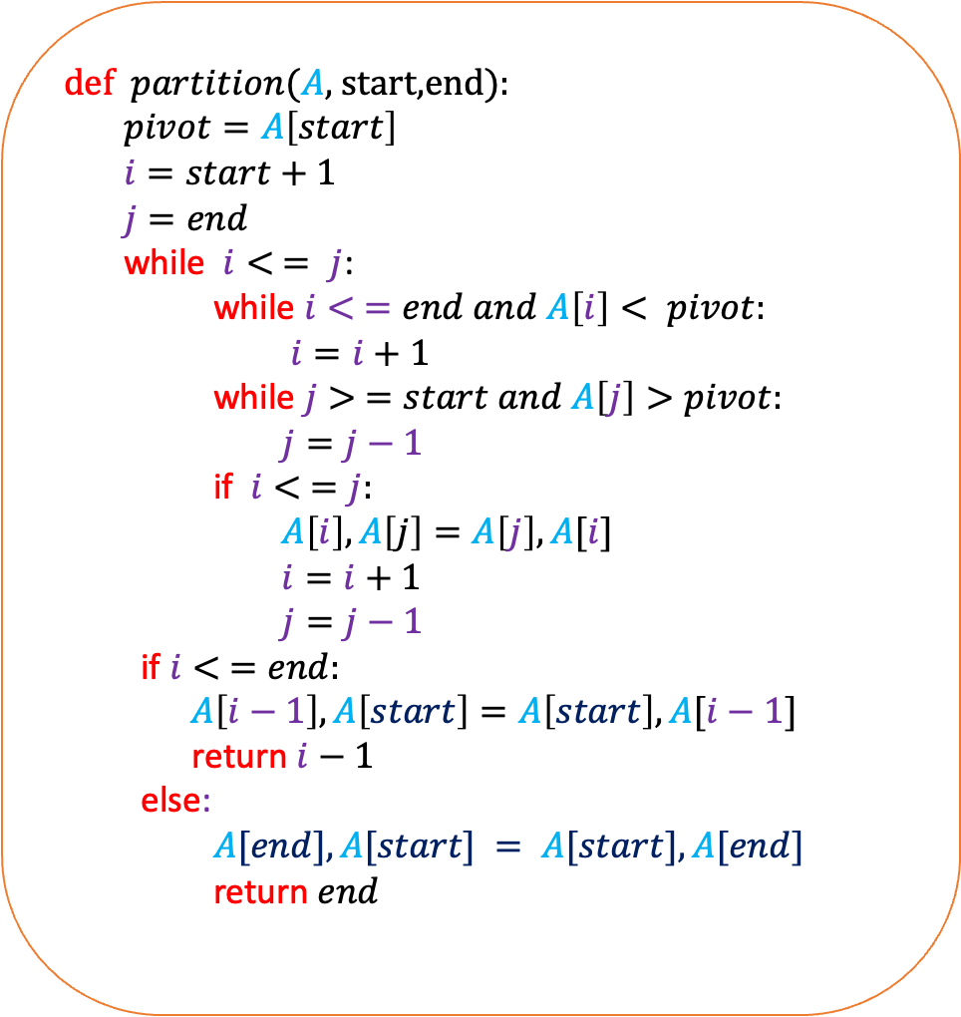
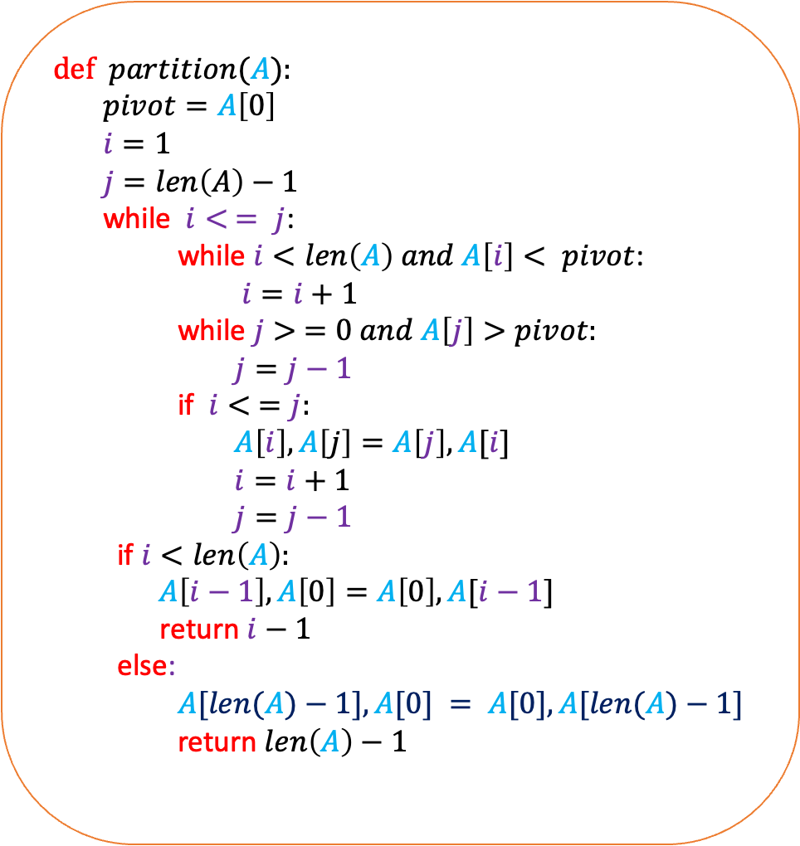
def $partition$($A$):
$pivot=A\left[0\right]$
$i=1$
$j=len\left(A\right)−1$
while $i< = j$:
while $i<len\left(A\right) and A\left[i\right]< pivot$:
$i=i+1$
while $j> =0 and A\left[j\right]>pivot:$
$j=j−1$
if $i< =j:$
$A\left[i\right],A\left[j\right]=A\left[j\right],A[i]$
$i=i+1$
$j=j−1$
if $i<len\left(A\right):$
$A\left[i−1\right],A\left[0\right]=A\left[0\right],A[i−1]$
return $i−1$
else:
$A[len(A)−1],A[0] = A[0],A[len(A)−1]$
return $len\left(A\right)−1$
def $partition$($A$, start,end):
$pivot=A\left[start\right]$
$i=start+1$
$j=end$
while $i< = j$:
while $i< =end and A\left[i\right]< pivot:$
$i=i+1$
while $j> =start and A\left[j\right]>pivot:$
$j=j−1$
if $i< =j:$
$A\left[i\right],A\left[j\right]=A\left[j\right],A[i]$
$i=i+1$
$j=j−1$
if $i< =end:$
$A\left[i−1\right],A\left[start\right]=A\left[start\right],A[i−1]$
return $i−1$
else:
$A[end],A[start] = A[start],A[end]$
return $end$

Slide 23
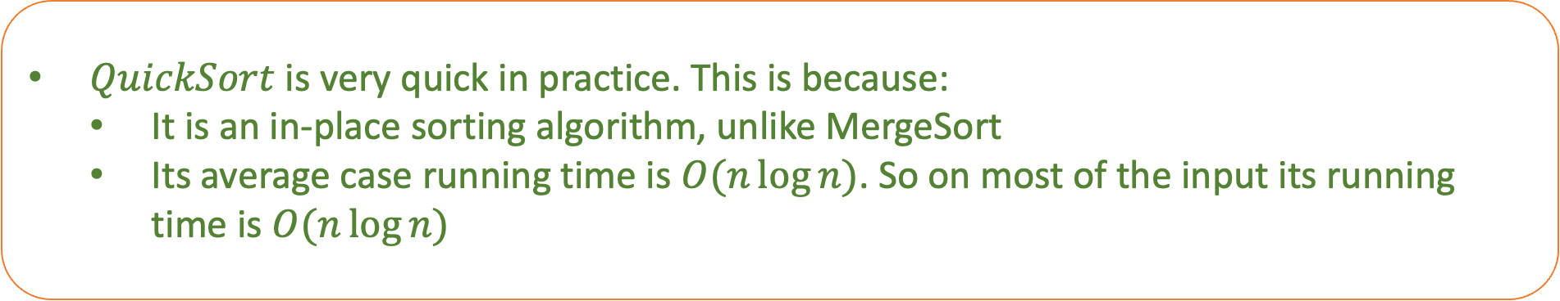
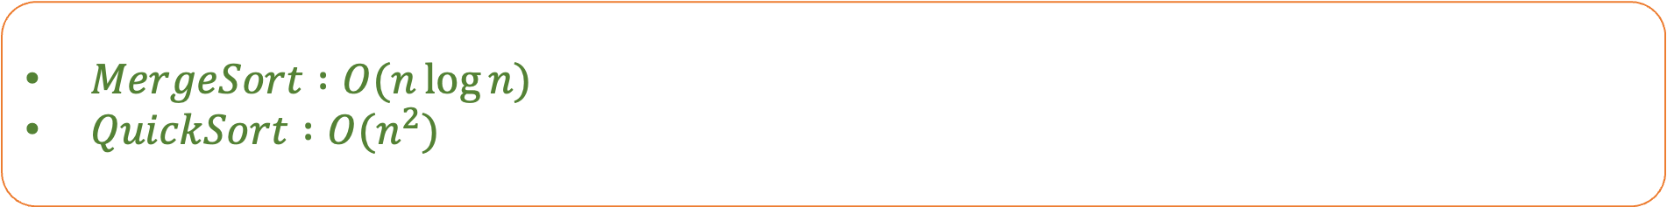
$MergeSort :O(n\log{n})$
$QuickSort :O(n^{2})$
Which one will you use?
$QuickSort$ is very quick in practice. This is because:
  It is an in-place sorting algorithm, unlike MergeSort
  Its average case running time is $O(n\log{n)}$. So on most of the input its running time is $O(n\log{n)}$

