Slide 1
Searching

Slide 2
9
2
4
10
5
Find the minimum number in the array.
Find the second minimum number in the array.
Implement this algorithm in python.

Slide 3
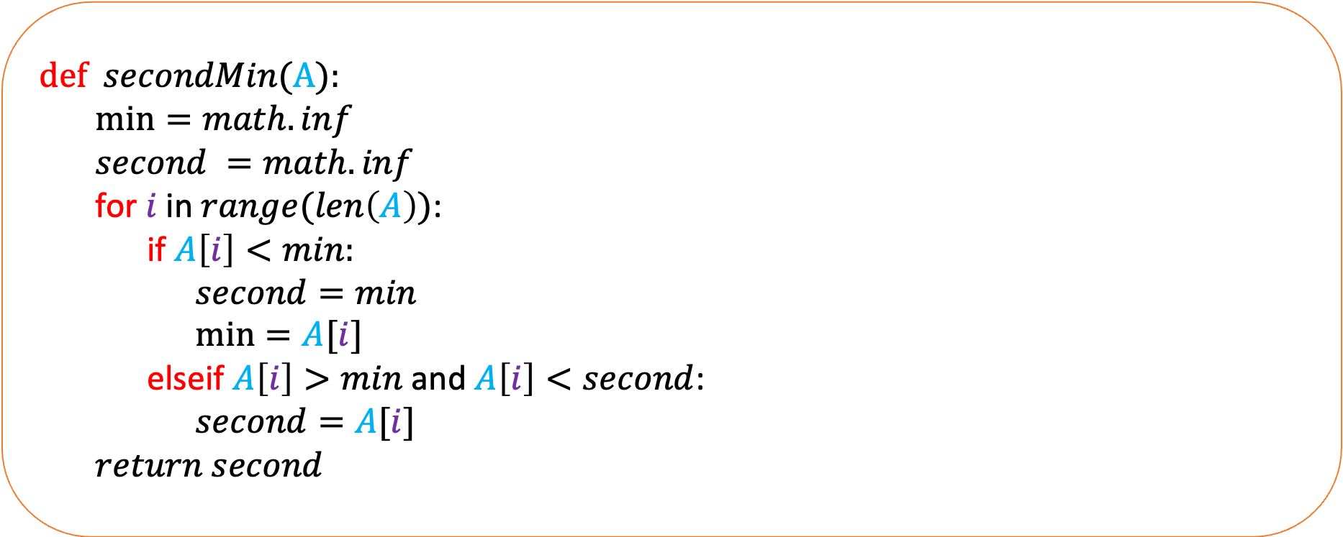
def $secondMin$(A):
$\min{=math.inf}$
$second =math.inf$
for $i$ in $range(len\left(A\right))$:
if $A\left[i\right]<min:$
$second=min$
$\min{=A[i]}$
elseif $A\left[i\right]>min$ and $A\left[i\right]<second$:
$second=A[i]$
$return second$
Running time = $O(n)$

Slide 4
Find the $k$-th smallest number in an array.
Suppose we want to find the 5-th smallest number in this array.
9
2
4
13
5
15
12
3

Slide 5
Find the $k$-th smallest number in an array.
Suppose we want to find the 8-th smallest number in this array.
9
2
4
13
5
15
12
3
Recurse on the algorithm again. But now, we want to find the third smallest element in this array

Slide 6
Find the $k$-th smallest number in an array.
Suppose we want to find the 2-th smallest number in this array.
9
2
4
13
5
15
12
3
Recurse on the algorithm again. We want to find the second smallest element in this array

Slide 7
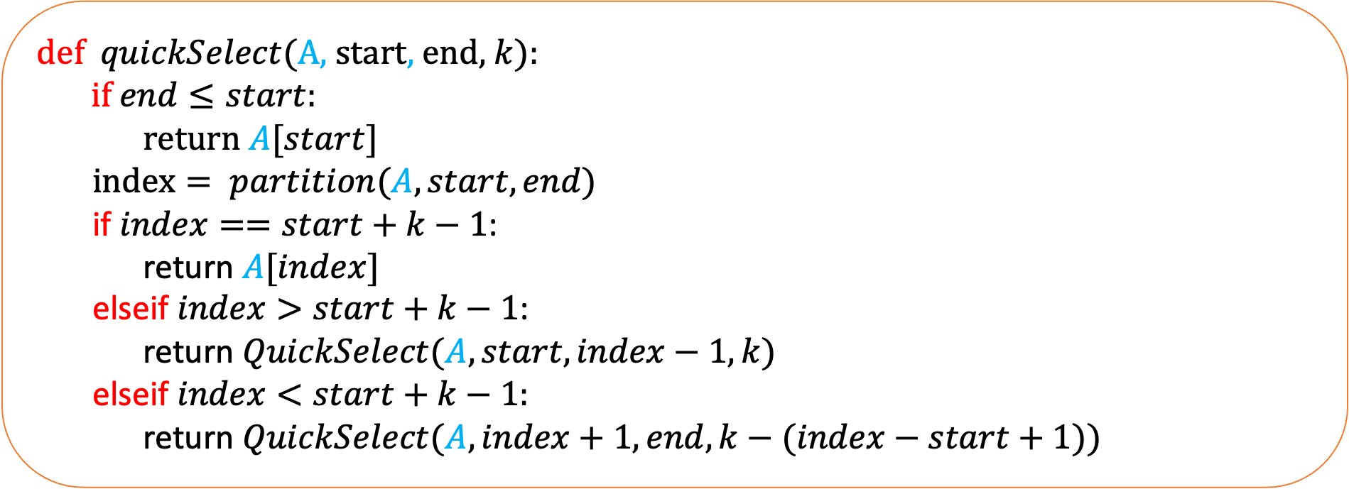
def $quickSelect$(A, start, end,$k$):
if $end≤start:$
return $A[start]$
$index= partition(A, start,end)$
if $index==start+k−1$:
return $A[index]$
elseif $index>start+k−1$:
return $QuickSelect(A,start,index−1,k)$
elseif $index<start+k−1:$
return $QuickSelect(A,index+1,end,k−(index−start+1))$
What is the running time of this algorithm?

Slide 8









Assume that you are trying to find $n$-th element in this array
1
2
3
4
5
$$… …. …. …. …$$
$$n−2$$
$$n−1$$
$$n$$
Time
$$cn$$
$$c(n−1)$$
$$c(n−2)$$
$$c(n−3)$$
.
.
.
1
$\frac{cn\left(n+1\right)}{2}$

Slide 9

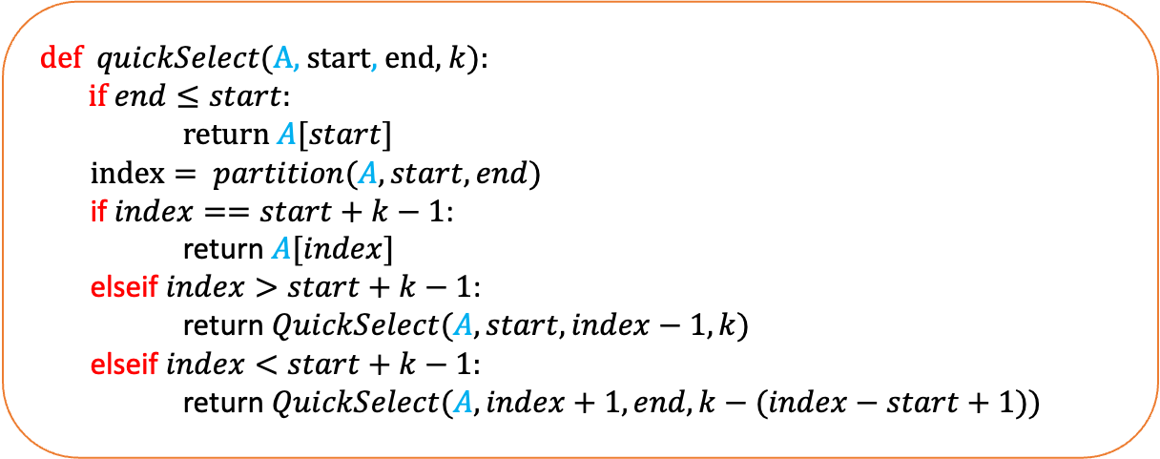
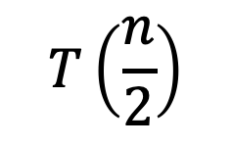

def $quickSelect$(A, start, end,$k$):
if $end≤start:$
return $A[start]$
$index= partition(A, start,end)$
if $index==start+k−1$:
return $A[index]$
elseif $index>start+k−1$:
return $QuickSelect(A,start,index−1,k)$
elseif $index<start+k−1:$
return $QuickSelect(A,index+1,end,k−(index−start+1))$
$$T(n)$$
$$cn$$
$$T\left(\frac{n}{2}\right)$$
What is the best input for this algorithm?
If the pivot always magically lands in the middle.

Slide 10


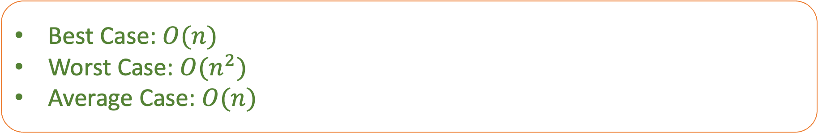
The recurrence relation is:
$$T\left(n\right)=T\left(\frac{n}{2}\right)+cn$$
$$T\left(1\right)=c$$
Similar to the recurrence relation in mergesort. Show that $T\left(n\right)=O(n)$
Best Case: $O(n)$
Worst Case: $O(n^{2})$
Average Case: $O(n)$

Slide 11
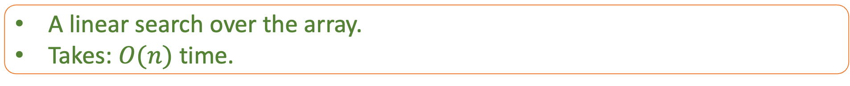
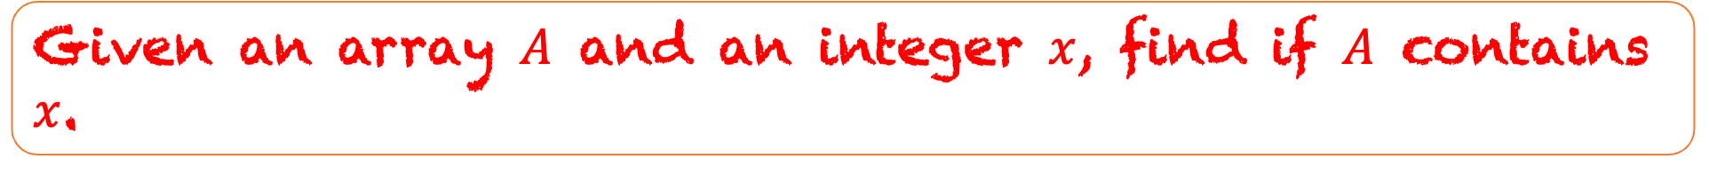
Given an array $A$ and an integer $x$, find if $A$ contains $x$.
A linear search over the array.
Takes: $O(n)$ time.

Slide 12

Given a sorted array $A$ and an integer $x$, find is $A$ contains $x$.
1
4
5
9
10
15
22
33
Search for 11

Slide 13
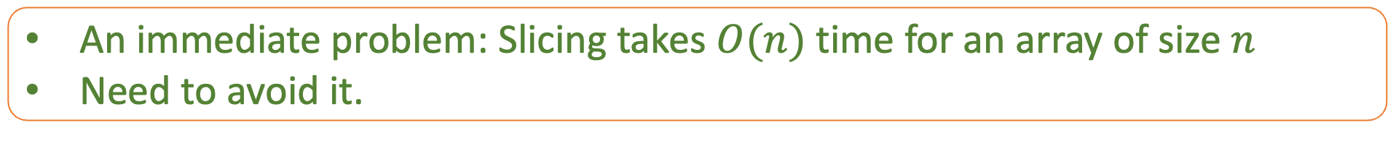
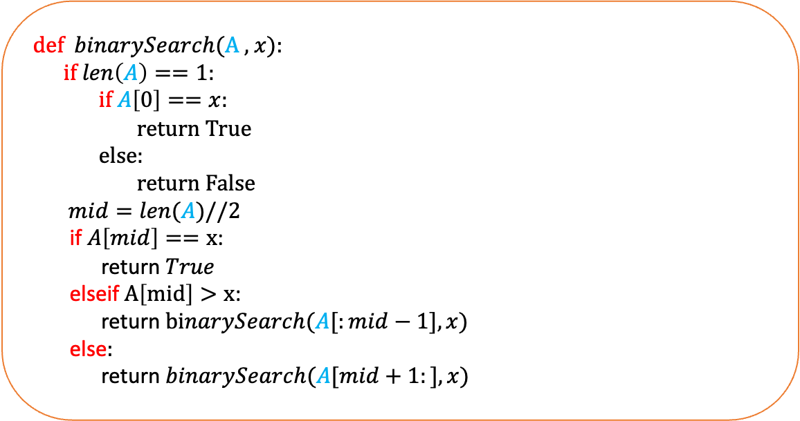
def $binarySearch$(A , $x$):
if $len\left(A\right)==1:$
if $A\left[0\right]==x$:
return True
else:
return False
$mid=len(A)//2$
if $A\left[mid\right]==x$:
return $True$
elseif $A\left[mid\right]>x$:
return $binarySearch(A[:mid−1],x)$
else$:$
return $binarySearch(A[mid+1:],x)$
What is the running time of this program?
An immediate problem: Slicing takes $O(n)$ time for an array of size $n$
Need to avoid it.

Slide 14
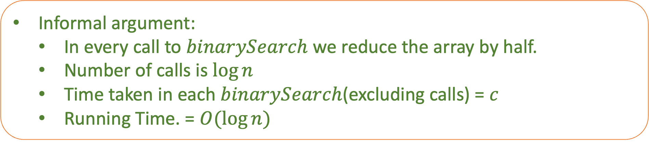
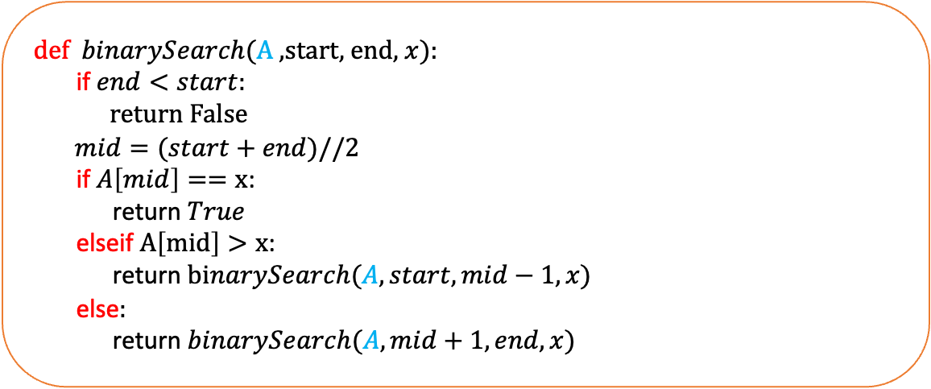
def $binarySearch$(A ,start, end, $x$):
if $end<start:$
return False
$mid=(start+end)//2$
if $A\left[mid\right]==x$:
return $True$
elseif $A\left[mid\right]>x$:
return $binarySearch(A,start,mid−1,x)$
else$:$
return $binarySearch(A,mid+1,end,x)$
What is the running time of this program?
Informal argument:
  In every call to $binarySearch$ we reduce the array by half.
  Number of calls is $\log{n}$
  Time taken in each $binarySearch$(excluding calls) = $c$
  Running Time. = $O(\log{n)}$

Slide 15


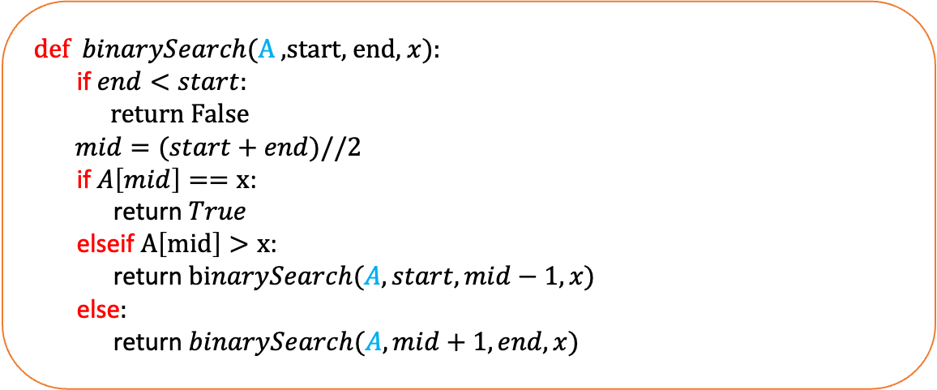
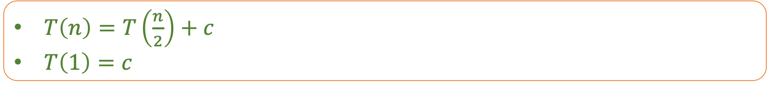
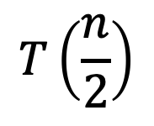

def $binarySearch$(A ,start, end, $x$):
if $end<start:$
return False
$mid=(start+end)//2$
if $A\left[mid\right]==x$:
return $True$
elseif $A\left[mid\right]>x$:
return $binarySearch(A,start,mid−1,x)$
else$:$
return $binarySearch(A,mid+1,end,x)$
$$T(n)$$
$$c$$
$$T\left(\frac{n}{2}\right)$$
$T\left(n\right)=T\left(\frac{n}{2}\right)+c$
$T\left(1\right)=c$
Running Time is $O(\log{n)}$

Slide 16
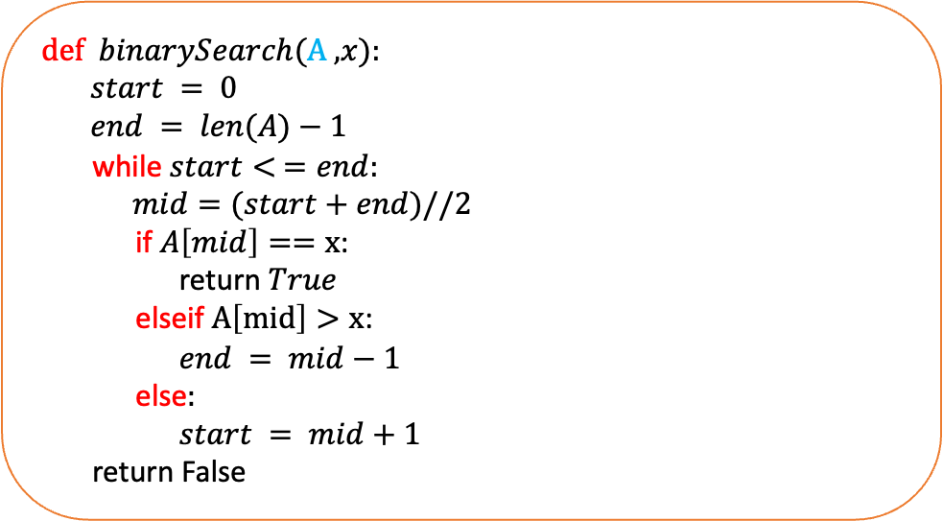
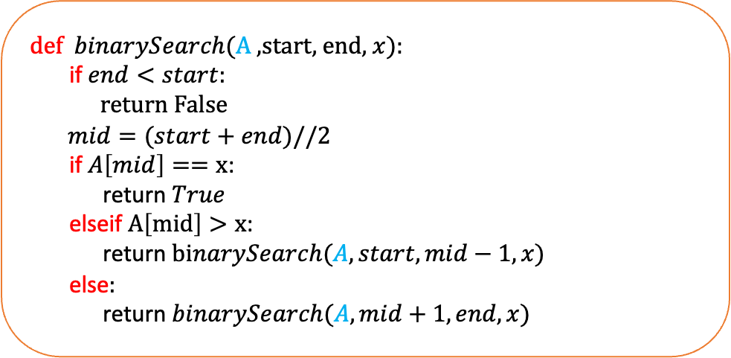
def $binarySearch$(A ,start, end, $x$):
if $end<start:$
return False
$mid=(start+end)//2$
if $A\left[mid\right]==x$:
return $True$
elseif $A\left[mid\right]>x$:
return $binarySearch(A,start,mid−1,x)$
else$:$
return $binarySearch(A,mid+1,end,x)$
Recursive
def $binarySearch$(A ,$x$):
$start = 0$
$end = len(A)−1$
while $start< =end:$
$mid=(start+end)//2$
if $A\left[mid\right]==x$:
return $True$
elseif $A\left[mid\right]>x$:
$end = mid−1$
else$:$
$start = mid+1$
return False
Non recursive / iterative

Slide 17
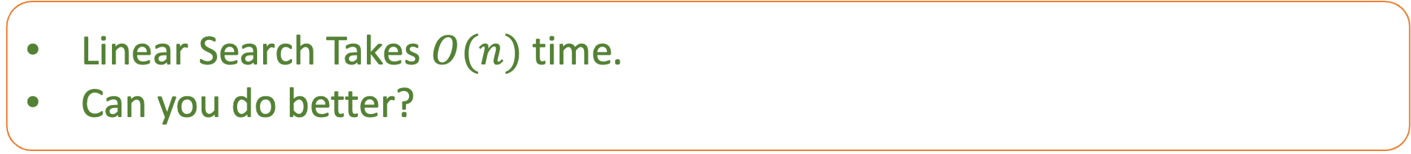
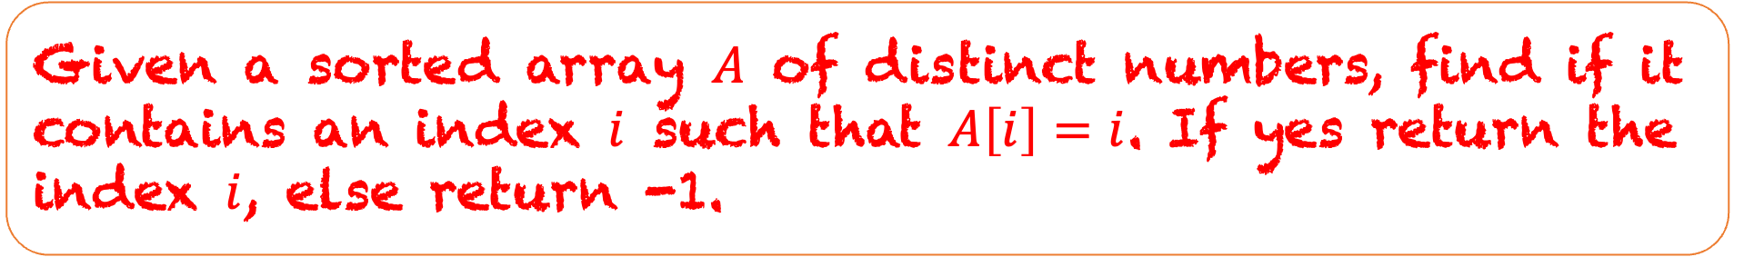

Given a sorted array $A$ of distinct numbers, find if it contains an index $i$ such that $A\left[i\right]=i$. If yes return the index $i$, else return -1.
$$A$$
-3
-2
-1
0
1
3
6
9
0
1
2
3
4
5
6
7
Linear Search Takes $O(n)$ time.
Can you do better?

Slide 18


$$A$$
-3
-2
-1
0
1
3
6
9
0
1
2
3
4
5
6
7
$$A\left[i\right]−i$$
-3
-3
-3
-3
-3
-2
0
2
What is special about this array?
This array is also sorted and we want to search 0 in this array.

Slide 19
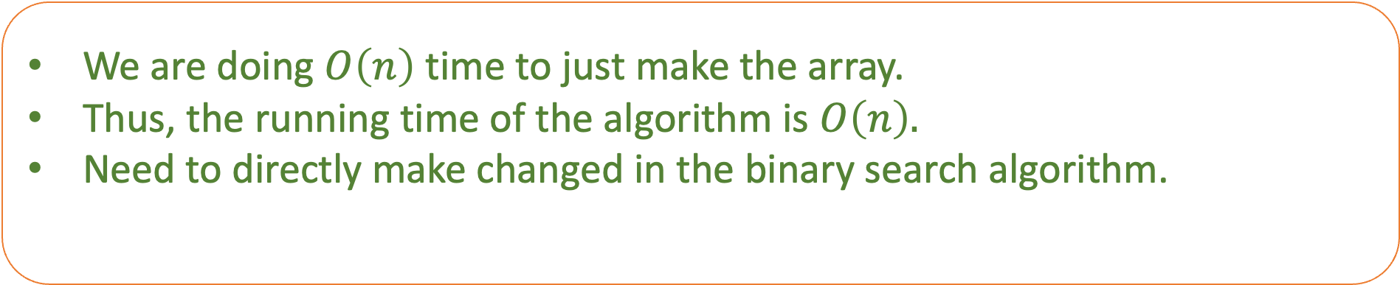
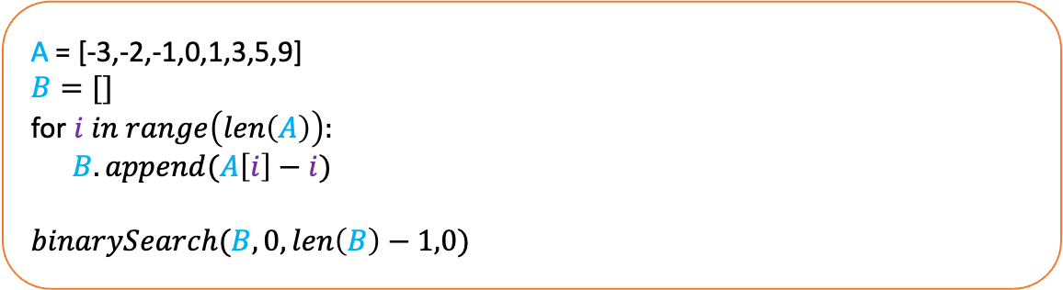
A = [-3,-2,-1,0,1,3,5,9]
$B=[]$
for $i in range\left(len\left(A\right)\right):$
$B.append(A\left[i\right]−i)$
$binarySearch(B,0,len\left(B\right)−1,0)$
We are doing $O\left(n\right)$ time to just make the array.
Thus, the running time of the algorithm is $O\left(n\right).$
Need to directly make changed in the binary search algorithm.

Slide 20
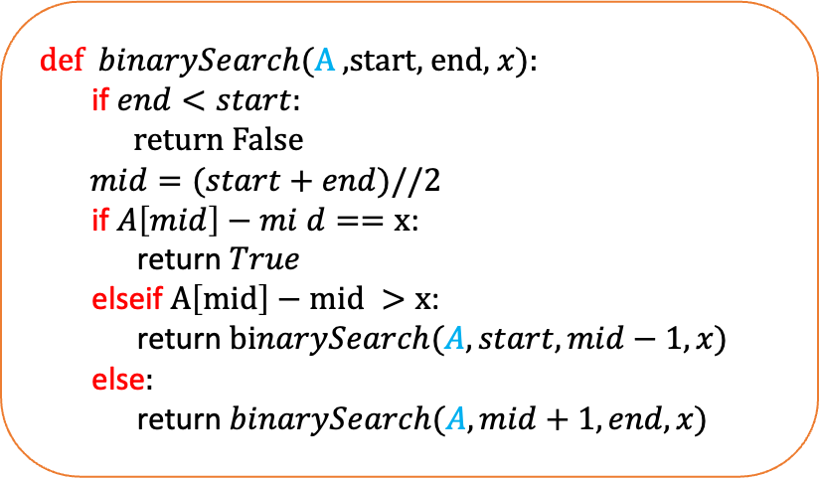
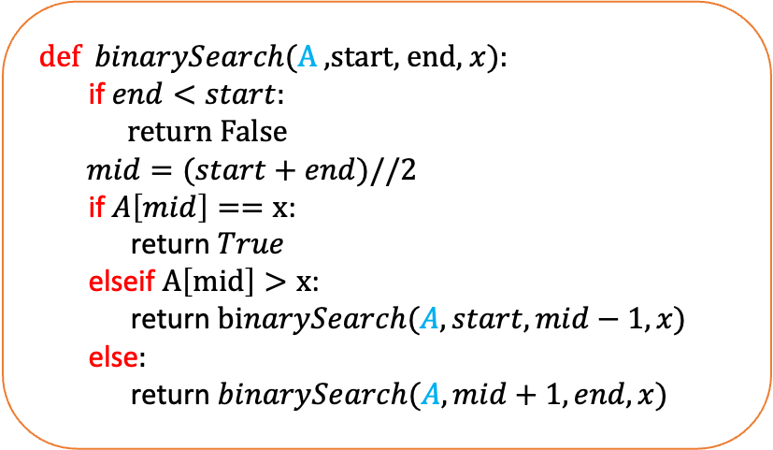
def $binarySearch$(A ,start, end, $x$):
if $end<start:$
return False
$mid=(start+end)//2$
if $A\left[mid\right]==x$:
return $True$
elseif $A\left[mid\right]>x$:
return $binarySearch(A,start,mid−1,x)$
else$:$
return $binarySearch(A,mid+1,end,x)$
def $binarySearch$(A ,start, end, $x$):
if $end<start:$
return False
$mid=(start+end)//2$
if $A\left[mid\right]−mi d==x$:
return $True$
elseif $A\left[mid\right]−mid >x$:
return $binarySearch(A,start,mid−1,x)$
else$:$
return $binarySearch(A,mid+1,end,x)$

Slide 21
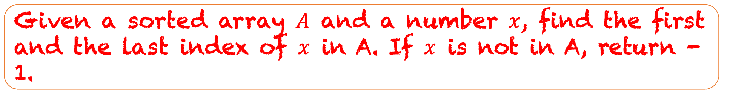
Given a sorted array $A$ and a number $x$, find the first and the last index of $x$ in A. If $x$ is not in A, return -1.
$$A$$
-3
-2
-2
0
0
0
6
9
0
1
2
3
4
5
6
7

Slide 22

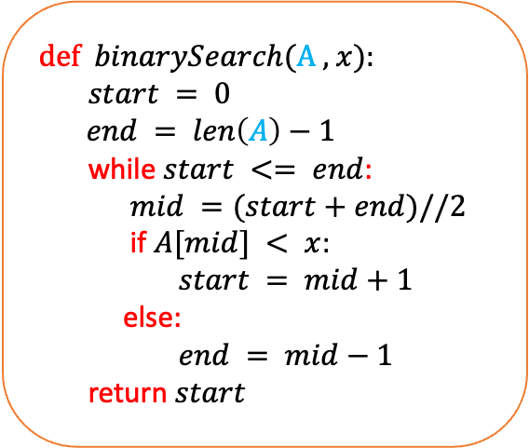

def $binarySearch$(A , $x$):
$start = 0$
$end = len\left(A\right)−1$
while $start <= end$:
$mid =(start+end)//2$
if $A[mid] < x$:
$start = mid+1$
else:
$end = mid−1$
return $start$
$$A$$
-3
-2
-2
0
0
0
6
9
start
end
start
end
start
end
Write an algorithm which will find the last occorence of $x$ in the array.

