Slide 1
Mid Sem Solutions

Slide 2
Lab – Question 1
You are given an array of n numbers – $a_{1},a_{2}, …,a_{n}$. Your job is to find two numbers in this array whose sum is the minimum.
Find the two smallest number in the array.
Add them and output
Running time is $O(n)$.

Slide 3
Lab – Question 2
You are given a permutation of n numbers from $[1, n]$. You have to output the smallest subarray that needs to be sorted in order to sort the array.
4 3 2
1
5

Slide 4
Lab – Question 2
You are given a permutation of n numbers from $[1, n]$. You have to output the smallest subarray that needs to be sorted in order to sort the array.
Find the integers from the left that are at its correct place.
Find the integers from the right that are at its correct place.
Output the number of integers left in the middle
Running Time: $O(n)$

Slide 5
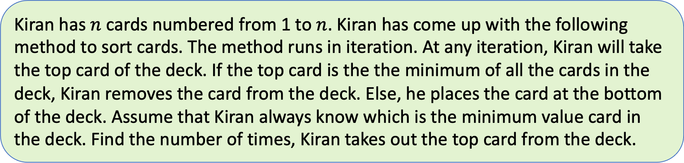
Lab – Question 3
Kiran has $n$ cards numbered from 1 to $n$. Kiran has come up with the following method to sort cards. The method runs in iteration. At any iteration, Kiran will take the top card of the deck. If the top card is the the minimum of all the cards in the deck, Kiran removes the card from the deck. Else, he places the card at the bottom of the deck. Assume that Kiran always know which is the minimum value card in the deck. Find the number of times, Kiran takes out the top card from the deck.

Slide 6
Iteration
1
2
3
4
5
6
7
6
3
1
2
6
3
6
3
1
2
6
3
6
1
2
6
3
2
6
3

Slide 7
Lab – Question 3
Kiran has $n$ cards numbered from 1 to $n$. Kiran has come up with the following method to sort cards. The method runs in iteration. At any iteration, Kiran will take the top card of the deck. If the top card is the the minimum of all the cards in the deck, Kiran removes the card from the deck. Else, he places the card at the bottom of the deck. Assume that Kiran always know which is the minimum value card in the deck. Find the number of times, Kiran takes out the top card from the deck.
You have to basically simulate the process.
There are efficient ways to do it.
Please see the sample code for one such method.

Slide 8
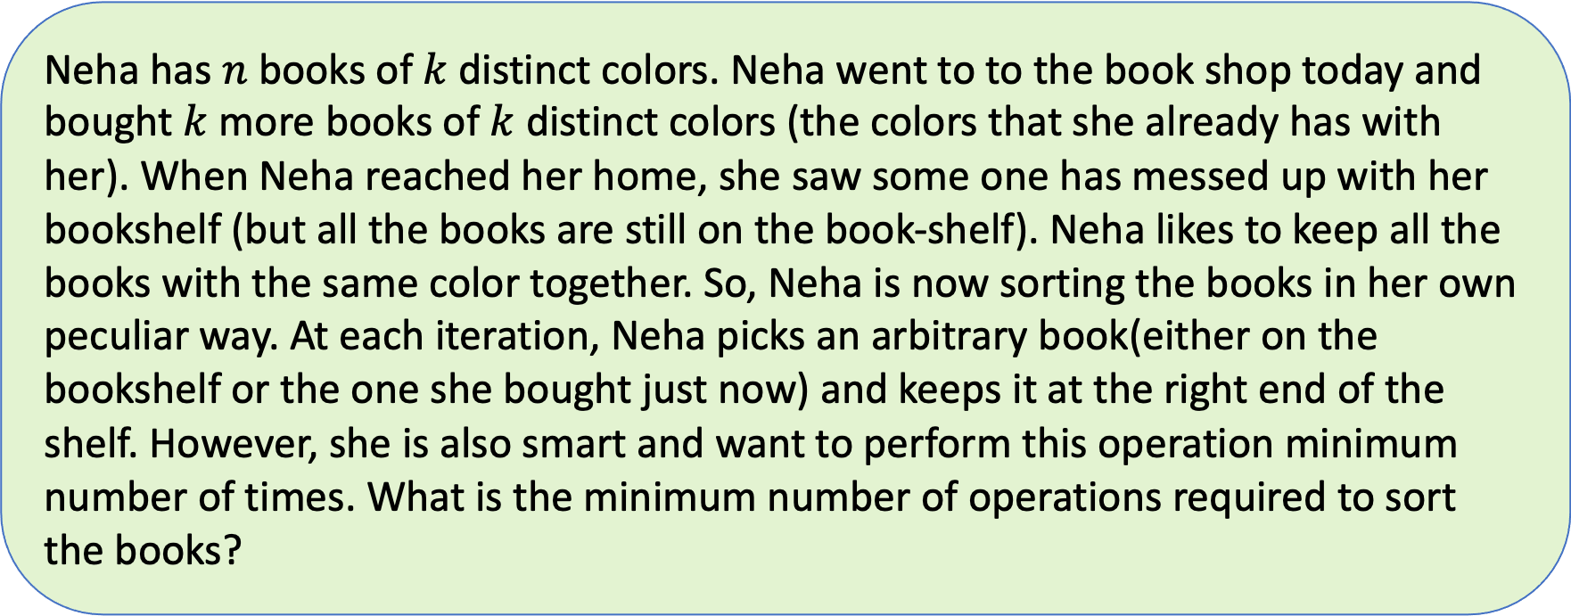
Lab – Question 4
Neha has $n$ books of$k$distinct colors. Neha went to to the book shop today and bought $k$ more books of $k$ distinct colors (the colors that she already has with her). When Neha reached her home, she saw some one has messed up with her bookshelf (but all the books are still on the book-shelf). Neha likes to keep all the books with the same color together. So, Neha is now sorting the books in her own peculiar way. At each iteration, Neha picks an arbitrary book(either on the bookshelf or the one she bought just now) and keeps it at the right end of the shelf. However, she is also smart and want to perform this operation minimum number of times. What is the minimum number of operations required to sort the books?

Slide 9
Iteration
1
2
1
2
1
1
2
2
1
2
1
2
2
1
3
2
2
1
1

Slide 10
1
2
3
3
1
2
3
These two books need not be touched.
However, all other books have to be kept at the end.
This also includes the books that Neha has bought just now.
Ans: 5

Slide 11
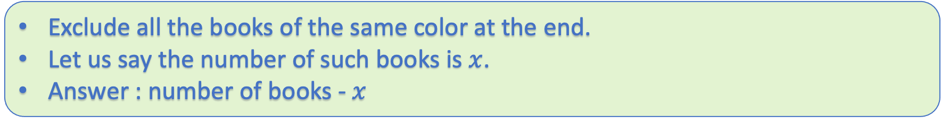
Exclude all the books of the same color at the end.
Let us say the number of such books is $x$.
Answer : number of books - $x$
Running Time: $O(n)$

Slide 12
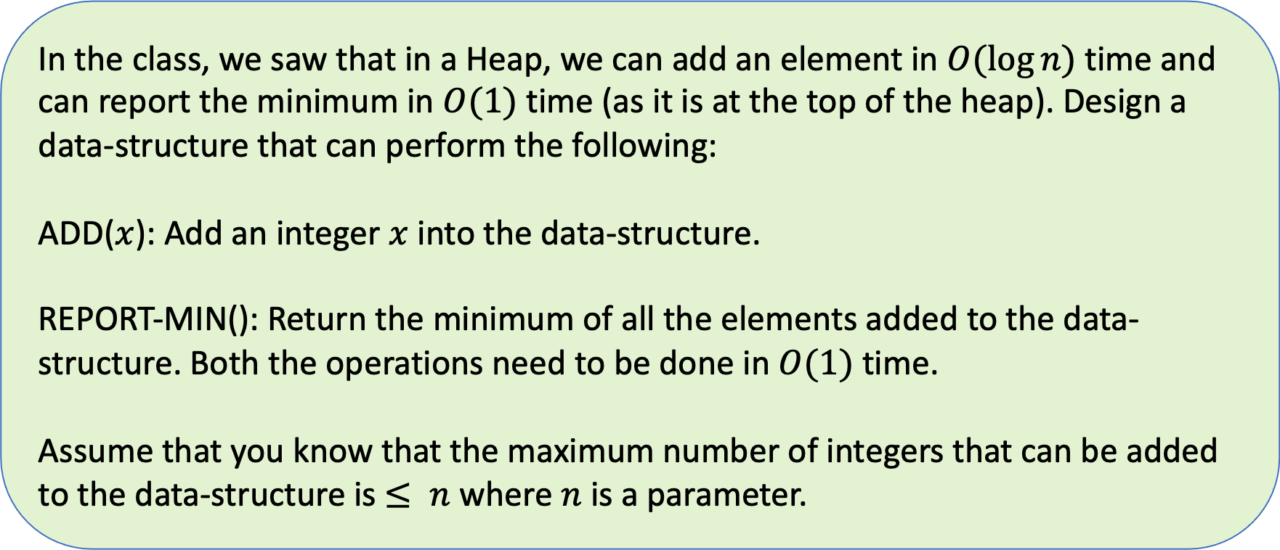
Theory – Question 1
In the class, we saw that in a Heap, we can add an element in $O(log⁡n)$ time and can report the minimum in $O(1)$ time (as it is at the top of the heap). Design a data-structure that can perform the following:
ADD($x$): Add an integer $x$ into the data-structure.
REPORT-MIN(): Return the minimum of all the elements added to the data-structure. Both the operations need to be done in $O(1)$ time.
Assume that you know that the maximum number of integers that can be added to the data-structure is $≤ n$ where $n$ is a parameter.

Slide 13
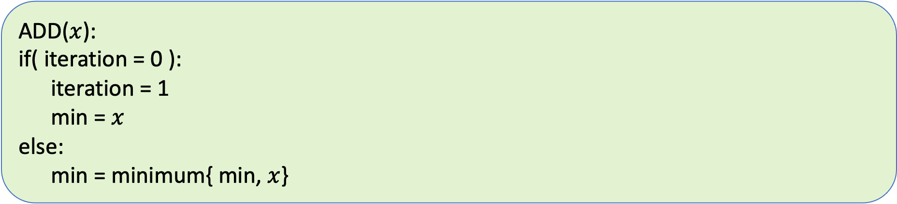
Initialization():
iteration = 0
min = 0
ADD($x$):
if( iteration = 0 ):
iteration = 1
min = $x$
else:
min = minimum{ min, $x$}
REPORT-MIN():
return min

Slide 14
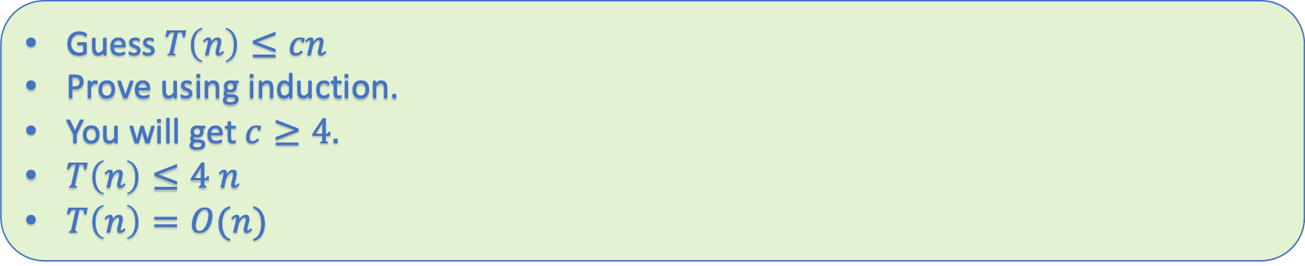
Theory – Question 2
$T(n) = T(n/2) + T(n/4) + n$, for $n > 5$
$T(n) = 1$, for $n ≤ 5$
Guess $T\left(n\right)≤cn$
Prove using induction.
You will get $c≥4.$
$T\left(n\right)≤4 n$
$T\left(n\right)=O(n)$

Slide 15
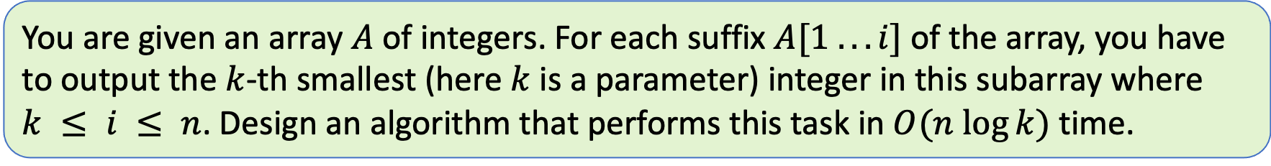
Theory – Question 3
You are given an array $A$ of integers. For each suffix $A[1 . . . i]$ of the array, you have to output the $k$-th smallest (here $k$ is a parameter) integer in this subarray where $k ≤ i ≤ n$. Design an algorithm that performs this task in $O(n log⁡k)$ time.
Make a max-heap of the first $k$ numbers in $A$.
The top of heap is the has the $k$-th smallest element in $A[1…k]$

Slide 16
10 9 8 7 6 1 2 3 4 5
$k=5$
10
9
7
8
6

Slide 17
10 9 8 7 6 1 2 3 4 5
$k=5$
1
Shift down
9
7
8
6

Slide 18
10 9 8 7 6 1 2 3 4 5
$k=5$
9
Shift down
8
7
1
6

Slide 19
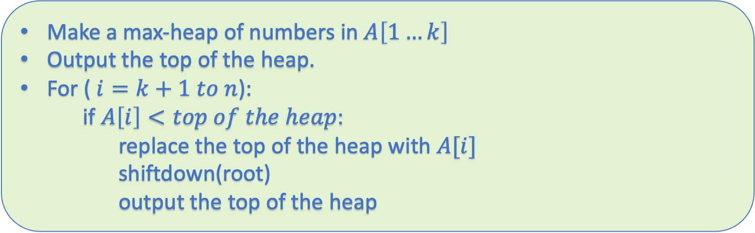
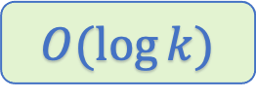
Make a max-heap of numbers in $A\left[1…k\right]$
Output the top of the heap.
For ($i=k+1 to n$):
  if $A\left[i\right]<top of the heap$:
  replace the top of the heap with $A[i]$
  shiftdown(root)
  output the top of the heap
$$O(\log{k)}$$
Observation: The size of the heap is equal to $k$.
Running Time: $O(n\log{k)}$

Slide 20
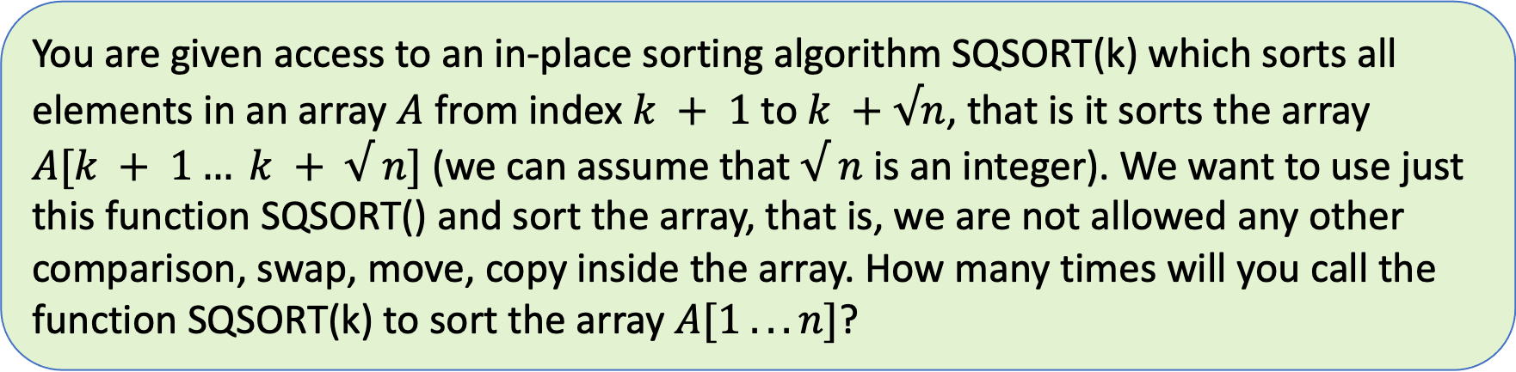
Theory – Question 4
You are given access to an in-place sorting algorithm SQSORT(k) which sorts all elements in an array $A$ from index $k + 1$ to $k +√n$, that is it sorts the array $A[k + 1… k + √ n]$ (we can assume that $√ n$ is an integer). We want to use just this function SQSORT() and sort the array, that is, we are not allowed any other comparison, swap, move, copy inside the array. How many times will you call the function SQSORT(k) to sort the array $A[1 . . . n]$?

Slide 21
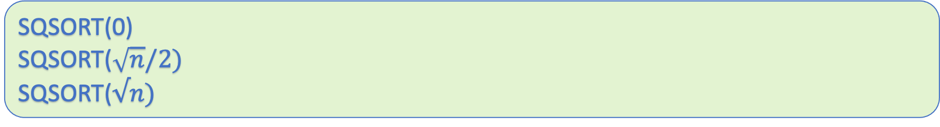

1
$$2√n$$
SQSORT(0)
SQSORT($\sqrt{n}/2)$
SQSORT($√n)$
The last $\sqrt{n}/2$ elements are placed in its correct position.

Slide 22


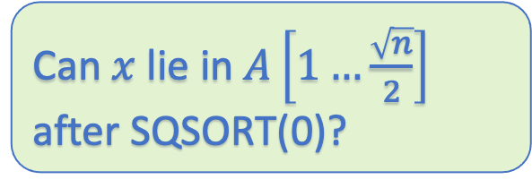

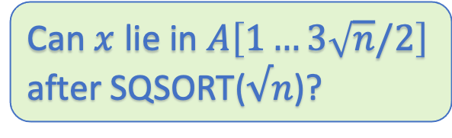




1
$√n$/2
$$√n$$
$3√n$/2
$$2√n$$
$$x$$
$$x$$
$$x$$
Can $x$ lie in $A\left[1…\frac{\sqrt{n}}{2}\right]$ after SQSORT(0)?
Can $x$ lie in $A\left[1…√n\right]$ after SQSORT($\frac{\sqrt{n}}{2}$)?
Can $x$ lie in $A\left[1…3\sqrt{n}/2\right]$ after SQSORT($√n$)?
Let $x$ be the maximum elements in the Array.

Slide 23
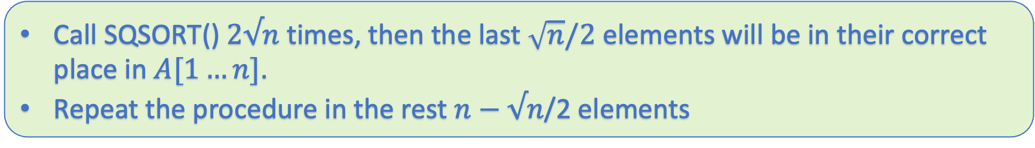
Call SQSORT() $2√n$ times, then the last $\sqrt{n}/2$ elements will be in their correct place in $A[1…n]$.
Repeat the procedure in the rest $n−√n$/2 elements
Let $T(n)$ be the total number of calls made to SQSORT()
$$T\left(n\right)=T\left(n−\frac{\sqrt{n}}{2}\right)+2\sqrt{n}$$

Slide 24
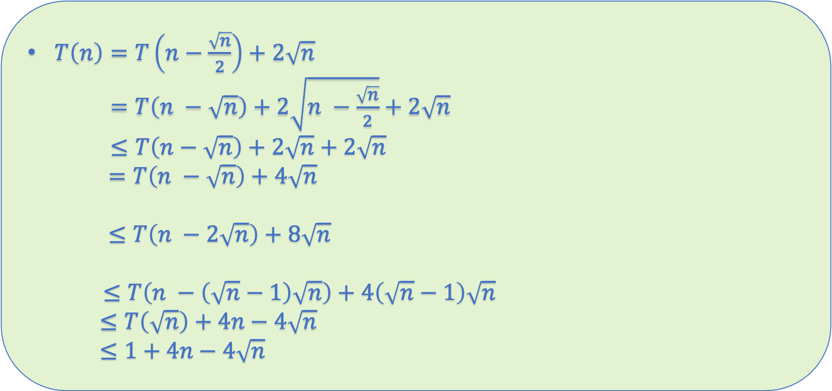
$T\left(n\right)=T\left(n−\frac{\sqrt{n}}{2}\right)+2\sqrt{n}$
$=T\left(n −\sqrt{n}\right)+2\sqrt{n −\frac{\sqrt{n}}{2}}+2\sqrt{n}$
$≤T\left(n−\sqrt{n}\right)+2\sqrt{n}+2\sqrt{n}$
$=T\left(n −\sqrt{n}\right)+4\sqrt{n}$
$≤T\left(n −2\sqrt{n}\right)+8\sqrt{n}$
$≤T\left(n −\left(\sqrt{n}−1\right)\sqrt{n}\right)+4\left(\sqrt{n}−1\right)\sqrt{n}$
$≤T\left(\sqrt{n}\right)+4n−4\sqrt{n}$
$≤1+4n−4\sqrt{n}$

