Slide 1
Pointers

Slide 2
int x;
Memory
The address of $x$ is 3210.
We can retrieve this address using “$\&x”$
The value written at this location can be retrieved by using just “$x”$
3210

Slide 3
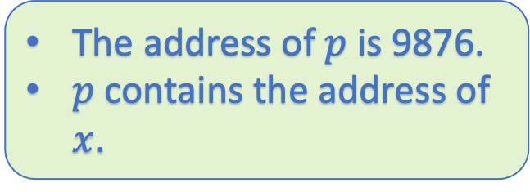
int x = 5;
int *p = &x;
Memory
The address of $p$ is 9876.
$p$ contains the address of $x$.
5
3210
3210
9876

Slide 4
int x = 5;
int *p = &x;
printf(“%d”, p)
printf(“%d”,*p)
The first print statement will output the address of $x$.
The second print statement will output the value at the address of x.
But why are pointers required?

Slide 5
Memory
Swap(int a, int b)
{
int temp = a;
a = b;
b = temp;
}
int main()
{
int a = 1;
int b = 2;
swap(a,b)
printf(“%d %d”, a, b)
}
1
2
6745(a)
8745(b)
swap
main
1
2
3210(a)
9876(b)

Slide 6
Memory
Swap(int a, int b)
{
int temp = a;
a = b;
b = temp;
}
int main()
{
int a = 1;
int b = 2;
swap(a,b)
printf(“%d %d”, a, b)
}
2
1
6745(a)
8745(b)
swap
main
1
2
3210(a)
9876(b)

Slide 7
Memory
Swap(int a, int b)
{
int temp = a;
a = b;
b = temp;
}
int main()
{
int a = 1;
int b = 2;
swap(a,b)
printf(“%d %d”, a, b)
}
main
1
2
3210(a)
9876(b)

Slide 8
The problem is that the variables are “passed by value” in C
Anything you do inside the function may not be reflected in the main program.
The problem is solved using pointers.

Slide 9
Memory
Swap(int *pa, int *pb)
{
int temp = *a;
*a = *b;
*b = temp;
}
int main()
{
int a = 1;
int b = 2;
swap(&a,&b);
printf(“%d %d”, a, b);
}
3210
9876
6745(pa)
8745(pb)
swap
main
1
2
3210(a)
9876(b)

Slide 10
Arrays and Pointers

Slide 11
There is a deep relation between Array and Pointer.
Let us look at it using an example.

Slide 12
Memory
int main()
{
int arr[3] = {1,2,3}
}
1 2 3
122
(arr)
126
130

Slide 13
int main()
{
int arr[3] = {1,2,3}
}
arr is actually a pointer.
If I do *arr, I will get
1
If I do, *(arr+1), I will get
Let us do this using visualize C.

Slide 14
int main()
{
int arr[3] = {1,2,3}
}
Remember that
arr[0] is same as *arr
arr[1] is same as *(arr+1) but not *arr+1

Slide 15
Passing an array in a function.
We say that a variable is passed by value.
What about arrays?

Slide 16
#include<stdio.h>
void print(int arr[], int n)
{
int i;
for(i=0; i< n;i++)
{
printf("%d", *(arr+i));
}
}
int main()
{
int arr[3] = {1,2,3};
print(arr, 3);
return 0;
}
Let us again use visualize C to get more insight into this code.

Slide 17
In C, you can dynamically allocate a large chunk of array on the fly.

Slide 18
#include<stdio.h>
int main()
{
int *ptr = (int*)malloc(3*sizeof(int));
}
Let us again use visualize C to get more insight into this code.

Slide 19
But then you will say that I have created array on the fly.
#include<stdio.h>
int* createArray()
{
int *ptr = (int*)malloc(3*sizeof(int));
return ptr;
}
int main()
{
int *p = createArray();
}
Let us again use visualize C to get more insight into this code.

Slide 20
But then you will say that I have created array on the fly.
#include<stdio.h>
int* createArray()
{
int arr[3] = {1,2,3};
return arr;
}
int main()
{
int *p = createArray();
}
Let us again use visualize C to get more insight into this code.

Slide 21
Structure

Slide 22
Suppose that you want to create a employee record that contains name, salary of the employee.
Currently, you do not have any tools to do this in C.
struct employee
{
char name[10];
int salary;
};

Slide 23
struct employee
{
char name[10];
int salary;
};
int main()
{
struct employee a;
scanf("%s", &a.name);
scanf("%s", &a.salary);
return 0;
}
Let us again use visualize C to get more insight into this code.

Slide 24
struct employee
{
char name[10];
int salary;
};
int main()
{
struct employee a;
struct employee *pa = &a;
scanf("%s", &(pa->name));
scanf("%s", &(pa.salary));
return 0;
}
Let us again use visualize C to get more insight into this code.

Slide 25
In a nutshell, structure is not same as pointers.
If str is a structure variable, then str.name should be used to access the name.
If str is a pointer to a structure, then str->name should be used to access the name.

